Slide 1
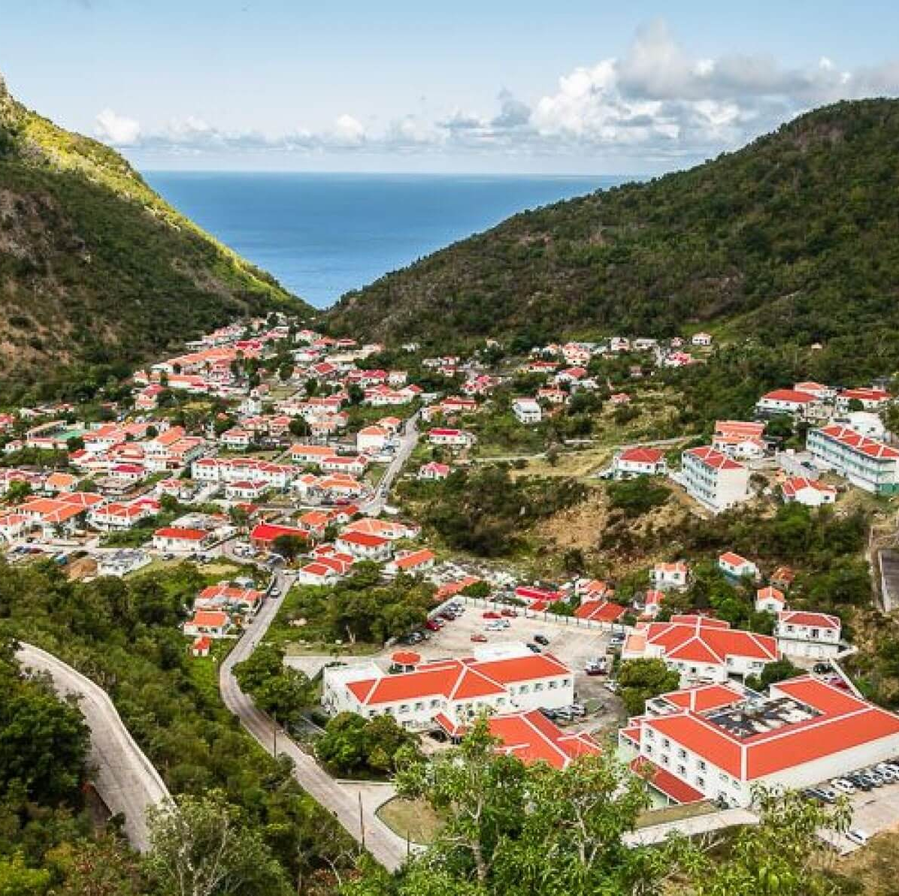
Research Proposal briefing
Joseph Harding, Lieutenant-Colonel (retired)
University of Manitoba, Canada
Faculty of Education, PhD Program
hardin16@myumanitoba.ca

Slide 2
United Nations Sustainable Development Goals 2030

Slide 3
How is Saba doing?
“Additionally, the Island Council has requested the Executive branch to research the possibility of incorporating a compostable material project to mitigate the high volume of materials shipped out. The efficiency of separation of the garbage has shown that the human capacity is not the main challenge for sustainability but rather the high cost to have the materials removed from the island. The Executive Council is working on securing additional funds to offset the high shipping cost.”
Saba Executive Council, 4 May 2021

Slide 4
Current situation in Saba
Over the years, waste management on Saba has transitioned greatly, stated Commissioner of Infrastructure Bruce Zagers. “We have evolved from a scenario where there was absolutely no separation of any waste streams, where everything was being burnt together. Now we export more than one million pounds of recyclable materials per year and burning of only organic waste happens once per week in a controlled manner in a state-of-the-art open-air burner. This is real progress,” he said.
Source: The Daily Herald, 28 April 2022

Slide 5
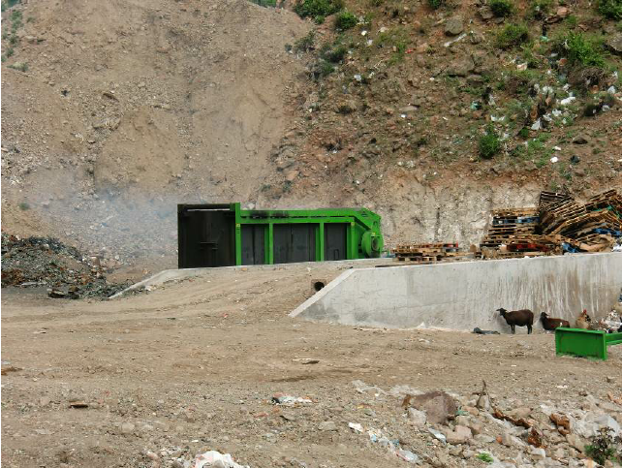
Previous related research?
Other ideas to limit the food availability to rats on Saba might include:
a) Improved waste collection, disposal and destruction practices
b) Separate collection of biological waste in support of a cottage industry producing hogs, humus, or methane
c) Not letting feral fruit go to waste but use it to develop a cottage industry of biological jams, juices and fruit preserves.
d) Removal of feral (non-native) fruit trees from nature. This not only could help limit food supply to rats but also in recovery of natural forest vegetation. (If this is considered great care must be taken to ensure that open patches are not primarily colonized by invasive plants.
Open air burner of the Saba landfill in operation. (Photo A. Debrot).
Source: Debrot et al., 2014. Predation threats to the Redbilled Tropicbird breeding colony of Saba: focus on cats

Slide 6
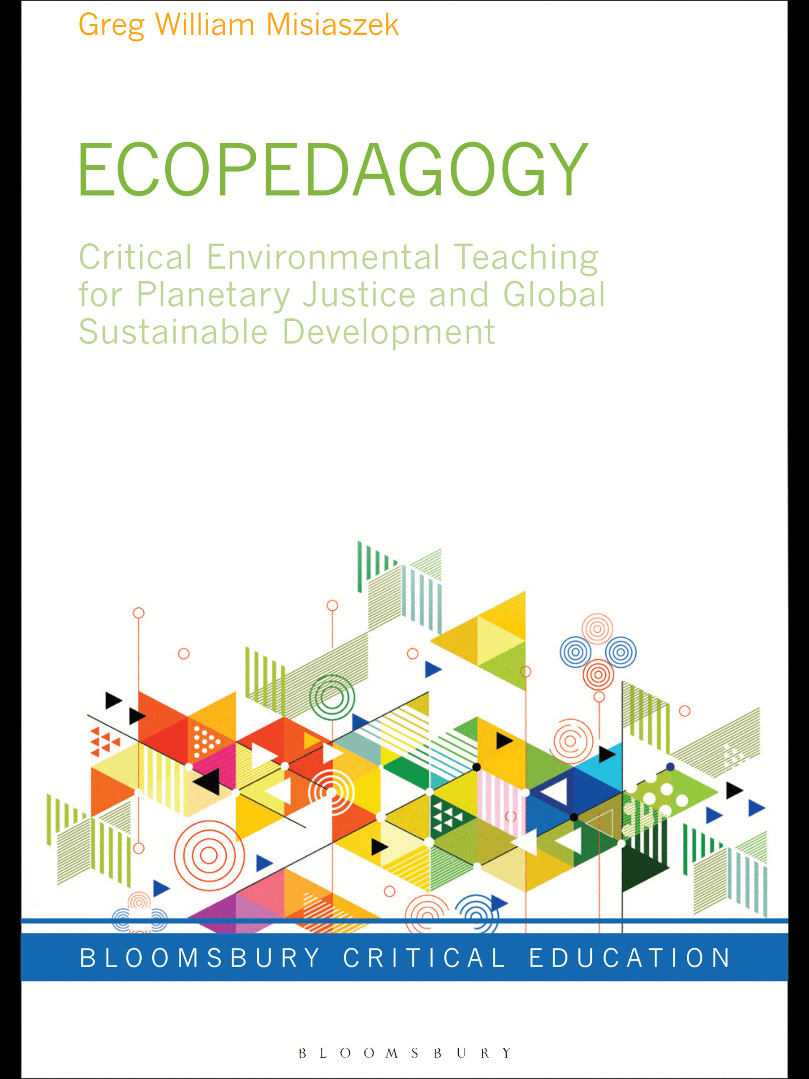
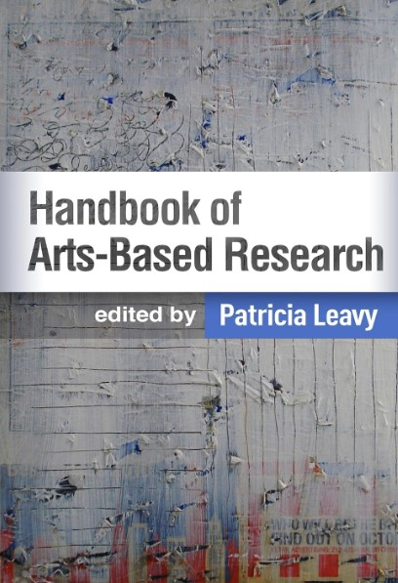
Research approach…? Apply the Arts to Environmental Education with a critical lens. This is Arts-based Ecopedagogy
Notes:
https://www.hotsweetandjumpy.com/spentcoffeegrounds

Slide 7
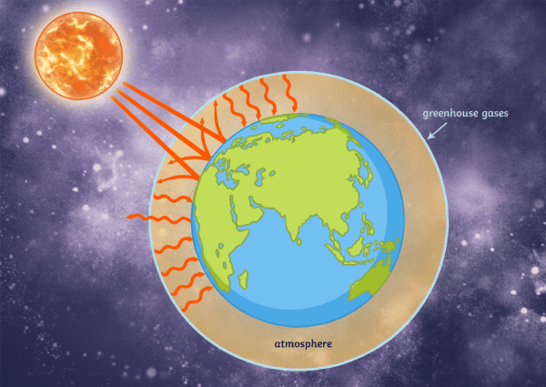
What would a project look like for Saba?
Implement a compost program? Compost Education for students and residents? Compost policy for small businesses? Organic waste separation? Waste collection? Art show for the island? Small business in waste entrepreneurship? International attention for funding? Other?

Slide 10
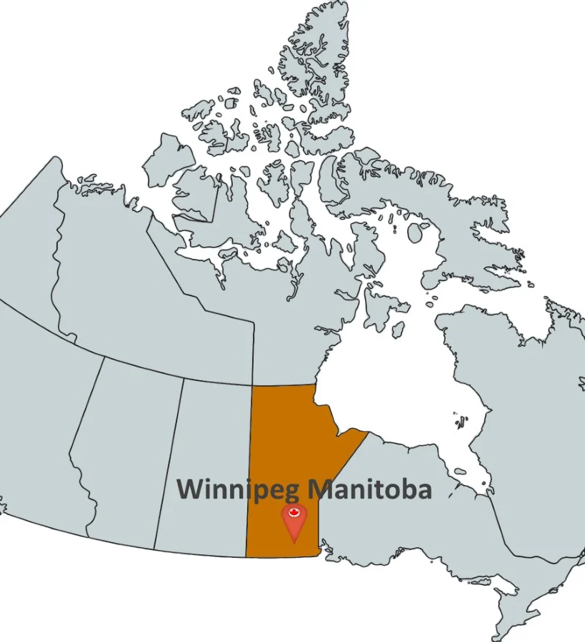
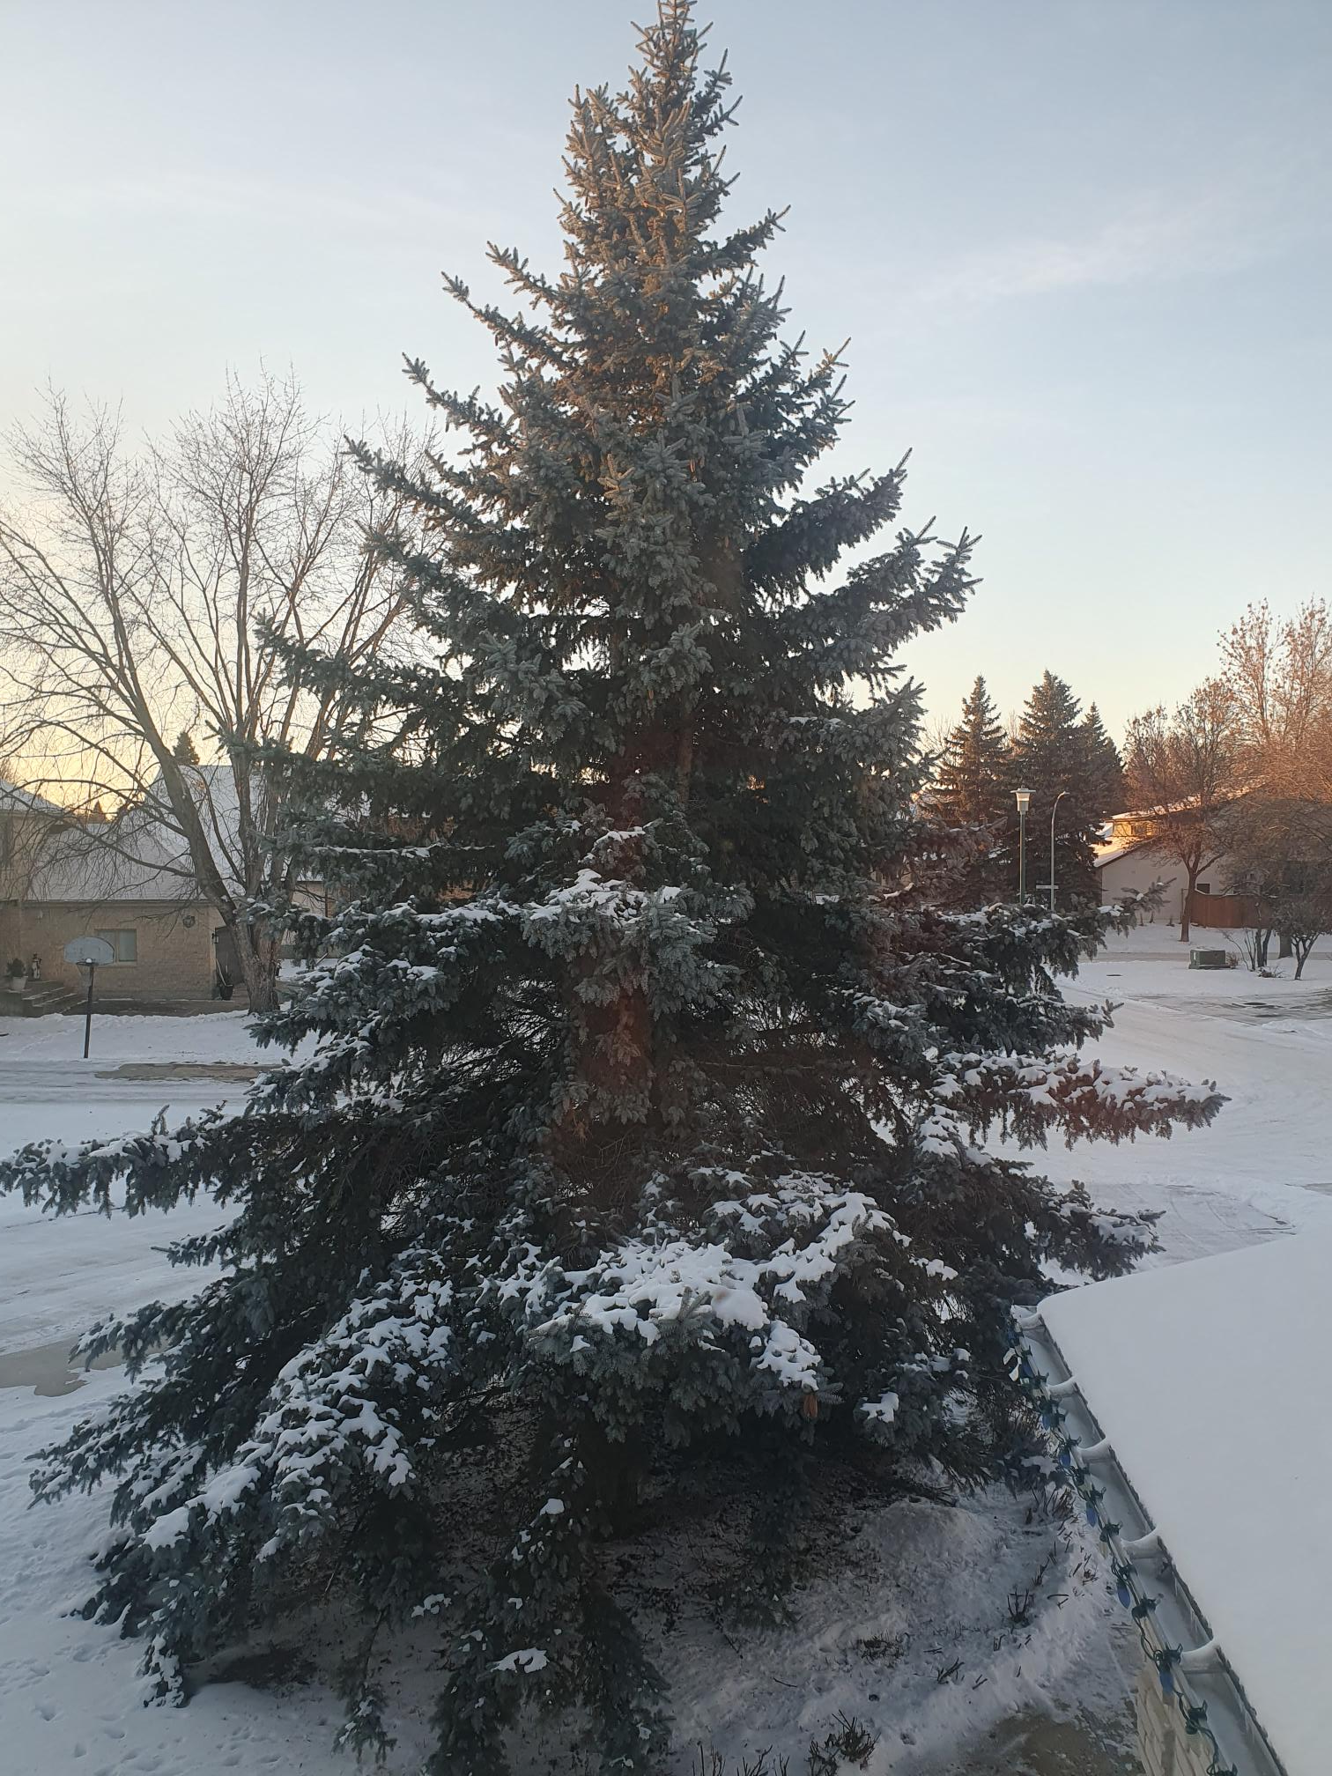
Questions?

