Slide 1
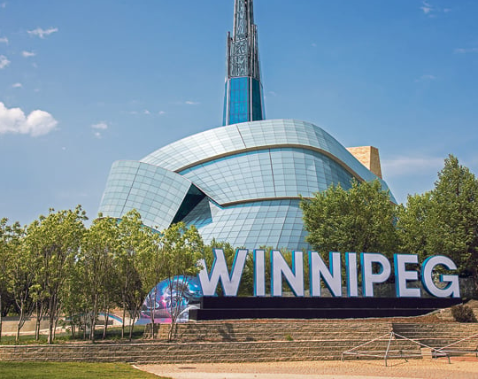
Research Proposal briefing
Joseph Harding, PhD Student
University of Manitoba
hardin16@myumanitoba.ca

Slide 2
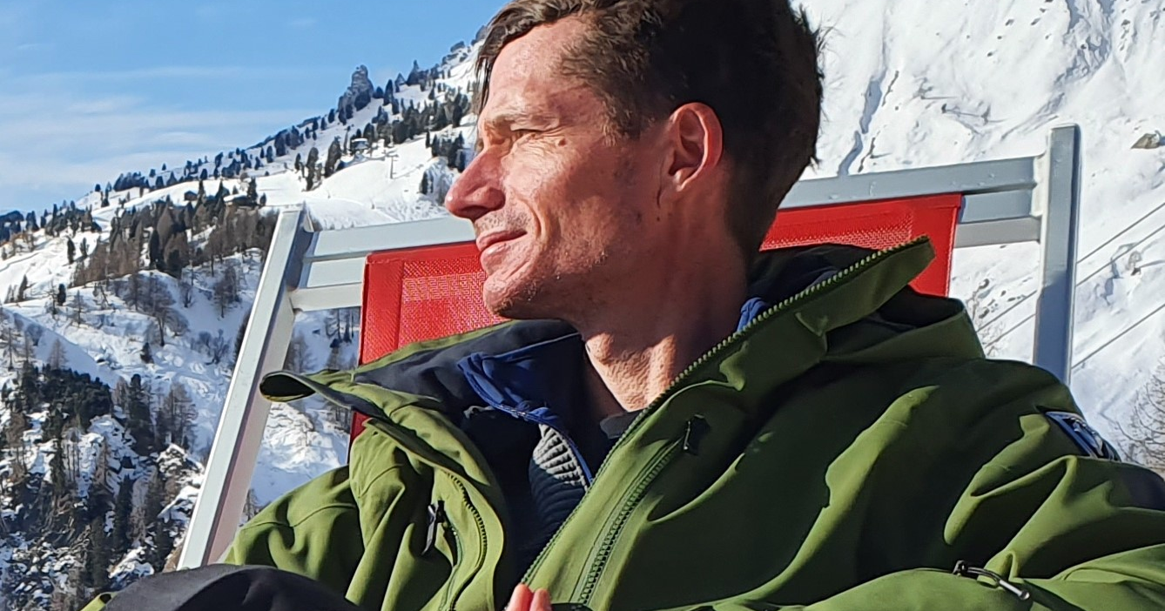
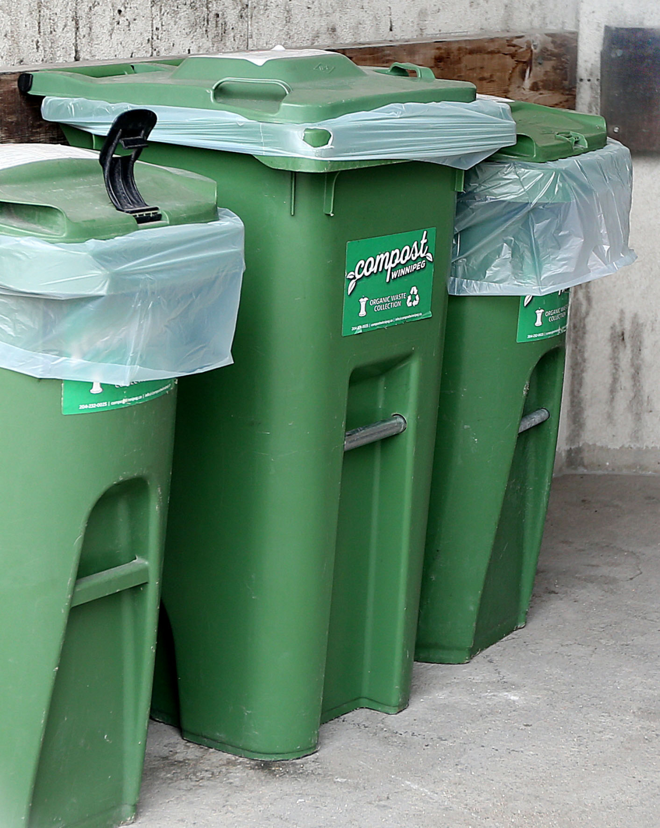
What can I do for you to add value?

Slide 3
United Nations Sustainable Development Goals 2030

Slide 4
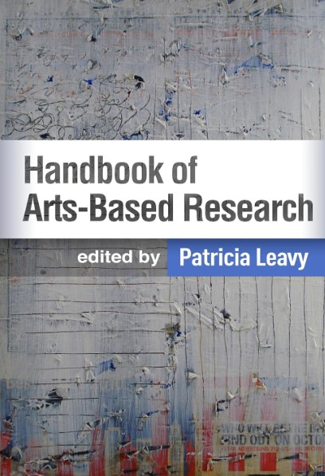
Arts-Based Research Proposal Demonstration
Notes:
https://www.hotsweetandjumpy.com/spentcoffeegrounds

Slide 5
Proposed timeline by phases
Jun-Aug 2024 Preparation. Confirm participants. Confirm research objectives and plan.
1
Sep-Dec 2024 Pre-production film workshops. Film. Present @ MARR Conference.
2
Jan-Aug 2025 Collate data. Focus group discussions. Data analysis. Post-production workshops.
3
Sep-Dec 2025 Edit film(s). Focus group discussions. Screen film. Education proposals.
4
Notes:
Date Activities / Deliverables:
Jan-Apr 2024 Candidacy exams. Jun-Aug 2024 Preparation. Confirm participants. Confirm research objectives and plan. Sep-Dec 2024 Pre-production film workshops. Film. Present @ MARR Conference. Jan-Aug 2025 Collate data. Focus group discussions. Data analysis. Post-production workshops. Sep-Dec 2025 Edit film(s). Focus group discussions. Screen film. Education proposals. Jan to Dec 2026 Complete dissertation. Education and sustainability conference presentations.

Slide 6
FAQs
Who is the target audience? Leaders for Residential Food Waste management. Could it be used in schools? Colleges/Universities yes. Select content for K-12 schools yes. Additional ethics approvals required for K-12 interviews.
Would you be open to changing the format, for example, a series of shorter videos compared to one full length film? Yes. The concept of “build once, use many” will be used. The participatory nature of this research means the participants/co-researchers will influence this decision with leadership approvals when required in phase 1. The project can shift to other forms of the arts depending on how the leadership feels the art will most impact change.
Is there an overarching narrative or plan for the film? How can arts-based ecopedagogy impact sustainability in Residential Food Waste management in Winnipeg, Canada? The narrative is the phase 1 of the project. How can the arts better influence waste management education (pedagogy) and decisions for citizens and small business owners?

Slide 7
FAQs
Is there a general script, or is the story built on what is filmed? The participatory nature of this research means the participants/co-researchers will influence this decision with leadership approvals when required in phase 1.
Is there a structure, for example, many documentaries explain a problem, get different viewpoints and then look for a solution. Do you have questions that will be considered / answered in the film? My objectives are: (a) monitor Residential Food Waste collection through Participatory Action Research in support of city and non-profit organizations in Winnipeg; (b) evaluate Arts-Based Research for developing environmental education for city and non-profit organizations in Winnipeg and (c) influence local public policy decisions regarding Residential Food Waste.

Slide 8
FAQs
Does the final version of the film require consensus / approval by all co-researchers? Yes. For example, if we feel that something should not be included, could it be removed from the film? Yes, throughout all phases. This is the participatory nature of the research. The project can shift to photography only, educational content, murals, music, or … a blend of it all!
Could you estimate the total time commitment for a co-researcher in 2024 / 2025? The goal is to conduct research in the working environment for as many as possible (i.e. test run with a participant resulted in negative time commitment due to me neing put to work! Art workshops will be offered to build community with all participants (city, non-profit, small business, multi-family dwelling, single homeowners etc). So... Time is negotiable to the participant(s), but an estimate would be 18 hours: 6 hours @ work, 6 hours of pre-production workshop, 6 hours of post-production workshop. Minimum of 2 hours for executives depending on their interest in the cross-participant engagements/communications.

Slide 9
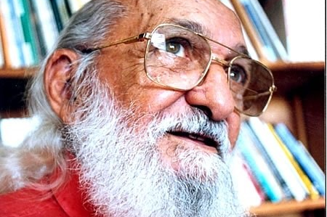
Final thoughts on critical pedagogy, the arts, and innovation…
Notes:
Who was Paulo Freire?
Paulo Freire’s work has influenced people working in education, community development, community health and many other fields. Freire developed an approach to education that links the identification of issues to positive action for change and development. While Freire’s original work was in adult literacy, his approach leads us to think about how we can ‘read’ the society around us. For Freire, the educational process is never neutral. People can be passive recipients of knowledge — whatever the content — or they can engage in a ‘problem-posing’ approach in which they become active participants. As part of this approach, it is essential that people link knowledge to action so that they actively work to change their societies at a local level and beyond. In the video above, Freire talks about the importance of curiosity, of critical thinking and ultimately of hope. It is a profound reflection on learning. Many of Freire’s writings are available in English. The most well known of these, Pedagogy of the Oppressed (1972) has been very influential but new readers of Freire may find The Politics of Education (1985) a more accessible text. Key concepts associated with Freire include the contrast between "banking" education (in which facts are deposited into the minds of passive students) and problem-posing education; the notion of conscientization (which is much more than simply awareness-raising); and the idea of the "culture of silence", in which people are unable to reflect critically upon their world - they become fatalistic and dominated. A typical feature of Freire-type education is that people bring their own knowledge and experience into the process. Training is typically undertaken in small groups with lively interaction and can embrace not only the written word but art, music and other forms of expression.
https://freire.org/paulo-Freire

