Slide 1
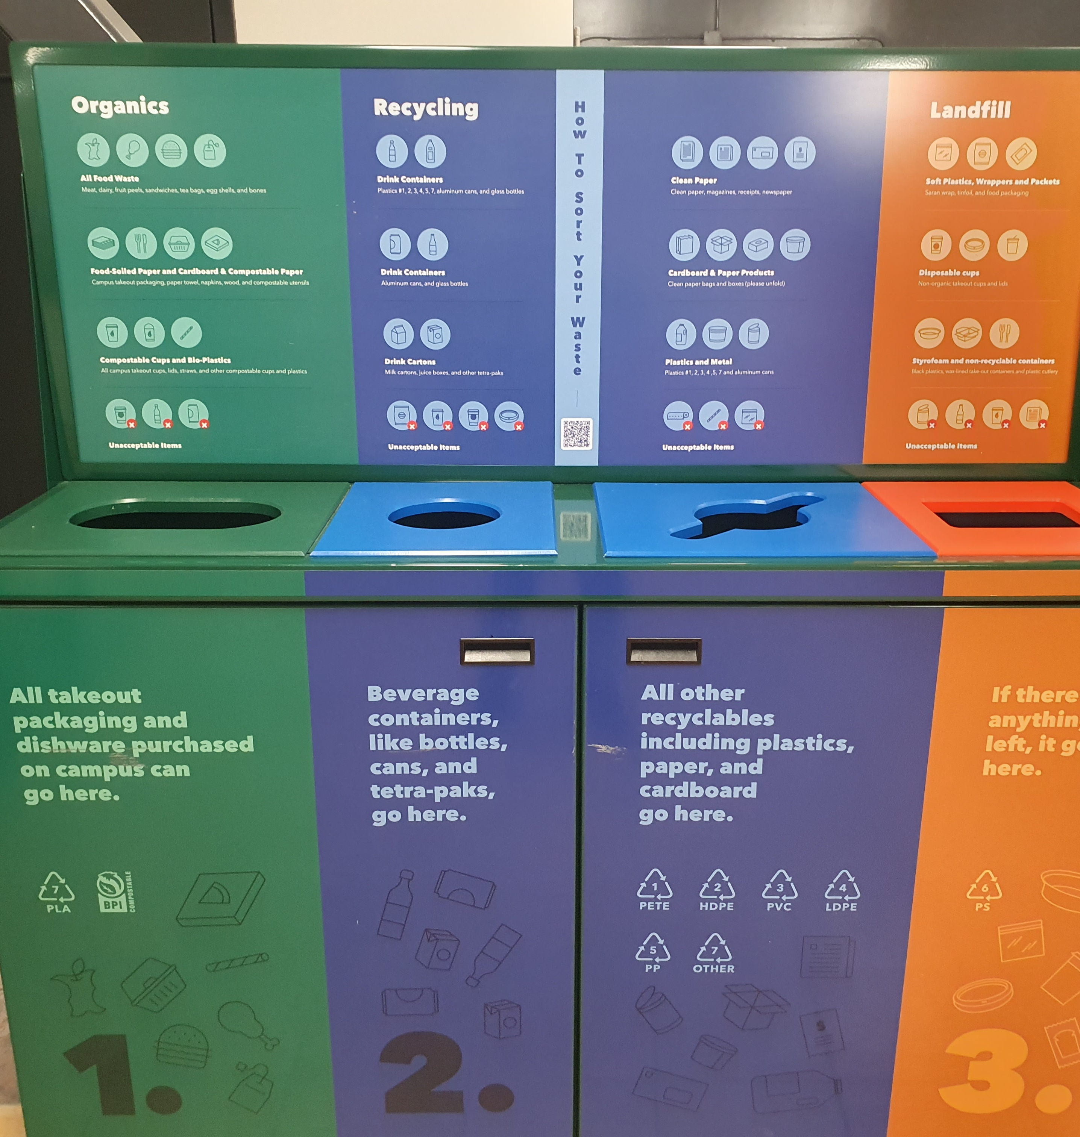
Replace the above image with your own by double-clicking on the image and selecting “change picture” from the menu on the left. Then insert the speech balloon text and/or the commentary narratives onto the image.
Delete either the speech balloon or commentary box if not used.
Fumettivoice Data Template
SHOWeD Analysis. Complete below in as much detail as necessary (change size of font if needed):
What do you See here?
What is really Happening here?
How does this relate to Our lives?
Why does this situation Exist?
What can we Do about it?
Narrative will go here as a speech balloon OR….
….OR a commentary at the bottom of the image…. OR both.
Complete: Image number (x / 30) ___/30_
Image by _(choose pseudonym) ___________________
Date (DD/MM/YYYY): __________________
Notes:
SHOWED Analysis(complete in as much detailas necessary):
What do you See here?
What is really Happeninghere?
How does this relate toOur lives?
Why does this situation Exist?
What can we Do about it?

