Slide 1
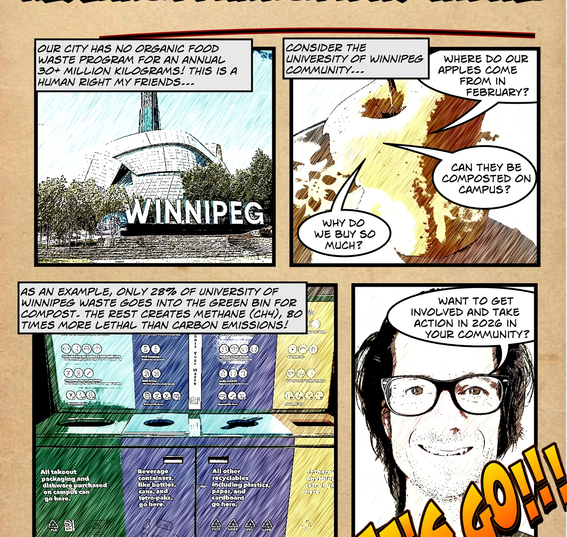
Elegantly Wasted: Documenting Community Experiences of Sustainable Waste Management in Winnipeg
A Research Proposal
by Joseph Harding, Lieutenant-Colonel (retd), CD
PhD Candidate Faculty of Education University of Manitoba
Notes:
This PhD research proposal "Elegantly Wasted: Documenting Community Experiences of Sustainable Waste Management in Winnipeg" articulates a complex, wicked problem linking local sustainable waste management with global frameworks. It incorporates innovative
arts-based and critical participatory action research methodologies, guided by the theoretical framework of ecopedagogy.

Slide 2


Land Acknowledgment
I acknowledge our shared global responsibility to honour the rights of Indigenous Peoples by refusing waste creation where possible and managing waste responsibly, thereby protecting ecosystems, land, and water.
Through collaborative partnerships and respectful research, this study commits to working together across communities and nations to care for and restore the health of ecosystems for the benefit of all life, now and in the future.
Photo by Joseph Harding, 2022
Who controls the narrative for the environment?

Slide 3
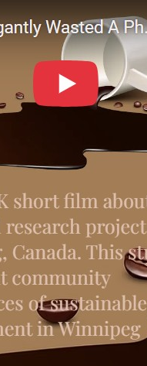
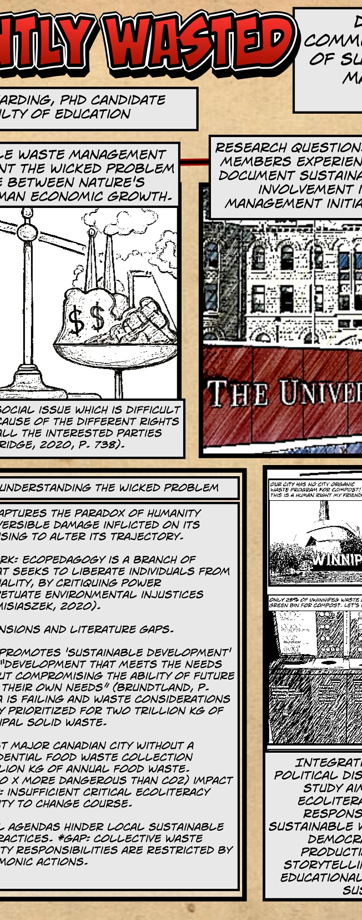
Research Proposal Accessibility Via:
An interactive website (hotsweetandjumpy.com/research)
A fumetti format (photocomic) – 2 x pages
A 4K Short Film: 4 min 40 secs
An email address to request alternate languages, formats, and ask questions

Slide 4
Presentation Agenda
Introducing the Wicked Problem
Literature Review
Methodology
Conclusion

Slide 5
Context
Winnipeg, Canada, currently lacks a publicly funded program for the collection and processing of residential food waste (HDR Corporation, 2023). The city has a plan to implement a limited residential food waste program by 2033, when an estimated 34 million kilograms (kg) of waste will be produced annually, reaching 42 million kg by 2058 (HDR Corporation, 2023, Appendix D, Table 1).
Due to bureaucratic delays, low priority, and cost, Winnipeg, a city of 841,000 people, is the last major Canadian city in 2025 without a full-scale publicly funded residential food waste material collection (Daigneault, 2024, para. 3; EWSWA, 2025).
This research project will involve a case study centred on the city campus of the University of Winnipeg.

Slide 6
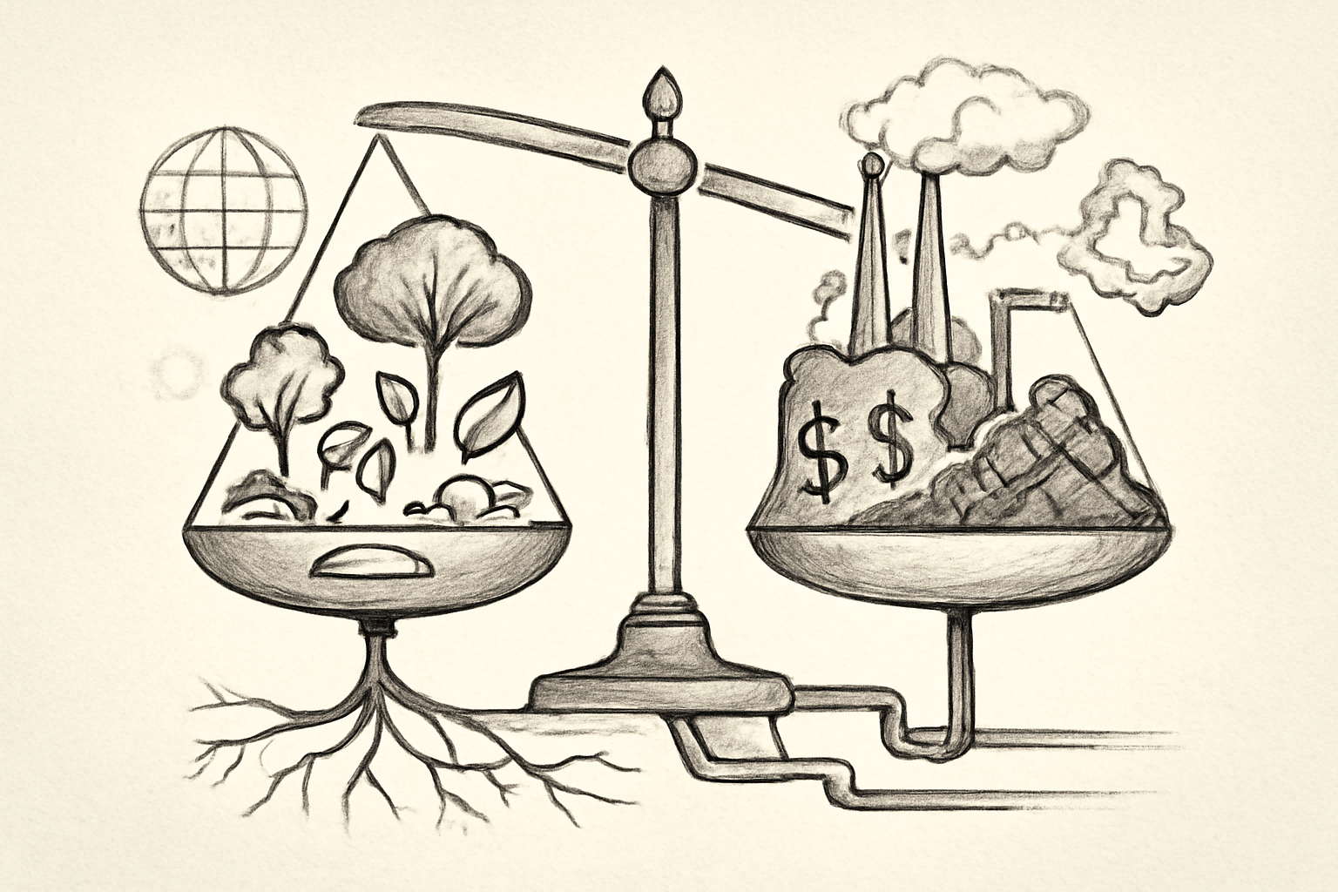
Introducing… The Wicked Problem
Global sustainable waste management practices represent the wicked problem of an imbalance between nature's ecosystems and human economic growth.
Humans produce a staggering two trillion kilograms
of municipal solid waste annually (Giurea et al., 2024).
Sustainable Development “…meets the needs of the present without compromising the ability of future generations to meet their own needs.” (Brundtland, 1987, p. 43).
According to Bainbridge (2020), a wicked problem is a “social issue which is difficult or impossible to fix because of the different rights and perspectives of all the interested parties involved” (p. 738).
Notes:
Image generated by Perplexity.AI, 2025
As you have access to the formal proposal in depth, I will only highlight the key aspects throughout the presentation.
Global sustainable waste management practices represent the wicked problem of an imbalance between nature's ecosystems and human economic growth.
According to Bainbridge (2020), a wicked problem is a “social issue which is difficult or impossible to fix because of the different rights and perspectives of all the interested parties involved” (p. 738).
Current global waste management practices are deemed insufficient by the United Nations for the current population, with predictions that waste will double by 2050, exceeding the direct correlation of population growth (UNEP, 2024). For instance, humans produce a staggering two trillion kilograms of municipal solid waste annually, which is expected to increase with changing consumption patterns (Giurea et al., 2024). Despite an international agreement to address the environment, pollution remains high, and surrounding ecosystems are suffering alarmingly. Humans (and other species) risk extinction, yet somehow, life continues as usual (de Pencier et al., 2023). The knowledge of environmental degradation is omnipresent and overwhelming.
The dominant global environmental agenda is called Sustainable Development, defined as “Development that meets the needs of the present without compromising the ability of future generations to meet their own needs.” (Brundtland, 1987, p. 43). In practical terms, the UN, since 2015, has tracked sustainable development as a framework with nations as 17 goals and 169 targets to essentially end poverty, hunger, inequality, protect human rights, and ensure the balance of the planet and its supporting resource ecosystems, all by 2030 (UN, 2015, 2023, 2025).
…..The Sustainable Development Goals (SDGs) are failing, with five years left to achieve their mandate.

Slide 7
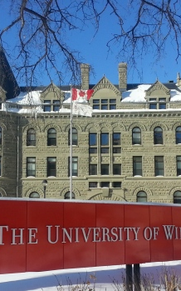
Rationale of the Study & Purpose
“By diverting food waste from landfills, we can reduce methane emissions and build a cleaner Canada. Working with local governments, we are creating innovative solutions to ensure that the energy, water, and land resources used to grow our food are not wasted.”
News release, September 29, 2025 – Ottawa, Ontario
– The Honourable Julie Dabrusin, Minister of Environment and Climate Change
This study frames organic waste management at the University of Winnipeg as a practical and explicit focus, positioning it as a case-study critique of global sustainability models and neoliberal agendas, through partnership with the University of Winnipeg waste community members.
Photo courtesy of the University of Winnipeg, 2022
2023 Audit: 40% waste is organic (of which, ONLY 28% separated correctly, 64% sent to landfill in plastic bags INCORRECTLY, 8% sent to recycling INCORRECTLY)
Notes:
This study frames organic waste management at the University of Winnipeg as a practical and explicit focus, positioning it as a case-study critique of global sustainability models and neoliberal agendas, through partnership with University of Winnipeg waste community members.
The University of Winnipeg has conducted seven waste audits since 2006. In 2023, as an example, the waste audit revealed that 40% of waste generated on campus is considered organic, with only 28% being sent for composting through a privately funded contract with Compost Winnipeg. Furthermore, 64% of all organic waste generated on campus ends up in the landfill stream, with an additional 8% ending up in the recycling stream (CSO, 2023, p. 15).
This study situates organic waste management as a complex and pressing problem with both local and global implications, arguing that innovative and participatory approaches are necessary to foster the critical consciousness and ecoliteracy required for effective environmental action.
Addressing gaps in neoliberal-dominated sustainability frameworks through participatory methods, the outcomes of this study will: (a) document collective responsibility related to sustainable waste management; (b) democratize knowledge production through visual storytelling; and (c) generate educational insights for campus sustainability.

Slide 8
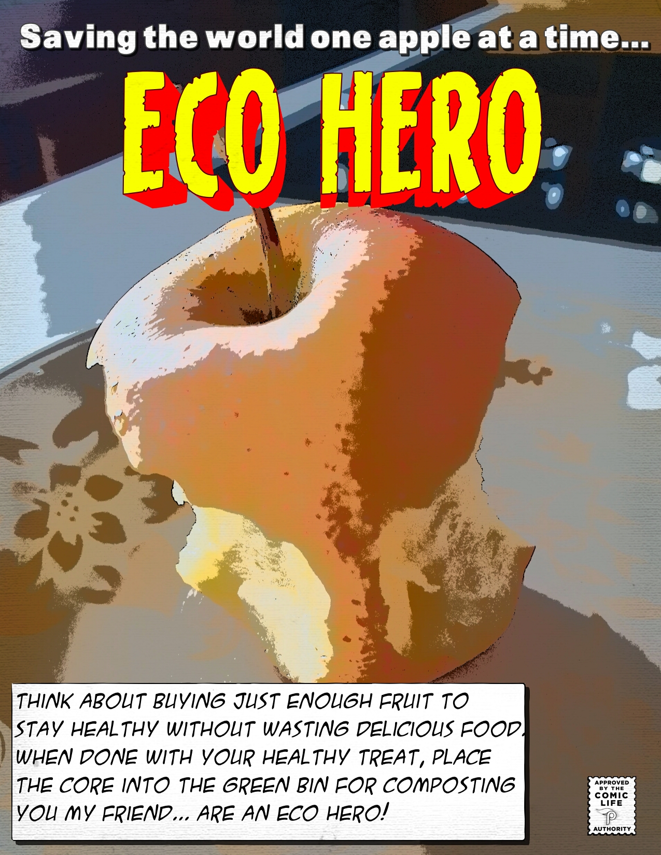
Research Question
“How do community members experience, understand, and document sustainability through their involvement in local waste management initiatives in Winnipeg?”
Image created by Joseph Harding, 2025
This project aims to: (a) document collective responsibility related to sustainable waste management;
(b) democratize knowledge production through visual storytelling; and
(c) generate educational insights for campus sustainability.
Notes:
-Research Question. How do community members experience, understand, and document sustainability through their involvement in local waste management initiatives in Winnipeg?
-Research sub-question 1: How do participants express and reflect their ecoliteracy and environmental perceptions through documented fumettivoice narratives in the context of sustainable waste management?
-Research sub-question 2: What discourses about the political, social, and ecological dimensions of waste management emerge within participants’ documented fumetti, and how do these narratives illustrate processes of collective awareness and critical reflection?
-Research sub-question 3: How do participants’ experiences of ride-alongs with waste management processes become documented and reinterpreted through fumettivoice, and what do these visual stories reveal about their understandings of collective responsibility and orientations toward environmental action?
Objective 1. To explore how participants express and reflect their ecoliteracy and environmental perceptions through documented fumettivoice narratives in the context of sustainable waste management.
Objective 2. To analyze the discourses emerging in participants' fumetti regarding the political, social, and ecological dimensions of waste management and how these narratives illustrate processes of collective awareness and critical reflection.
Objective 3. To investigate how participants document and reinterpret their experiences of ride-alongs with waste management processes through fumettivoice, and to reveal their understandings of collective responsibility and environmental action orientations.

Slide 9
Literature Review – Defining the Wicked Problem
Current Mixed Media
Theoretical Frameworks
Community-based Projects
Contextual Research Data
Seminal Influential Texts
Subject Matter Experts
100 + refs, majority 2016-2025, seminal references (1972, 1986)
Followed Callahan’s (2014) five characteristics of a robust literature review: “concise, clear, critical, convincing, and contributive” (p. 272).
Notes:
The UN Secretary-General António Guterres raises the alarm in the 2023 UN Sustainability Report for governments and citizens to consider the effects of not addressing the 2030 Sustainable Development Goals (SDGs) for the planet: “Progress on more than 50 percent of targets of the SDGs is weak and insufficient; on 30 percent, it has stalled or gone into reverse. These include key targets of poverty, hunger, and climate change. Unless we act now, the 2030 Agenda could become an epitaph for a world that might have been. (UN, 2023, p. 2).”
The criteria used to select literature for this research study encompass the wicked research problem that global sustainable waste management practices represent an imbalance between nature’s ecosystems and human economic growth. Information was also chosen to create a critical synthesis of relevant knowledge that supports the study’s research question(s) and research objectives, respecting Callahan’s (2014) five characteristics of a robust literature review: “concise, clear, critical, convincing, and contributive” (p. 272).

Slide 10
Literature Review:
Key Components
Theoretical Framework: Ecopedagogy
Sustainable Development and Neoliberalism
Wicked Problem Dimensions

Slide 11
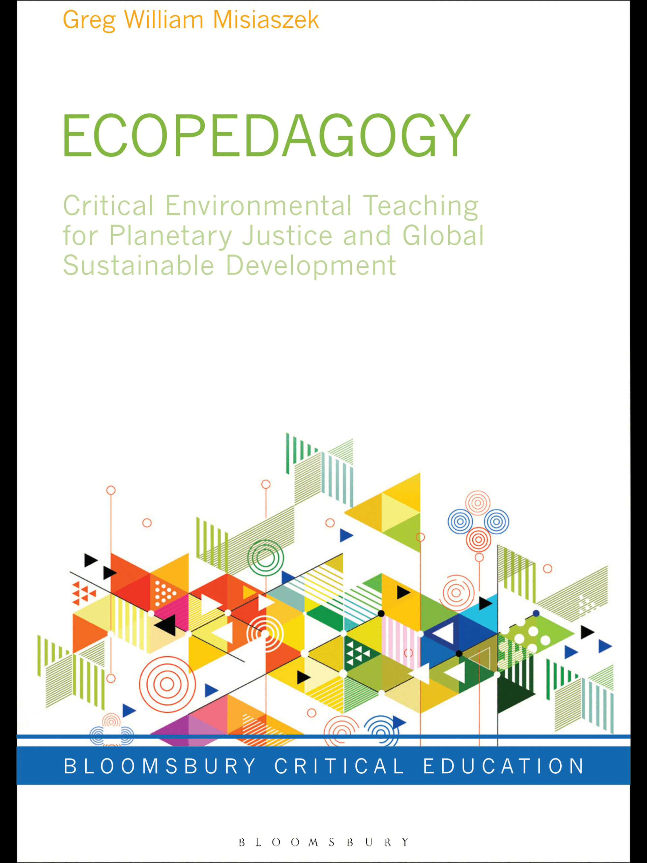
Theoretical Framework: Ecopedagogy
My research is guided by the theoretical framework of ecopedagogy, which acknowledges that a critical approach to enhancing ecoliteracy skills is necessary to address the irreversible effects of human interference with today’s ecosystems, commonly referred to by de Pencier et al. (2023) as the Anthropocene Era.
As one of the early collaborators of the concepts of ecopedagogy in the late 1990s in Brazil, alongside Paulo Freire and Francisco Gutierrez, Moacir Gadotti (2011) suggests
“(a) viewing human beings and nature holistically and (b) maintaining a balance between them so that sustainability can be attained.
These are considered the fundamental beliefs of ecopedagogy” (p. 21).
Notes:
My research is guided by the theoretical framework of ecopedagogy, which acknowledges that a critical approach to enhancing ecoliteracy skills is necessary to address the irreversible effects of human interference with today’s ecosystems, commonly referred to by de Pencier et al. (2023) as the Anthropocene Era.
I adopt a critical qualitative research paradigm deeply influenced by ecopedagogy as the philosophical and theoretical foundation. Ecopedagogy extends critical pedagogy into environmental education by promoting ecological literacy, social justice for all ecosystems, and critically examining power structures such as neoliberalism that perpetuate environmental injustice.
Ecopedagogy is an appropriate theoretical framework for this study according to the literature; however, it is not all-encompassing and continues to evolve. Initially considered a pedagogy for sustainable development, or an Earth pedagogy, ecopedagogy emphasizes the need to address imbalances between humans and nature critically (Antunes & Gadotti, 2005).
As one of the early collaborators of the concepts of ecopedagogy in the late 1990s in Brazil, alongside Paulo Freire and Francisco Gutierrez, Moacir Gadotti (2011) suggests “(a) viewing human beings and nature holistically and
(b) maintaining a balance between them so that sustainability can be attained. These are considered the fundamental beliefs of ecopedagogy” (p. 21).
According to Misiaszek (2020) and Kahn (2010), ecopedagogy can serve as a philosophical and practical lens to frame the ecological and environmental
injustices inherent in contemporary issues, such as the complex problem of sustainable waste management addressed in this study.
Critics of ecopedagogy argue that it is rigid, utopian, and not realistic (Jandrić & Ford, 2022; The Schumacher Institute, 2024).
In the foreword to Postdigital ecopedagogies: Genealogies, contradictions,
and possible futures, McLaren (in Jandrić & Ford, 2022) provides a caution: “Today’s ecological consciousness demands that we move away from ecopedagogical models that posit a compromise with neoliberal capitalism, or that do not recognize that socialism can sometimes be more productivist than
even the most despotic tendrils of capitalism” (p. xi).
Ecopedagogy builds on the fundamentals of critical pedagogy to foster ecoliteracy and encourage the appropriate action to address ecological justice (Hossain, 2024). Critical pedagogy is a robust framework for emancipatory learning, action-oriented to help liberate individuals from social oppression.
Misiaszek (2022) considers ecopedagogy “literacy education for reading and rereading human acts of environmental violence” (p. 2298) as a development of critical pedagogy. Ecopedagogy calls for human reflection and action on their influences on the ecosystem toward justice for the ecological environment (nature), social (human), and non-human elements. This uniqueness transforms a “systemic change in which relationships and structures are fundamentally altered, often contrasted with smaller-scale changes such as varying or refining existing relations” (Cornish et al., 2023, p. 12).

Slide 12
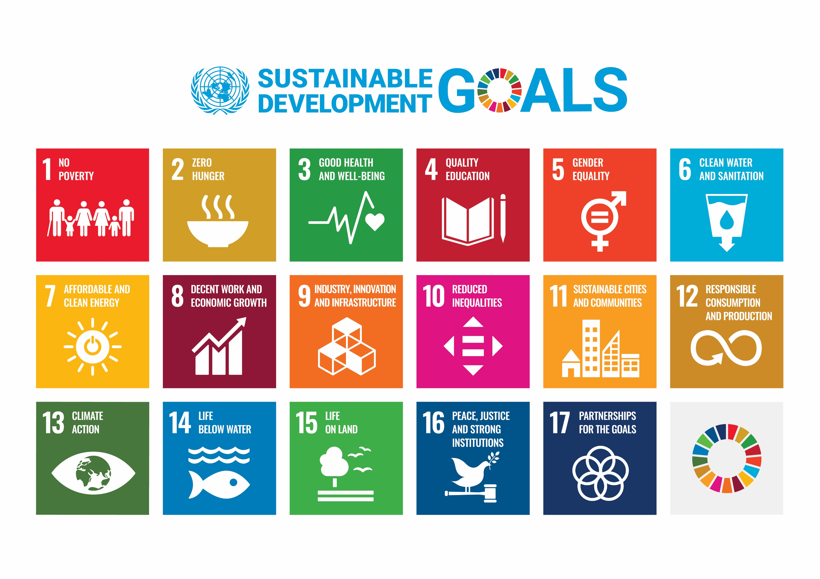
Sustainable Development and Neoliberalism
Timeline
1970: Earth Day
1986: Our Common Future
1992: Earth Summit
1997: Kyoto Protocol
2000: Millenium Development Goals (MDG)
2015: Paris Agreement
2015: MDG Target Date (FAILED)
2015: Sustainable Development Goals (SDG)
2030: SDG Target Date (FAILING)
Notes:
The Origins of Sustainable Development.
In the United States of America (USA), 22 April 22, 1970, was established as Earth Day, drawing 20 million activists and protesters to the streets due to environmental concerns (Yeo, 2024). This influenced a global mass environmental movement. Following Earth Day, the first significant international environmental conference, the UN Conference on the Human Environment, was held in Stockholm, Sweden, from June 5 to 16, 1972. This conference sparked the creation of global environmental awareness and policy, as well as the formation of the UNEP organization, the leading environmental authority within the UN (Grasso & Giugni, 2022). Establishing the World Commission on Environment and Development (WCED) was also noteworthy.
The 1987 WCED report, Our Common Future, was the result of approximately four years of international coordination by a team of interdisciplinary specialists, who mapped a sustainable environmental future for the world. The 1987 UN report, published uniquely as a book by its chairperson, Gro Harlem Brundtland, proposed the concept of sustainable development, which remains familiar today (Brundtland, 1987; UN, 2025).
The 1992 Earth Summit in Rio de Janeiro, Brazil (and subsequently in 2012) promoted sustainable development globally, including the attendance of environmental non-governmental organizations. This was significant in its challenge and augmentation to governmental top-down perspectives on economic growth models (Grasso & Giugni, 2022).
The 1997 international treaty to reduce greenhouse gases, known as the Kyoto Protocol, was made to reduce global warming due to human interference (Brittania, 2024). The Kyoto Protocol “was made by the authority and group members of UNFCCC in 1997 to ensure sustainable business and non-commercial practices within every field so that a higher degree of sustainable growth might be achieved” (Akhtar et al., 2024, p. 1849).
The next milestone for the UNFCCC was the 2015 Paris Agreement, so “that they might use innovative and creative techniques in their industrial and commercial practices to maximize sustainability across the globe without facing any resource shortage-related issues” (Akhtar et al., 2024, p. 1850).
Sustainable development became operational in 2000 following several critical international engagements. The 1987 objectives were developed into eight Millennium Development Goals (MDGs) in 2000, which were to be achieved by 2015. Unfortunately, they failed due to a lack of global priority, target funding, politicized agendas, and difficult international cooperation (Mondini, 2019). Updated in 2015 and adjusted for a 2030 target date, the SDGs are essentially on a path similar to that of the original MDGs (Kopnina, 2020).
The Environmental Challenges of Neoliberalism. Alternative critical environmental frameworks, such as ecopedagogy and degrowth, struggle to reach communities and promote knowledge democracy due to the influence of political hegemony and neoliberalism (Fu, 2016; Kopnina, 2020; Thompson, 2022). Adkin (2022) writes about the crisis of hegemony of fossil capitalization that followed World War II, in which massive economic growth required the colonial access and exploitation of fossil fuels to support energy demand. Whether intended or not, the SDGs reinforce a hegemonic model in which resources and energy continue to be negotiated between higher- and lower-income nations (Misiaszek, 2022).
The Impacts of Neoliberalism. In a neoliberal environment, governments allow free markets to prevail, growth is expected, and private companies prioritize profits above all else. Secondary compliance with environmental regulations is a competing obstacle, as it conflicts with growth. According to Warlenius (2022), sustainable development presents a competing dilemma between desired consumption and maintaining a balance of waste.

Slide 13
Wicked Problem Dimensions
Waste is predicted to double by 2050, exceeding population growth, with little hope of a solution (UNEP, 2024).
Critical ecoliteracy deficiencies.Example:
  Greenhouse gas emissions are necessary to maintain the average Earth surface temperature of 15 °C.
  Carbon (CO2) versus Methane (CH4) emissions. CO2 dominates the news, yet CH4 (i.e. food waste) is 80 times more lethal than CO2 over a 20-year time scale.
Environmental education agendas favour formal learning over informal & non-formal.
Notes:
Wicked Problem Dimensions. This proposal already outlines the history of a complex situation in which economic growth continues to exceed nature’s capacity to achieve balance. Waste is predicted to double by 2050, exceeding population growth, with little hope of a solution (UNEP, 2024). Waste management is a conflict between human consumption and nature’s resources, as evidenced by the most recent organic waste management assessment in Winnipeg, which represents global struggles (HDR Corporation, 2023). A key characteristic that makes this research’s problem wicked is the inability to change course due to low critical global ecoliteracy levels (Bainbridge, 2020).
Greenhouse Gas Emissions Ecoliteracy. According to the Prairie Climate Centre (2019), greenhouse gas contributions are necessary to maintain a healthy average surface temperature on Earth of approximately 15 °C through the greenhouse effect of maintaining the ability of the sun to warm the Earth above permanent freezing temperatures of about -18 °C, which is too cold to sustain life.
Carbon versus Methane. Nordahl et al. (2023) research shows significant climate change ecoliteracy gaps in the science of managing carbon footprints and methane emissions. Carbon dioxide (CO2) emission management dominates global agendas; however, the more lethal methane (CH4) emissions from poorly managed organic waste have the most potential for improvement in this study. CH4 is a potent greenhouse gas that is colourless, odourless, and invisible to the naked eye. It is responsible for more than 25 percent of the global warming we are experiencing today. Due to its structure, CH4 traps more heat in the atmosphere per molecule than CO₂, making it 80 times more harmful to the atmosphere than CO₂ for 20 years after its release (UNEP, 2022, para. 1).
The Challenges of an Emphasis on Formal Learning Towards Ecoliteracy. Sterling (2024) describes efforts to transform EE as rhetoric in formal higher education, ignoring the need for profound modifications to an educational system that is ignorant of the realities of environmental violence. While formal global critical ecoliteracy and action is assessed as low, non-formal, and informal education are often being neglected as part of holistic environmental action (Bainbridge, 2020).
* “An ecopedagogy-based education system teaches students to sacrifice their self-interests, assigns obligations to the land and nonhuman beings, and overall changes the philosophy of sustaining what is 'money-making' only” (Hossain, 2024, p. 5). *

Slide 14
Gaps in the Literature
Gap 1: Limited Integration of Ecopedagogy with Sustainable Development
Gap 2: Need for Critical Challenge to Neoliberal Educational Methods in Sustainability
Gap 3: Insufficient Research Linking Local Waste Management Practices to Global Frameworks
Notes:
Gap 1: Limited Integration of Ecopedagogy with Sustainable Development. Ecopedagogy has been reported as a credible and critical challenge to sustainable development, albeit with some limitations as previously noted. Both frameworks have extensive literature on their individual merits; however, a gap exists in integrating alternative models into the UN environmental agenda. There appears to be a reluctance to pursue alternative models to sustainable development, given its popularity and dominance in Western environmental agendas (Hickel, 2021; Kopnina, 2020).
Gap 2: Need for Critical Challenge to Neoliberal Educational Methods in Sustainability. Historical consumerism and exponential growth, under the guise of development, perpetuate free market paradigms that continue to challenge nations and the UN in their management. Waste is one indicator that the dominant environmental agenda of sustainable development, as outlined in the SDGs, is failing, as companies are not held reasonably accountable (Arora-Jonsson, 2023).
Gap 3: Insufficient Research Linking Local Waste Management Practices to Global Frameworks. Local communities require a deeper understanding of ecoliteracy to navigate the influences of hegemony and neoliberalism, particularly in waste management, where these forces have a direct impact as communities grow rapidly (Chen et al., 2024; Kopnina et al., 2024; Kowasch, 2024). The literature promotes alternative models to sustainable development, yet there appears to be a reluctance to adopt higher levels of ecoliteracy through alternative means.

Slide 15
Research Study Paradigm
Guiding Philosophy (reality, knowledge, and values)
Ontology (nature of reality and what exists) – social & ecological realities are connected, constructed & subjective
Epistemology (how do we know) – constructivist, focused, critical & participatory (knowledge co-created and actively constructed)
Axiology (what do we value) – ethical obligations, values co-constructed, no research on us without us
Notes:
The Merriam-Webster dictionary defines ontology as: “a branch of metaphysics concerned with the nature and relations of being; and a particular theory about the nature of being or the kinds of things that have existence” (Merriam-Webster, 2025c).
The ontology of this study considers social and ecological realities as interconnected, complex, and shaped by hegemonic power relations, necessitating critical consciousness and transformative action in sustainable waste management from the local to the global scale.
Epistemology is defined as “the study or a theory of the nature and grounds of knowledge, especially with reference to its limits and validity” (Merriam-Webster, 2025b).
Epistemologically, this study’s research paradigm is constructivist and participatory—knowledge is co-created with University of Winnipeg community research participants, valuing their lived experience and situated knowledges.
Axiology is defined as “the study of the nature, types, and criteria of values and of value judgments especially in ethics” (Merriam-Webster, 2025a).
Axiology, in the context of this study, refers to my foundational belief that more critical and participatory qualitative research on waste management is required to represent the perspectives of the communities most affected (Fine & Torre, 2021), following the “no research on us without us“ philosophy.

Slide 16
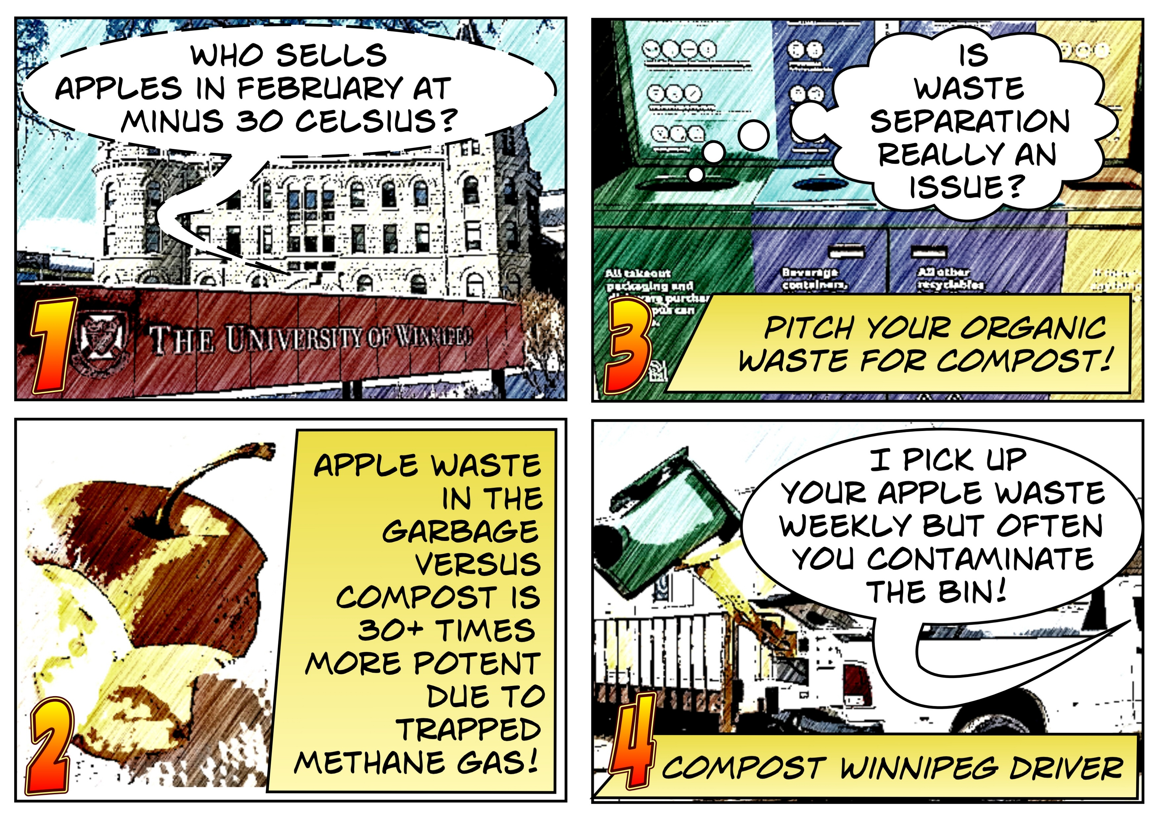
Methodology – Addressing the Wicked Problem
This image depicts the broader methodology of this study visually.
Fumetti image generated by Joseph Harding, 2025
My research integrates critical participatory action research and arts-based research within an ecopedagogical framework to document the community’s experiences with a focus on community empowerment and social justice. This study adopts a “no research on us without us” stance with the University of Winnipeg waste community.
Notes:
This image depicts the broader methodology of this study.
Overall, my research integrates critical theory, participatory methods, and arts-based visual research within an ecopedagogical framework to investigate the wicked problem of sustainable waste management with a focus on community empowerment and social justice. This study adopts a “no research on us without us” stance for the University of Winnipeg waste community.
Methodologically, my research uses an arts-based participatory paradigm, specifically integrating Arts-Based Research (ABR) and Critical Participatory Action Research (CPAR). ABR engages participants as co-researchers through creative, visual methods—in my case, the novel fumettivoice method combining photovoice with photo-comic storytelling. CPAR emphasizes collaborative research aimed at documenting, challenging, and transforming social and ecological injustices, fostering collective empowerment and social change.

Slide 17
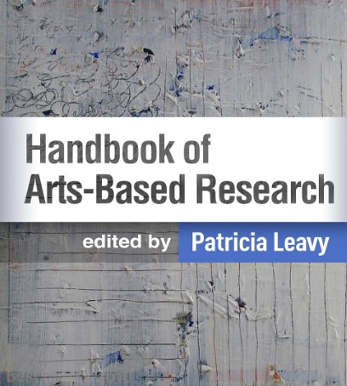
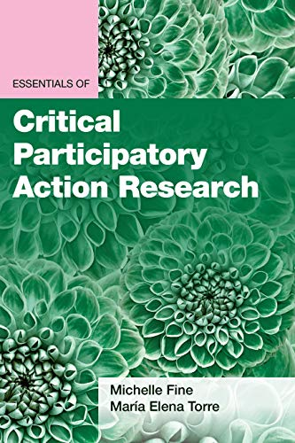
Research Methodologies
Notes:
Arts-based research (ABR) is “a participatory research practice that connects embodied, visual literacy to more traditional academic research practices in higher education (Burnard et al., 2018; Jagodzinski & Wallin, 2013), through which any art form/s are used to generate, interpret or communicate research knowledge (Knowles & Cole, 2008; Parsons & Boydell, 2012)” (as cited in Morris & Paris, 2022, p. 99). “The greatest potential of ABR is its ability to advance public scholarship and thus be useful” (Leavy, 2020, p. 32).
Critical Participatory Action Research (CPAR) - CPAR is a “framework for engaging research with communities interested in documenting, challenging, and transforming conditions of social injustice” (Fine & Torre, 2021, p. 3).
CPAR is a complementary research methodology to ABR for social justice, encouraging a grassroots approach where participants become co-researchers within their own environment. CPAR includes “the role of the relationship between education and social change; a commitment to participation; a commitment to revealing the disempowerment and injustice created in industrialized societies; and the inclusion of critical friends in the research group” (Bodziński-Guzik & Stożek, 2024, p. 2).
The integration of ecopedagogy, ABR and CPAR supports documenting critical ecoliteracy and can empower communities.

Slide 18
“The greatest potential of ABR is its ability to advance public scholarship and thus be useful” (Leavy, 2020, p. 32).
Arts-based research (ABR) is “a participatory research practice that connects embodied, visual literacy to more traditional academic research practices in higher education (Burnard et al., 2018; Jagodzinski & Wallin, 2013), through which any art form/s are used to generate, interpret or communicate research knowledge (Knowles & Cole, 2008; Parsons & Boydell, 2012)” (as cited in Morris & Paris, 2022, p. 99).
Notes:
Arts-based research (ABR) is “a participatory research practice that connects embodied, visual literacy to more traditional academic research practices in higher education (Burnard et al., 2018; Jagodzinski & Wallin, 2013), through which any art form/s are used to generate, interpret or communicate research knowledge (Knowles & Cole, 2008; Parsons & Boydell, 2012)” (as cited in Morris & Paris, 2022, p. 99). “The greatest potential of ABR is its ability to advance public scholarship and thus be useful” (Leavy, 2020, p. 32).
Critical Participatory Action Research (CPAR) - CPAR is a “framework for engaging research with communities interested in documenting, challenging, and transforming conditions of social injustice” (Fine & Torre, 2021, p. 3).
CPAR is a complementary research methodology to ABR for social justice, encouraging a grassroots approach where participants become co-researchers within their own environment. CPAR includes “the role of the relationship between education and social change; a commitment to participation; a commitment to revealing the disempowerment and injustice created in industrialized societies; and the inclusion of critical friends in the research group” (Bodziński-Guzik & Stożek, 2024, p. 2).
The integration of ecopedagogy, ABR and CPAR supports documenting critical ecoliteracy and can empower communities.

Slide 19
CPAR includes “the role of the relationship between education and social change; a commitment to participation; a commitment to revealing the disempowerment and injustice created in industrialized societies; and the inclusion of critical friends in the research group” (Bodziński-Guzik & Stożek, 2024, p. 2).
Critical Participatory Action Research (CPAR) - CPAR is a “framework for engaging research with communities interested in documenting, challenging, and transforming conditions of social injustice” (Fine & Torre, 2021, p. 3).
Notes:
Arts-based research (ABR) is “a participatory research practice that connects embodied, visual literacy to more traditional academic research practices in higher education (Burnard et al., 2018; Jagodzinski & Wallin, 2013), through which any art form/s are used to generate, interpret or communicate research knowledge (Knowles & Cole, 2008; Parsons & Boydell, 2012)” (as cited in Morris & Paris, 2022, p. 99). “The greatest potential of ABR is its ability to advance public scholarship and thus be useful” (Leavy, 2020, p. 32).
Critical Participatory Action Research (CPAR) - CPAR is a “framework for engaging research with communities interested in documenting, challenging, and transforming conditions of social injustice” (Fine & Torre, 2021, p. 3).
CPAR is a complementary research methodology to ABR for social justice, encouraging a grassroots approach where participants become co-researchers within their own environment. CPAR includes “the role of the relationship between education and social change; a commitment to participation; a commitment to revealing the disempowerment and injustice created in industrialized societies; and the inclusion of critical friends in the research group” (Bodziński-Guzik & Stożek, 2024, p. 2).
The integration of ecopedagogy, ABR and CPAR supports documenting critical ecoliteracy and can empower communities.

Slide 20
Research Participants (n = 12)
Co-researchers:
UWinnipeg Campus Sustainability Office (6)
(a) Leadership (1+)
(b) Ambassador Students (3+)
Co-researchers:
Compost Winnipeg (5)
(a) Staff (2+)
(b) Drivers (3+)
Co-researchers:
City of Winnipeg:
Compost Project Manager (1+)
18 years +, 6-20 people (goal is n=12). All are welcome from the three stakeholder groups. Average 3 hours/week x 13 weeks (total 39 hours). Compensation $50.
Notes:
All participants will continue to be paid via approval from their stakeholder oprganizations, with a $50 research compensation for expenses, paid at the beginning of the study.

Slide 21
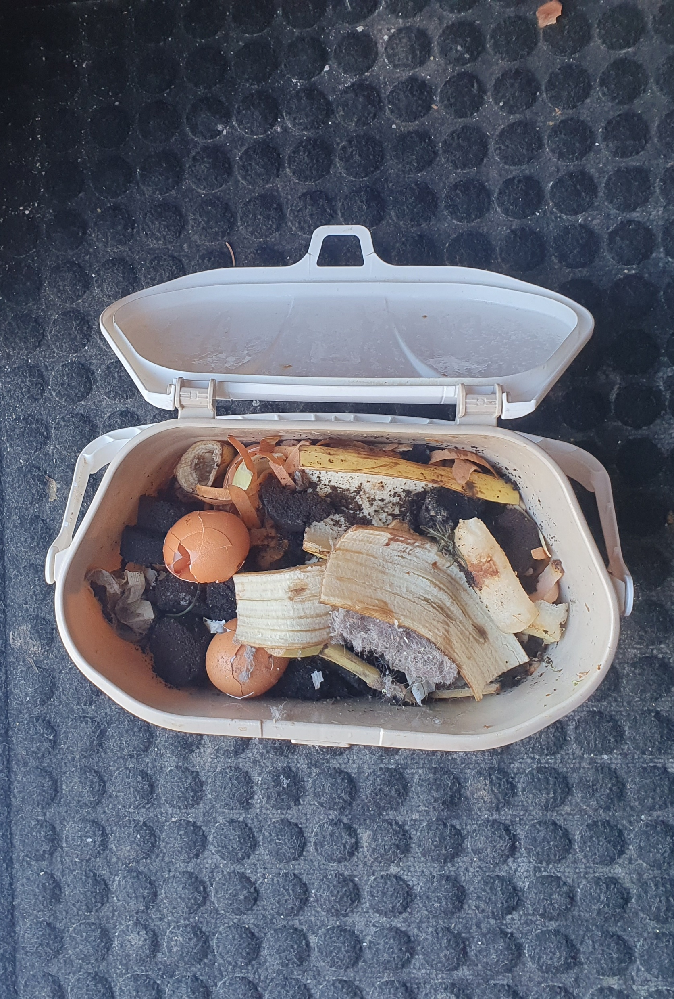
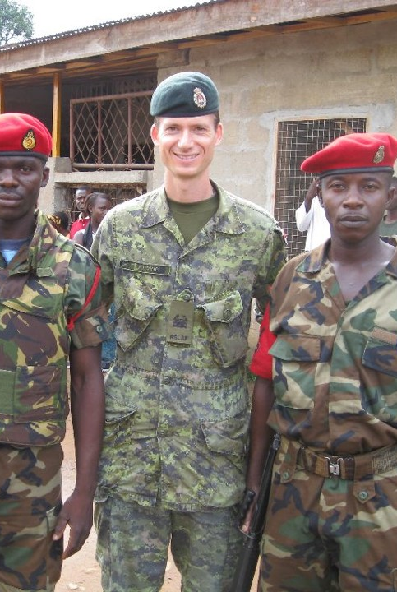
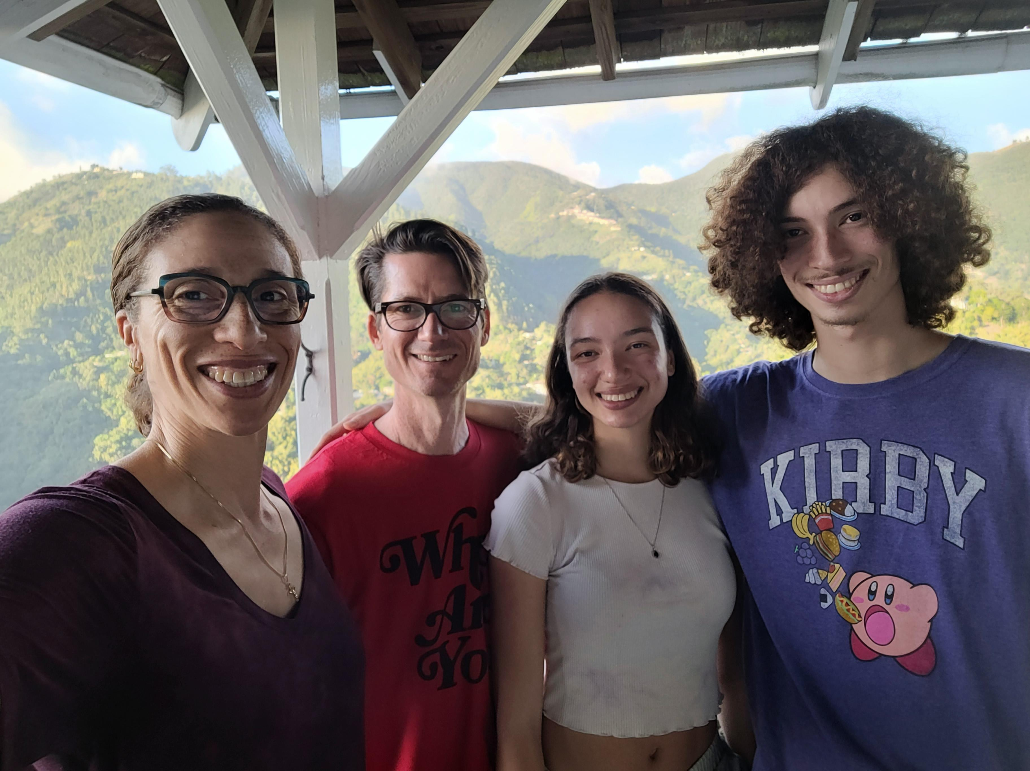
Positionality (as an outlier)
Waste influences as a “Third Culture Kid”… [born location 1, raised location 2, live location 3+, Pollock et al. (2017).
Impacts of a Canadian Armed Forces career on research [global operations, environmental violence, leadership, policy, and adult education focus].
Struggle with environmental hypocrisy in Canada (as a family) as my ecoliteracy levels rise.
Photos by Joseph Harding, 2008-present
Notes:
According to Pollock et al., a third-culture kid is someone raised during the formative years of their youth in a non-passport country to at least one of their parents, often moving frequently and returning to foreign countries to live and work.
SO WHAT? What of my principal investigator positionality as it affects the study?

Slide 22
Research Methods
Research Method 1:
Ride-along
Research Method 2: Fumettivoice
Research Method 3: Focus Group

Slide 23
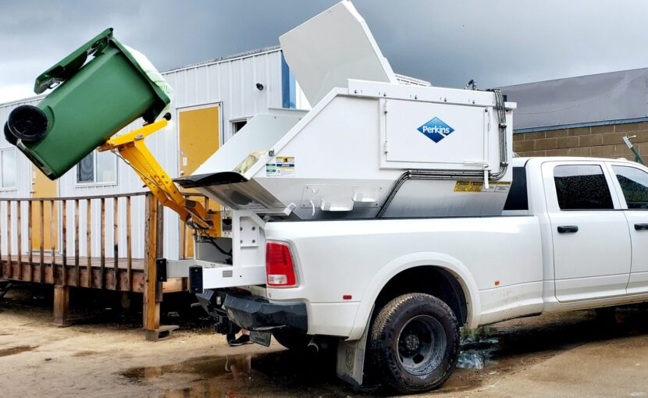
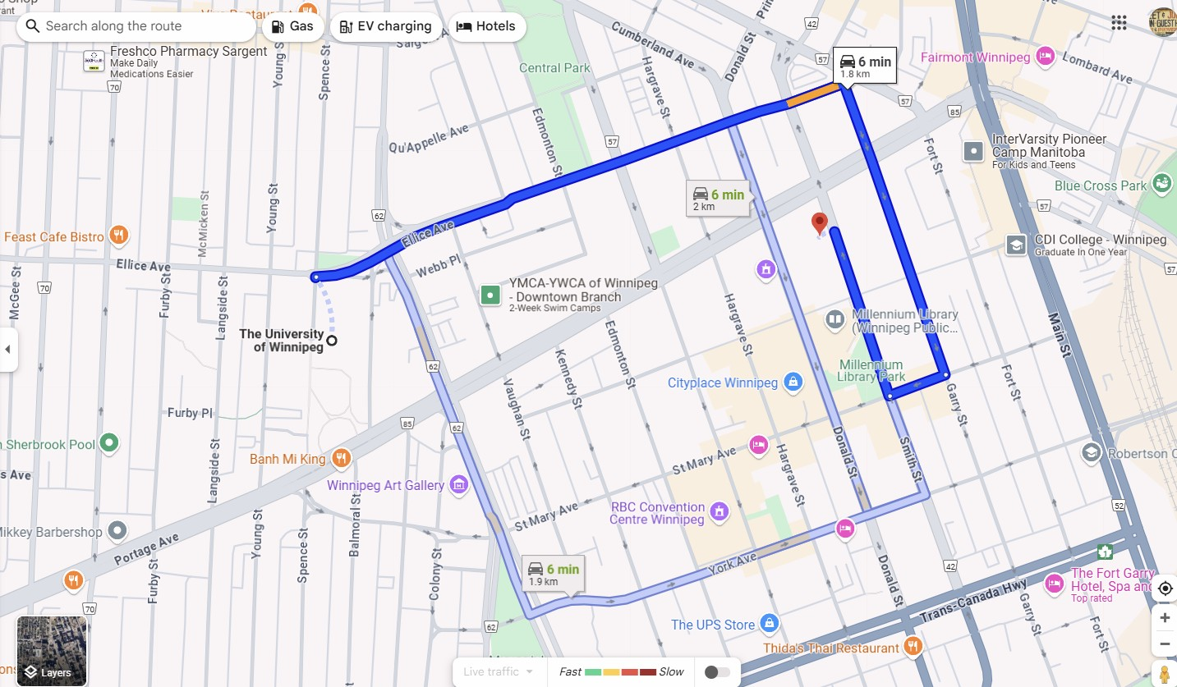
Research Method 1:
Ride-along
This involves researchers accompanying participants during their journeys or daily activities, typically using various modes of transportation such as vehicles.
This will involve an exchange of experience between University of Winnipeg Campus Sustainability Ambassadors and Compost Winnipeg organic waste collection drivers.
Photo and supporting narrative data are to be documented by participants using mobile phones.
Image courtesy of Compost Winnipeg, 2024
Notes:
Ride-along involves researchers accompanying participants during their journeys or daily activities, typically using various modes of transportation such as vehicles. It can also involve accompanying a participant whose activities are static, such as sitting at a booth with them and answering questions.

Slide 24

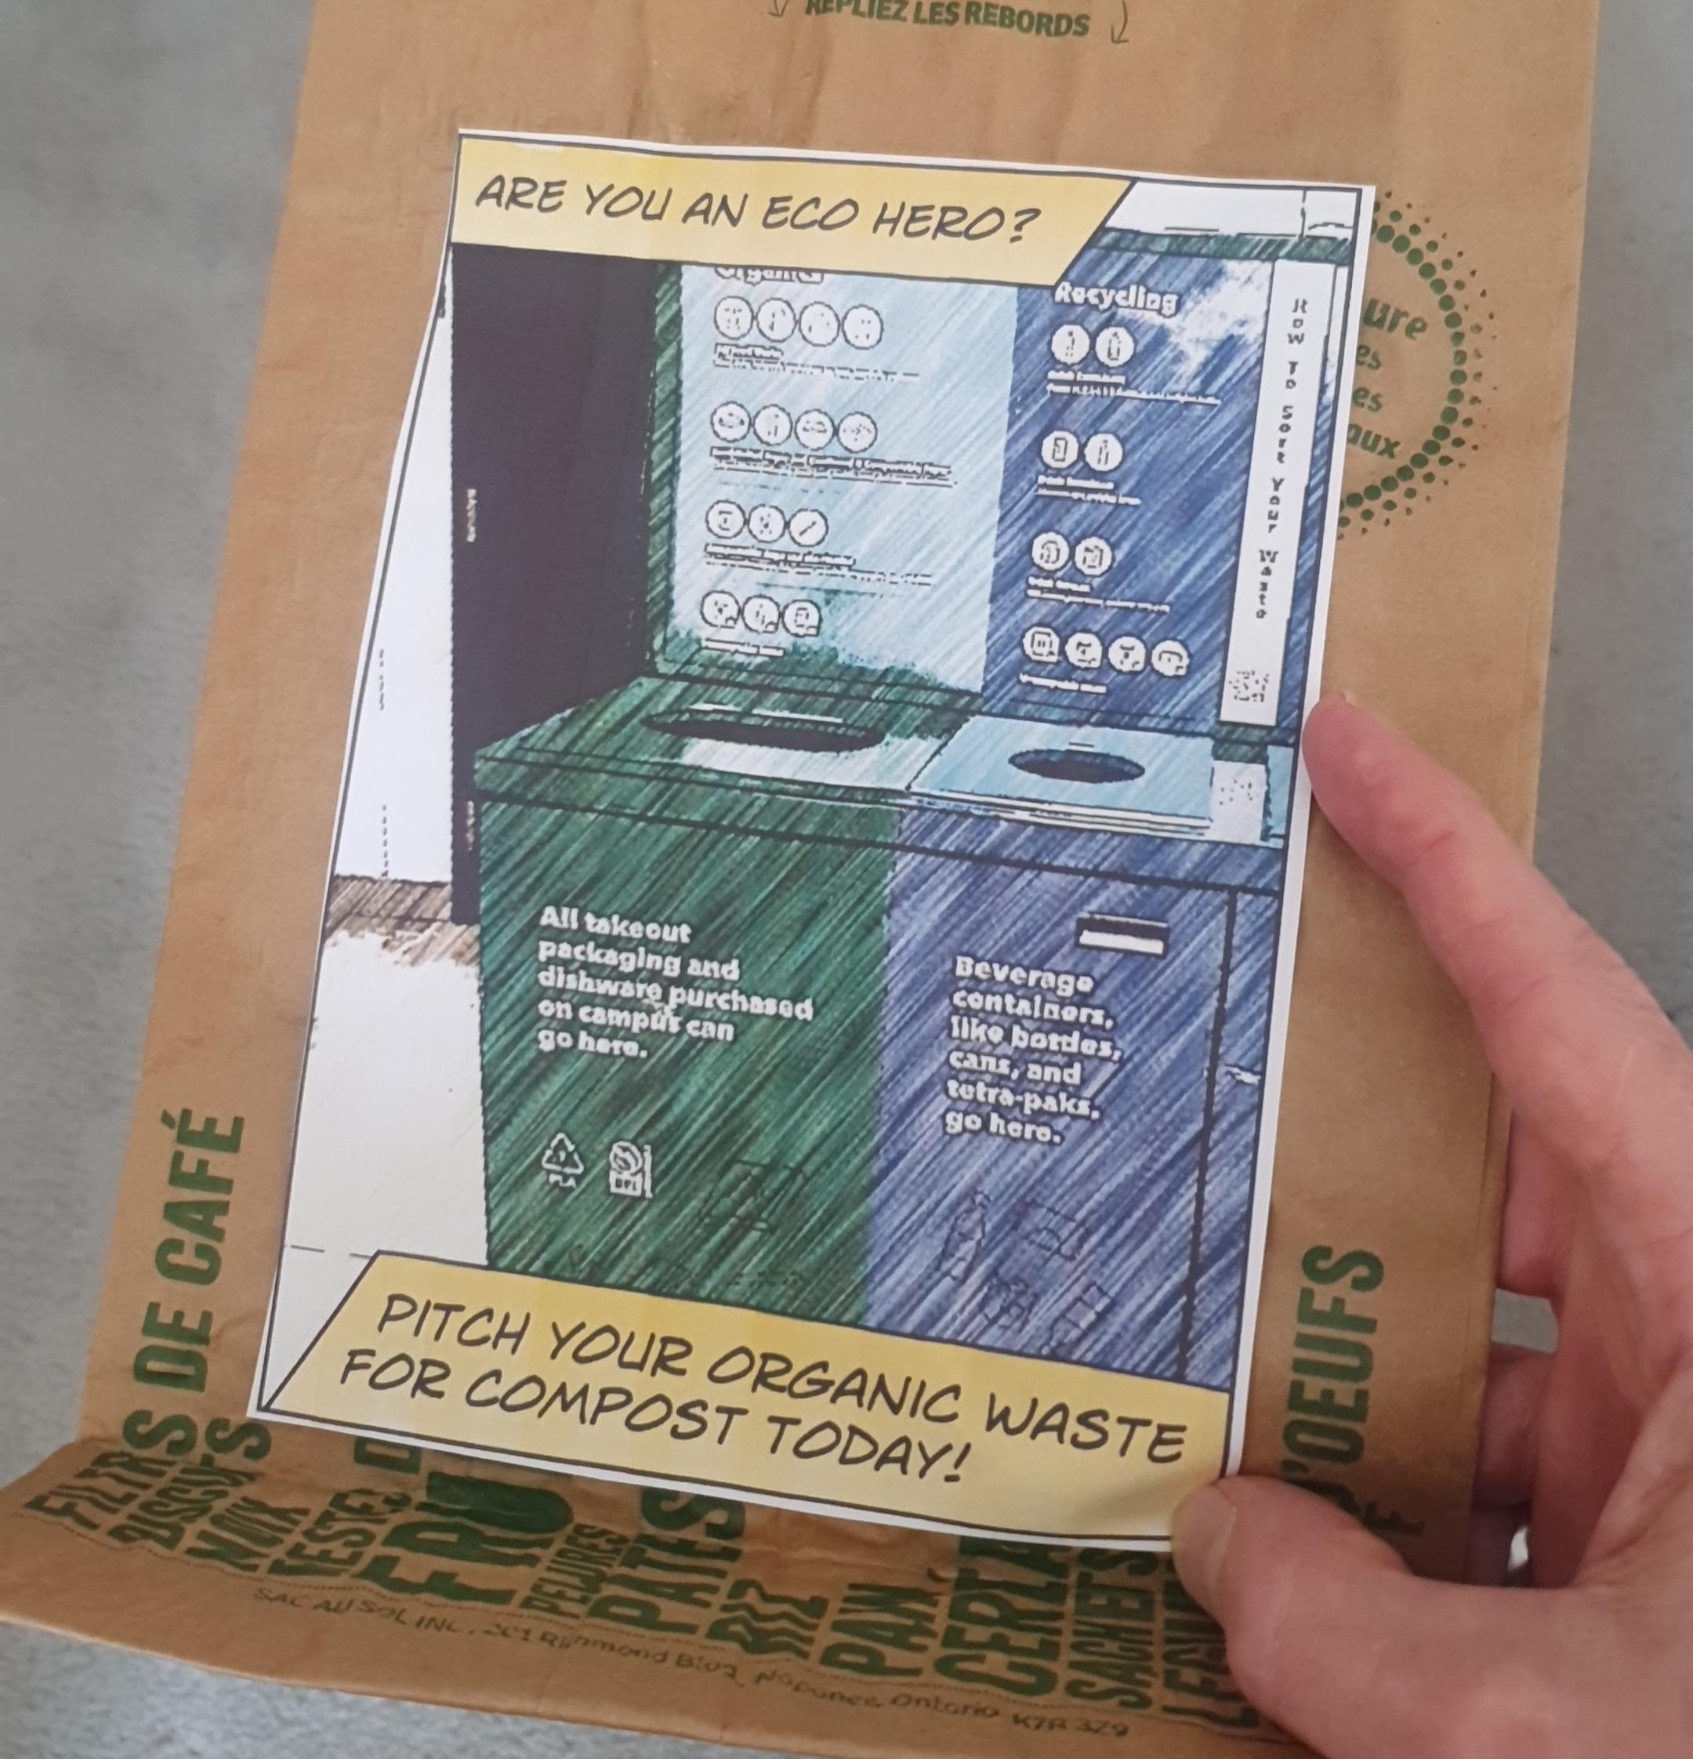
Research Method 2: Fumettivoice
‘Fumettivoice transforms participant photos, image analysis, and narratives into fumetti, an integrated photocomic story’.
Fumetti (singular: fumetto) is Italian for “puff of smoke”, referring to speech balloons in Italian comics, also considered photocomics in North America
(Comberiati & Spadaro, 2023).

Slide 25
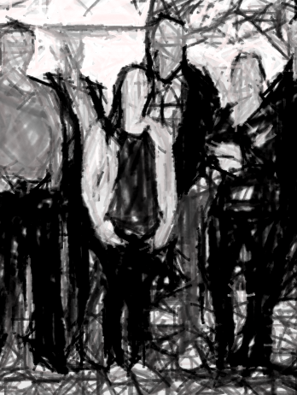
Research Method 3: Focus Group
Critically explore fumettivoice art, observations, and narratives.
Explore deeper insights identified during the data collection and initial analysis phases.
Documented visually into the fumetti story as well as analytic memo inputs.
Image by Joseph Harding, 2025
Image courtesy of CSO UWinnipeg
Notes:
A focus group is a form of qualitative research conducted in a group interview format. The focus group typically consists of a group of participants and a researcher who serves as the moderator for discussions among the group members. In focus groups, there is not always the usual exchange of questions and answers between the researcher and the group that one would commonly envision in an interview setting. Rather, the researcher often ensures that specific topics of research interest are discussed by the entire group in hopes of exploring and documenting data and self-disclosure that might otherwise be withheld in the traditional researcher-interviewee environment.

Slide 26
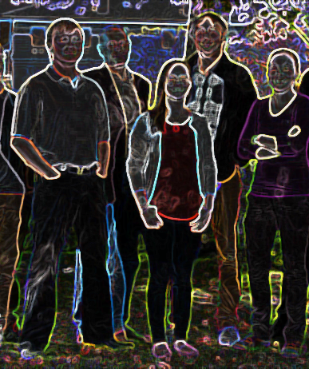
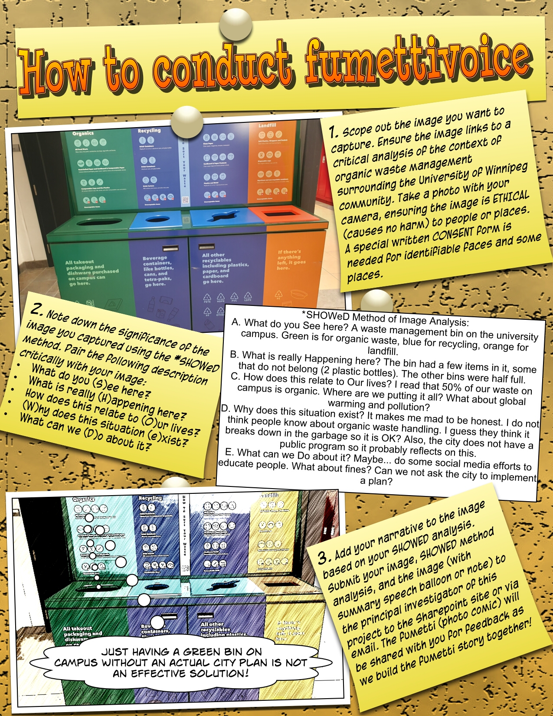
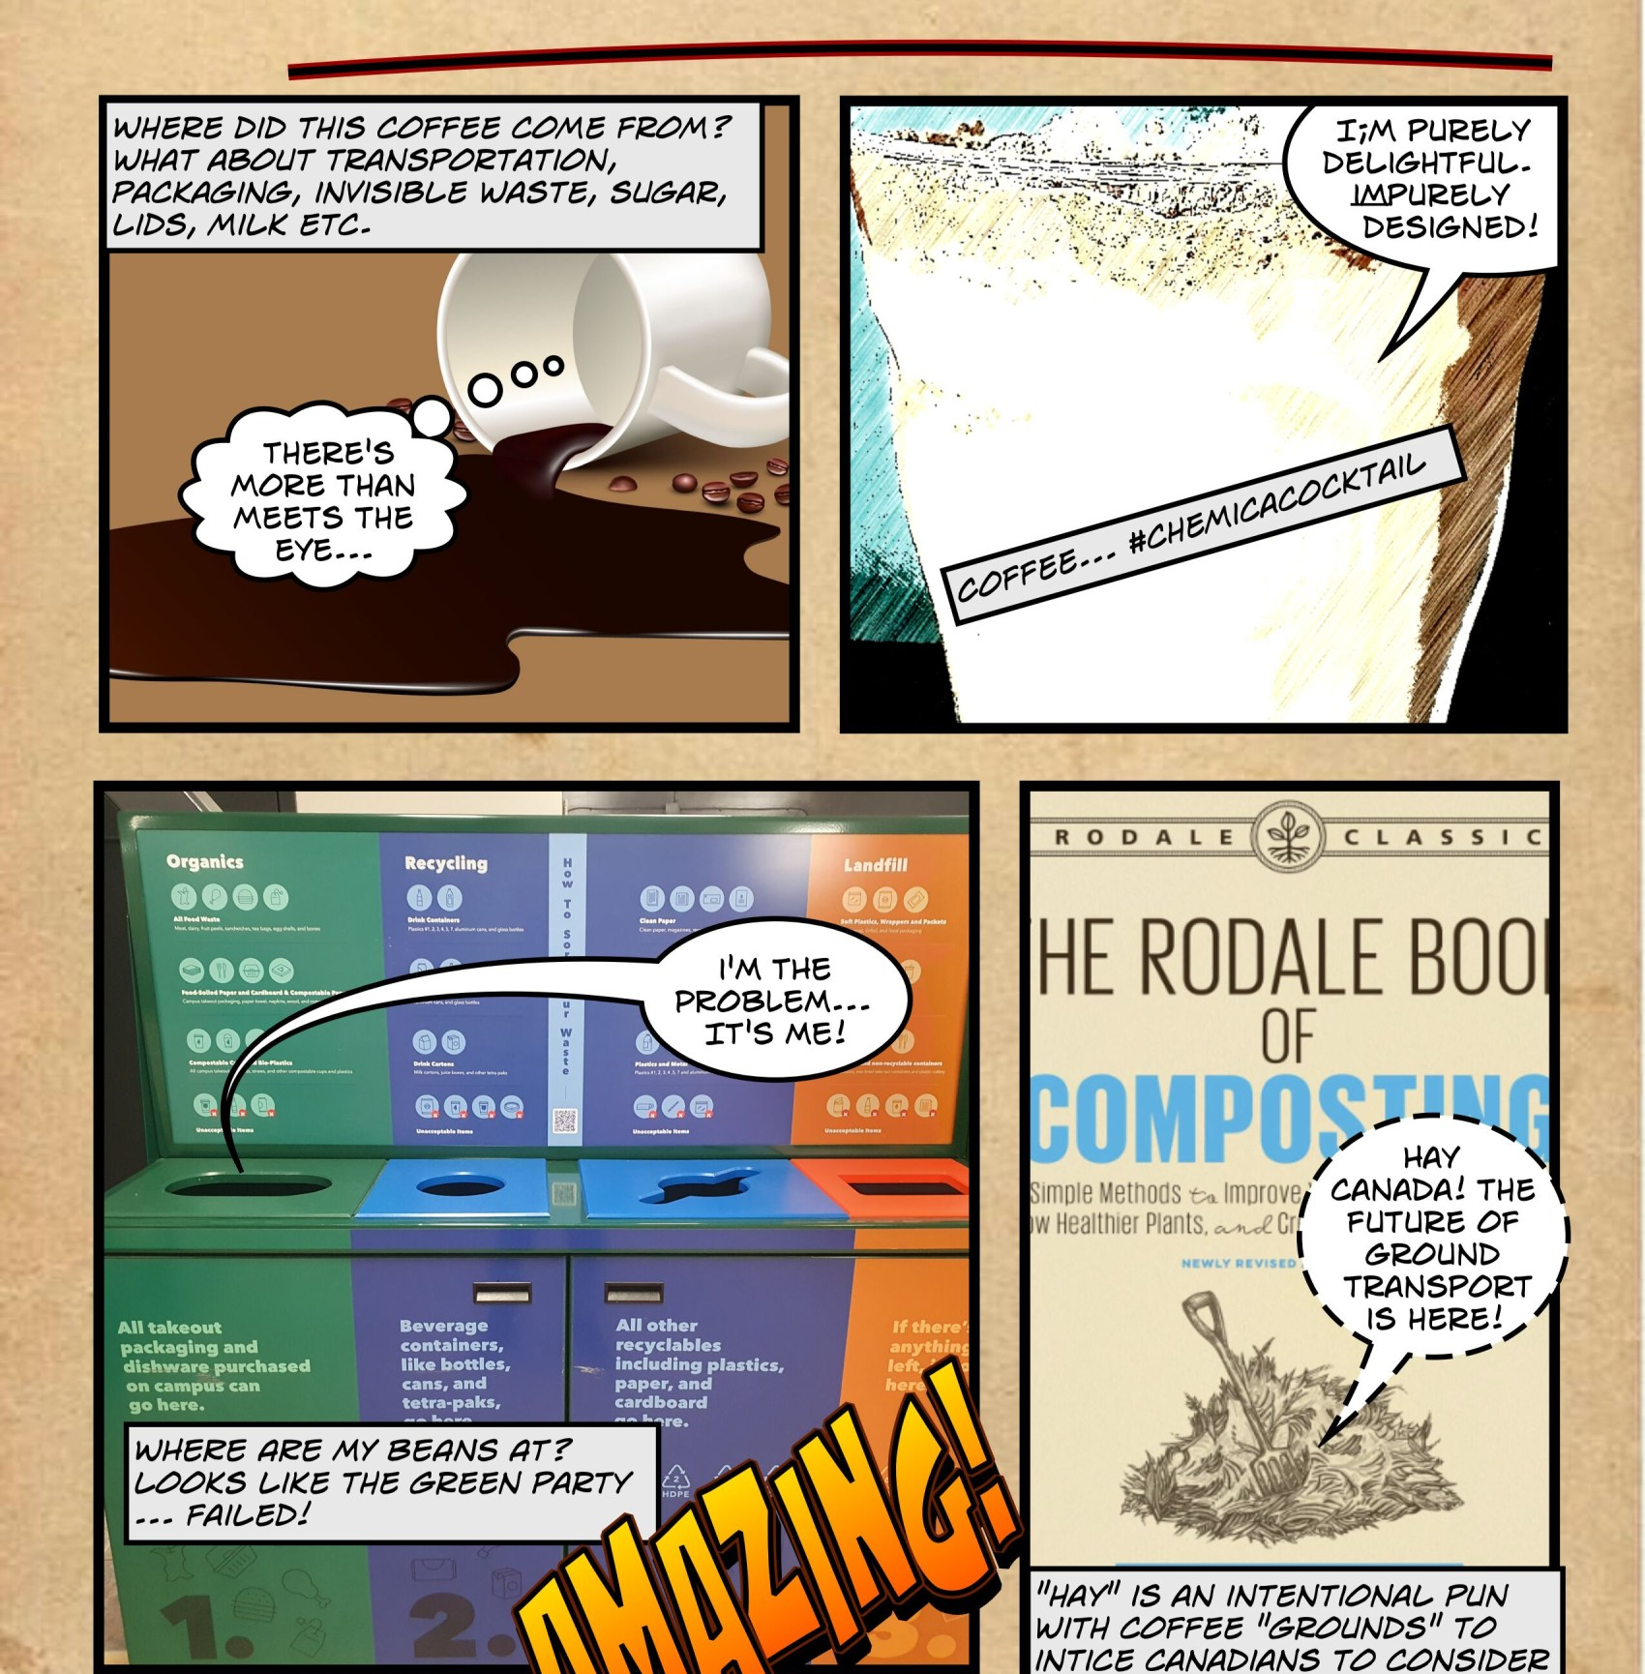
Data Analysis

Slide 27
SHOWeD Method of Image Analysis
What do you See here?
What is really Happening here?
How does this relate to Our lives?
Why does this situation exist?
What can we Do about it?
The SHOWeD method is a structured approach that facilitates discussion and critical analysis of photographs, supporting participants in reflecting on and interpreting images within participatory research settings.
Authored by Wang and Burris (1997) as part of their photovoice research method
Notes:
The SHOWeD method of image analysis was authored by Caroline Wang and Mary Ann Burris. They introduced this technique as part of their development of the photovoice methodology in the 1990s. The SHOWeD method is a structured approach that facilitates discussion and critical analysis of photographs, supporting participants in reflecting on and interpreting images within participatory research settings.

Slide 28

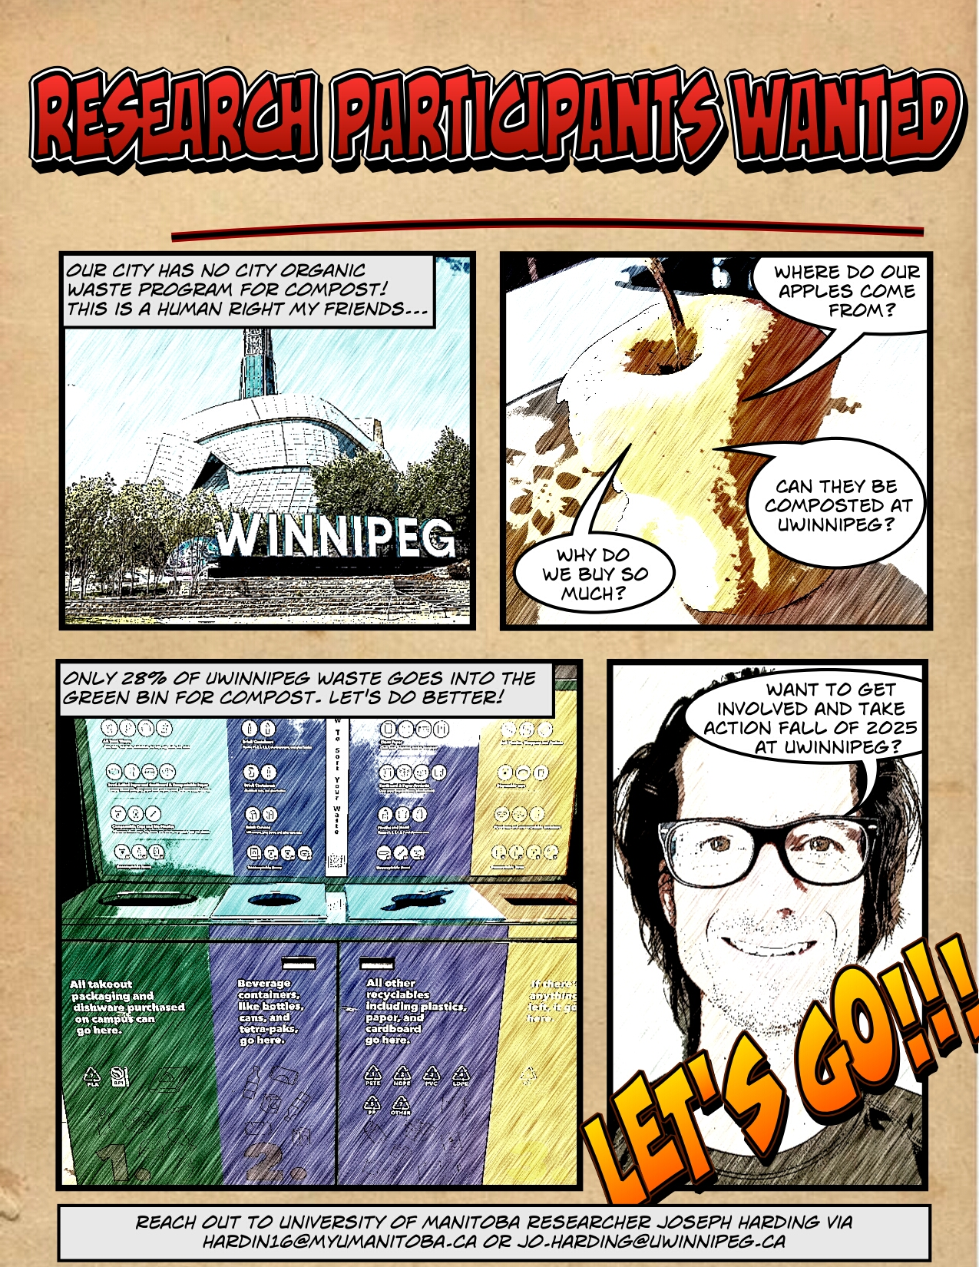

Multimodal Critical Discourse Analysis (MCDA)
MCDA is an “emerging method, grounded in linguistic and visual communication scholarship, of identifying how different modes of communication - text, speech, image, sound - are used to achieve political purposes” (Machin, 2013, as cited in Joy et al., 2024, p. 1)
Memos
As an expansion of Fairclough’s CDA, MCDA’s approach to data analysis broadens the angle on what constitutes discourse (Liu et al., 2024).
Notes:
The project’s data will be analyzed using Multimodal Critical Discourse Analysis (MCDA), an expansion of Fairclough’s (2013) CDA. MCDA is an “emerging method, grounded in linguistic and visual communication scholarship, of identifying how different modes of communication—text, speech, image, sound - are used to achieve political purposes” (Machin, 2013, as cited in Joy et al., 2024, p. 1). MCDA’s approach to data analysis broadens the angle on what constitutes discourse (Liu et al., 2024). The core of the analysis remains CDA, albeit with a more inclusive outlook on data sources, such as fumettivoice, and the final fumetti story.

Slide 29
Research Rigor and Trustworthiness
Elegantly Wasted: an imbalance between nature's ecosystems and human economic growth.
Research Question: “How do community members experience, understand, and document sustainability through their involvement in local waste management initiatives in Winnipeg?”
The Fumetti Story: Ethical, social justice project that is “rigorous, innovative, creative, insightful, useful, beautiful, and perhaps even profound” (Huffman, 2023, p. 91).
Sub Q1. How do participants express and reflect their ecoliteracy and environmental perceptions in the context of sustainable waste management?
Sub Q2. What discourses about the political, social, and ecological dimensions of waste management emerge, and how do these narratives illustrate processes of collective awareness and critical reflection?
Sub Q3. How do participants’ experiences with waste management processes become documented and reinterpreted, and what do these experiences reveal about their understandings of collective responsibility and orientations toward environmental action?
Research methods 1-3.
Data: Images, SHOWeD analysis, Narratives, Fumettivoice.
Data Analysis: Multimodal Critical Discourse Analysis (MCDA).
Research methods 1-3.
Data: Images, SHOWeD analysis, Narratives, Fumettivoice.
Data Analysis: Multimodal Critical Discourse Analysis (MCDA).
Research methods 1-3.
Data: Fumettivoice, Fumetti.
Data Analysis: Multimodal Critical Discourse Analysis (MCDA).
Qualitative studies are often evaluated based on the concepts of trustworthiness and rigor
(albeit contested in academia) in projects to reflect “confidence in its probable success”
(Merriam & Tisdell, 2015, p. 237).
Notes:
Trustworthiness and Rigor. Worthy qualitative research studies differ both philosophically and methodologically from well-established quantitative study evaluation criteria, which emphasize validity and reliability, where measurement is a core component (Yadav, 2022). Qualitative studies are often evaluated based on the concepts of trustworthiness and rigor (albeit contested in academia) in projects to reflect “confidence in its probable success” (Merriam & Tisdell, 2015, p. 237). This means that a study’s calibre is dependent on achieving its objectives within a customized set of evaluation criteria, considering the highest ethical standards possible.
This study aims high, with research objectives within a theoretical framework focused on ecological justice, a bold new research method, and multiple interdisciplinary research methodologies that insist on collaboration with participants. Huffman (2023) encourages researchers in social justice projects, such as community waste management, to be fundamentally ethical towards people, and maintain standards of research scholarship that are “rigorous, innovative, creative, insightful, useful, beautiful, and perhaps even profound” (p. 91).

Slide 30
Ethical Considerations
Research will follow the Canadian TCSP-2 policy.
Ethics review will occur at the University of Manitoba, followed by the University of Winnipeg.
Participants will be at least 18 years old, employed, and not expected to be vulnerable.
Participants will be offered the opportunity to consider consent at all stages of the research.
Ride-along voluntary opportunities will follow an additional consent and safety process.
Anonymity (or lack of) is not expected to impact data analysis.
Basic snacks and non-alcoholic drinks will be provided during the focus group sessions.
Mobile phones/cameras will be provided to participants by the Principal Investigator as required.
The collected participants’ personal information will be minimal (name/email/mobile number).
Photos and narratives will be uploaded to secure University of Manitoba Sharepoint individual folders, then shared following vetting by the principal investigator.
University of Winnipeg mental health support by the Nurse Practitioner will be available as required, as well as stakeholder additional employee assistance program offices. All other emergencies are addressed through 911.
The three participant stakeholder organizations will be briefed regularly.
Risk is considered low due to low/medium identifiable personal information.
Research data will be encrypted and stored per TCPS-2 policy on the University of Manitoba electronic servers for seven years.

Slide 31
Research Timeline
Phase / Activity | Description & Key Tasks | Duration | Timeline
Proposal & REB Ethics Approval | Submit proposal to REB for review and approval; incorporate feedback and finalize consent materials and participant forms. | 4 weeks | 28 Oct to 26 Nov 2025
Participant Recruitment | Recruit participants, distribute information letters, and obtain informed consent. | 4 weeks | 26 Nov 2025 to 6 Jan 2026
Participant Orientation | Conduct orientation and introduce research procedures (e.g., photovoice framework, expectations, and timelines). | 1 week | 6-10 Jan 2026
Data Collection & Initial Analysis | Conduct photovoice sessions, focus groups, and initial coding using MAXQDA or NVivo to organize visual and textual data. | 13 weeks | Jan–Apr 2026
Multimodal Critical Discourse Analysis (MCDA) | Perform integrated analysis of visual, textual, and contextual findings using MCDA. | 8 weeks | May–Jun 2026
Drafting Dissertation Chapters 4 & 5 | Draft findings and discussion chapters, connecting multimodal results to theory and literature. | 8 weeks | Jul–Aug 2026
Advisor Review | Incorporate advisor feedback on analytical depth, clarity, and coherence. | 6 weeks | Sep-Oct 2026
Committee Review (Round 1) | Submit full draft to committee members for feedback. | 30 days | Nov 2026
External Reviewer | Submit revised dissertation to external evaluator and address major revisions. | 30 days | Dec 2026 to Jan 2027

Slide 32
Research Timeline
Phase / Activity | Description & Key Tasks | Duration | Timeline
Committee Review (Round 2) | Receive and address committee feedback to refine final draft. | 30 days | Feb 2027
External Reviewer | Submit revised dissertation to external evaluator and address major revisions. | 30 days | Mar 2027
Committee Review (Final) | Final review and approval before defence scheduling. | 30 days | Apr-May 2027
Defence Rehearsals | Prepare presentation and defence responses with mock sessions. | 2 weeks | May-Jun 2027
Dissertation Defence | Conduct formal defence before the committee and external examiner. | 1 week | Jun 2027
Knowledge Mobilization | Share outcomes through community events, publications, or conferences (can overlap with final review or post-defence). | 60 days (concurrent) | Jun 2026 to Oct 2027

Slide 33

Conclusion
Elegantly Wasted captures the paradox of being aware of environmental destruction yet failing to act, a theme central to this research on waste management.
This study can advance participatory and visual qualitative methods, generating educational and policy-relevant insights for campus sustainability, while empowering community voices in environmental action.
Image licensed by Shutterstock to Joseph Harding, 2022
Notes:
Winnipeg can consider the metaphor of being elegantly wasted. ‘Elegantly wasted' captures the paradox of being aware of environmental destruction yet failing to act, a theme central to this research on waste management. The city has sufficient knowledge and talent to enhance sustainability while challenging dominant, unsustainable environmental agenda patterns, such as blindly following the Sustainable Development Goals. This study aims to answer the following research question: “How do community members experience, understand, and document sustainability through their involvement in local waste management initiatives in Winnipeg?” *The answer rests somewhere in the messy portion as participants explore and document this wicked problem.
This study can advance participatory and visual qualitative methods, generating educational and policy-relevant insights for campus sustainability, while empowering community voices in environmental action.

Slide 34
References
Bainbridge, A. (2020). Digging our own grave: A Marxian consideration of formal education as a destructive enterprise. International Review of Education, 66(5), 737–753. https://doi.org/10.1007/s11159-020-09866-7
Bodziński-Guzik, B., & Stożek, R. (2024). Exploring the relationship between legislative theatre and critical participatory action research. Educational Action Research, 1–14. https://doi.org/10.1080/09650792.2024.2332435
Brundtland, G. H. (1987). Our common future. Oxford University Press. https://www.jstor.org/stable/44518052
Callahan, J. L. (2014). Writing Literature Reviews: A Reprise and Update. Human Resource Development Review, 13(3), 271–275. https://doi.org/10.1177/1534484314536705
Comberiati, D., & Spadaro, B. (2023). Introduction: Transnational Italian comics: Memory, migration, transformation. Journal of Graphic Novels and Comics, 14(4), 489–501. https://doi.org/10.1080/21504857.2023.2239334
Daigneault, T. (2024, November 6). Food waste drop-off sites now in operation. Our Communities. https://www.winnipegfreepress.com/our-communities/correspondents/2024/11/06/food-waste-drop-off-sites-now-in-operation
de Pencier, N., Burtynsky, E., & Baichwal, J. (2023). The Anthropocene Project. https://theanthropocene.org/
EWSWA. (2025). Green Bin Program, Essex-Windsor, Ontario. Essex-Windsor Solid Waste Authority (EWSWA). https://www.ewswa.org/
Fairclough, N. (2013). Critical discourse analysis: The critical study of language. Routledge. https://doi.org/10.4324/9781315834368
Fine, M., & Torre, M. E. (2021). Essentials of critical participatory action research. (pp. x, 118). American Psychological Association. https://doi.org/10.1037/0000241-000

Slide 35
References
Gadotti, M. (2011). Adult education as a human right: The Latin American context and the ecopedagogic perspective. International Review of Education, 57(1), 9–25. https://doi.org/10.1007/s11159-011-9205-0
Giurea, R., Carnevale Miino, M., Torretta, V., & Rada, E. C. (2024). Approaching sustainability and circularity along waste management systems in universities: An overview and proposal of good practices. Frontiers in Environmental Science, 12. https://doi.org/10.3389/fenvs.2024.1363024
HDR Corporation. (2023). Winnipeg Organics Planning Study – Executive Summary Consolidated Recommendations. https://clkapps.winnipeg.ca/DMIS/ViewDoc.asp?DocId=23988&SectionId=701707&InitUrl=
Huffman, T. (2023). Qualitative inquiry for social justice. Routledge. https://doi.org/10.4324/9781003107552
Joy, P., Hammond, B., Hammond, C., Bonardi, O., Wassef, K., & Ferlatte, O. (2024). Pulling at All Threads: Reflections on Using Multimodal Critical Discourse Analysis Within Arts-Based Health Research. Qualitative Health Research, 10497323241307893. https://doi.org/10.1177/10497323241307893
Leavy, P. (2020). Method meets art: Arts-based research practice. Guilford publications. https://www.guilford.com/books/Method-Meets-Art/Patricia-Leavy/9781462538973

Slide 36
References
Liu, H., Liu, L., & Li, H. (2024). Multimodal Discourse Studies in the International Academic Community (1997–2023): A Bibliometric Analysis. Sage Open, 14(4), 21582440241305454. https://doi.org/10.1177/21582440241305454
Merriam, S. B., & Tisdell, E. J. (2015). Qualitative research: A guide to design and implementation. John Wiley & Sons. https://download.e-bookshelf.de/download/0003/7195/84/L-G-0003719584-0007575839.pdf
Morris, J. E., & Paris, L. F. (2022). Rethinking arts-based research methods in education: Enhanced participant engagement processes to increase research credibility and knowledge translation. International Journal of Research & Method in Education, 45(1), 99–112. https://doi.org/10.1080/1743727X.2021.1926971
Pollock, D. C., Van Reken, R. E., & Pollock, M. V. (2017). Third Culture Kids: The experience of growing up among worlds: The original, classic book on TCKs (3rd ed.). Hachette UK. https://www.amazon.ca/Third-Culture-Kids-3rd-Growing/dp/1473657660
UNEP. (2022, October 18). What’s the deal with methane? https://www.unep.org/news-and-stories/video/whats-deal-methane
UNEP. (2024). Global Waste Management Outlook 2024 | UNEP - UN Environment Programme. https://www.unep.org/resources/global-waste-management-outlook-2024
Wang, C., & Burris, M. A. (1997). Photovoice: Concept, methodology, and use for participatory needs assessment. Health Education & Behavior, 24(3), 369–387. https://doi.org/10.1177/109019819702400309

Slide 37
Gratitude
Dr. Bruno de Oliveira Jayme (advisor), Faculty of Education [guarda avançada / advance guard]
Dr. Beryl Peters, Faculty of Education [Trustworthiness]
Dr. Dawn Sutherland, Faculty of Education [Insightfulness]
Dr. Thomas Falkenberg, Faculty of Education [EDUC 7050 (A) PhD Professor #1 – ontology, epistemology?]
Dr. Michelle Honeyford, Faculty of Education [EDUC 7050 (B) PhD Professor #2 - fumettivoice]
Dr. Andrea Charron, Centre for Defence and Security Studies [mentor]
Dr. Robert Sarfi, Boreas Group [mentor]
Thomas Chaput [mentor]
Kevin Lopuck and Jenny Wright [Beer & Wings cohort]
Compost Winnipeg, University of Winnipeg, City of Winnipeg, Manitoba Association of Regional Recyclers [keeping it real]
Sharlene and my crew [xoxo]

Slide 38

Questions / Comments
Photo by Joseph Harding, 2024

Slide 39

Supplementary Information

Slide 40
Research Sub-questions
How do participants express and reflect their ecoliteracy and environmental perceptions in the context of sustainable waste management?
What discourses about the political, social, and ecological dimensions of waste management emerge, and how do these narratives illustrate processes of collective awareness and critical reflection?
How do participants’ experiences with waste management processes become documented and reinterpreted, and what do these experiences reveal about their understandings of collective responsibility and orientations toward environmental action?

Slide 41
Research Objectives
Objective 1. To explore how participants express and reflect their ecoliteracy and environmental perceptions through documented fumettivoice narratives in the context of sustainable waste management.
Objective 2. To analyze the discourses emerging in participants' fumetti regarding the political, social, and ecological dimensions of waste management and how these narratives illustrate processes of collective awareness and critical reflection.
Objective 3. To investigate how participants document and reinterpret their experiences of ride-alongs with waste management processes through fumettivoice, and to reveal their understandings of collective responsibility and environmental action orientations.

Slide 42
Fumettivoice Process
A. Photography Basics
B. Ethics & Consent
C. Project Expectations
1. Capture the Experience (Photo and Narrative)
2. Document the Meaning (SHOWeD Method)
3. Create the Fumetti Story
Training
Conduct
Notes:
Conduct training sessions covering: The basics of photography, Research ethics and obtaining consent for photos, The purpose and expectations of the project.
Photo-Discussion Sessions: Facilitate group workshops where participants present their photos and share stories or interpretations behind them. Use structured prompts, such as the SHOWeD method, participants will do a visual analysis of their own images TO DEVELOP deeper narratives that will develop into fumetti (i.e. fumettivoice):
What do you See here?
What is really Happening here?
How does this relate to Our lives?
Why does this situation exist?
What can we Do about it?

Slide 43
Fumettivoice – participant instructions example

Slide 44
Focus Groups 1A & 1B – From Images & Narratives to Themes
(two three-hour sessions)
Focus Groups 2A & 2B – From Themes to Fumetti
(two three-hour sessions)
Share fumetti art
Share photos and narratives
Discuss initial themes
Critically discuss key themes
Develop fumetti story
Create fumetti art and storyboard
Focus Group Sessions
Notes:
The SHOWed method of image analysis was authored by Caroline Wang and Mary Ann Burris. They introduced this technique as part of their development of the photovoice methodology in the 1990s. The SHOWed method is a structured approach that facilitates discussion and critical analysis of photographs, supporting participants in reflecting on and interpreting images within participatory research settings.
Photo-Discussion Sessions: Facilitate group workshops where participants present their photos and share stories or interpretations behind them. Use structured prompts, such as the SHOWED method, participants will do a visual analysis of their own images TO DEVELOP deeper narratives that will develop into fumetti (i.e. fumettivoice):
What do you See here?
What is really Happening here?
How does this relate to Our lives?
Why does this situation exist?
What can we Do about it?

Slide 45
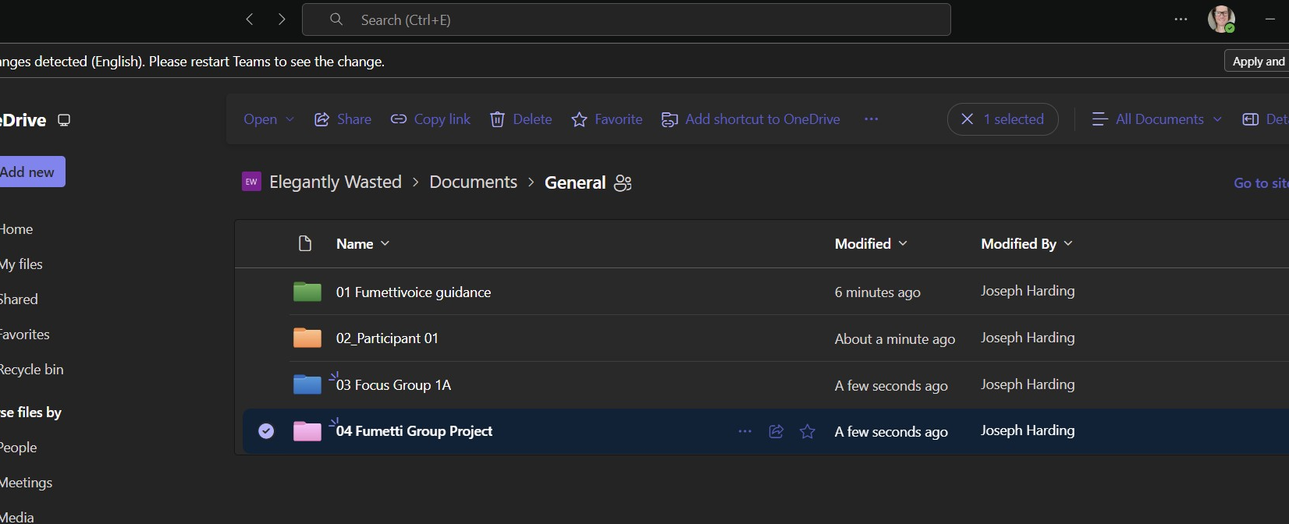
Data Management:
Key Features
University of Manitoba MS Teams protected folder as central repository
Restricted access to individual folders for participants
Group access folders for focus groups
Group access folder for final fumetti photo comic story
Ability to remove data from withdrawn participants
Encryption and storage post study for seven years

Slide 46
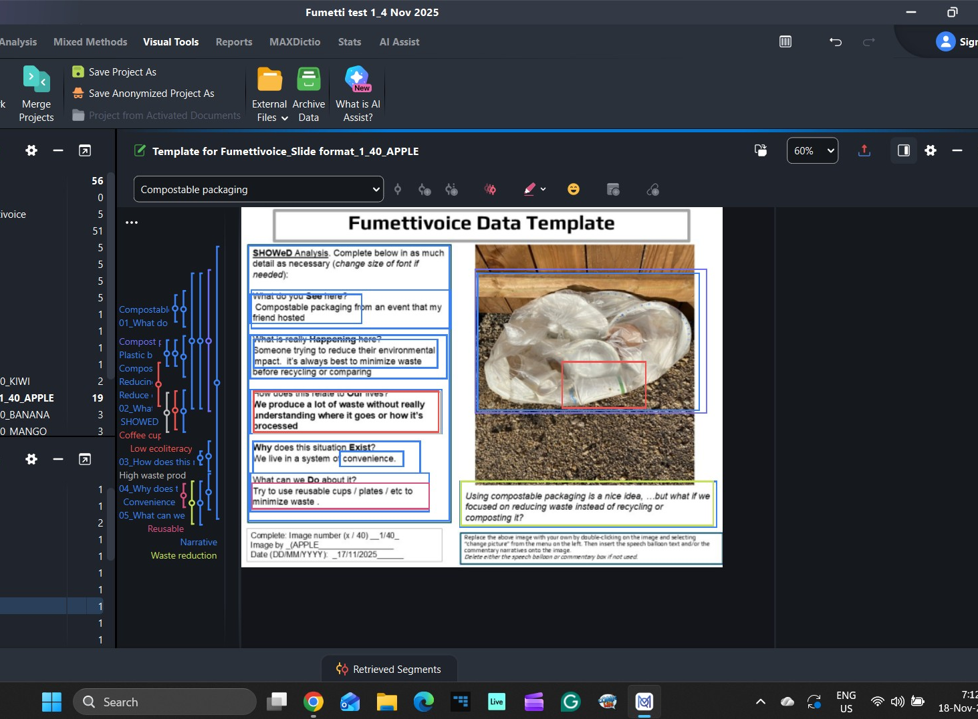
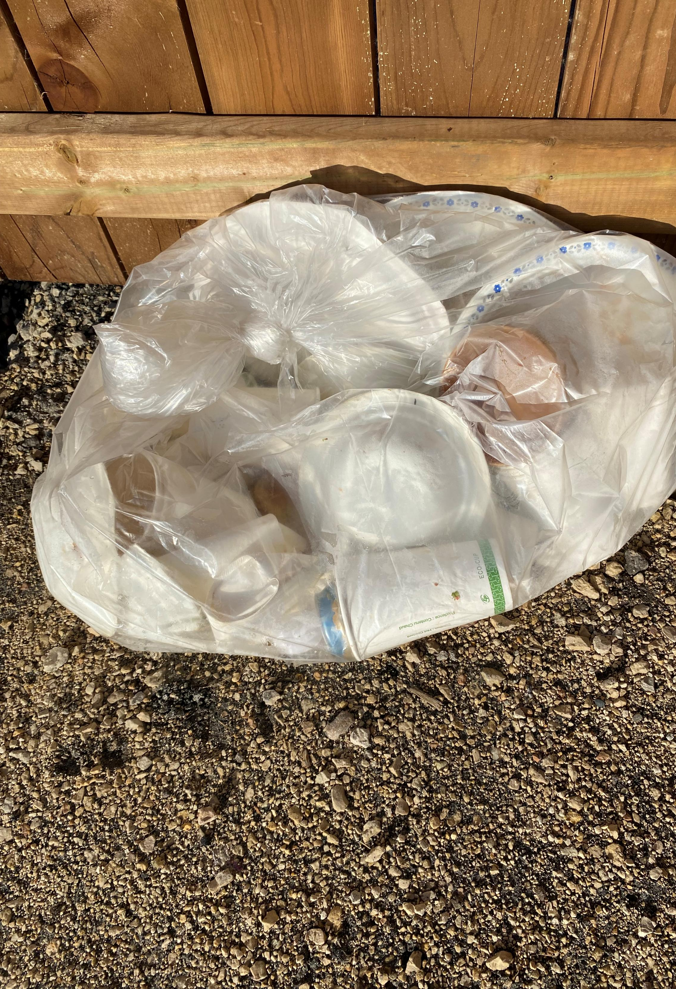
Data Analysis Software – MAXQDA [https://www.maxqda.com]
Threat Risk Assessment completed by the University of Manitoba, Information Security & Compliance, 18 Nov 2025

Slide 47
Elegantly Wasted: Documenting Community Experiences of
Sustainable Waste Management in Winnipeg
Wicked Problem: an imbalance between nature's ecosystems and human economic growth.
Research Question: “How do community members experience, understand, and document sustainability through their involvement in local waste management initiatives in Winnipeg?”
The Fumetti (Photocomic) Story: Ethical, social justice project that is “rigorous, innovative, creative, insightful, useful, beautiful, and perhaps even profound” (Huffman, 2023, p. 91).
Sub Q1. How do participants express and reflect their ecoliteracy and environmental perceptions in the context of sustainable waste management?
Sub Q2. What discourses about the political, social, and ecological dimensions of waste management emerge, and how do these narratives illustrate processes of collective awareness and critical reflection?
Sub Q3. How do participants’ experiences with waste management processes become documented and reinterpreted, and what do these experiences reveal about their understandings of collective responsibility and orientations toward environmental action?
Research methods 1-3.
Data: Images, SHOWeD analysis, Narratives, Fumettivoice.
Data Analysis: Multimodal Critical Discourse Analysis (MCDA).
Research methods 1-3.
Data: Images, SHOWeD analysis, Narratives, Fumettivoice.
Data Analysis: Multimodal Critical Discourse Analysis (MCDA).
Research methods 1-3.
Data: Fumettivoice, Fumetti.
Data Analysis: Multimodal Critical Discourse Analysis (MCDA).
Qualitative studies are often evaluated based on the concepts of trustworthiness and rigor (albeit contested in academia) in projects to reflect “confidence in its probable success” (Merriam & Tisdell, 2015, p. 237).
Notes:
Trustworthiness and Rigor. Worthy qualitative research studies differ both philosophically and methodologically from well-established quantitative study evaluation criteria, which emphasize validity and reliability, where measurement is a core component (Yadav, 2022). Qualitative studies are often evaluated based on the concepts of trustworthiness and rigor (albeit contested in academia) in projects to reflect “confidence in its probable success” (Merriam & Tisdell, 2015, p. 237). This means that a study’s calibre is dependent on achieving its objectives within a customized set of evaluation criteria, considering the highest ethical standards possible.
This study aims high, with research objectives within a theoretical framework focused on ecological justice, a bold new research method, and multiple interdisciplinary research methodologies that insist on collaboration with participants. Huffman (2023) encourages researchers in social justice projects, such as community waste management, to be fundamentally ethical towards people, and maintain standards of research scholarship that are “rigorous, innovative, creative, insightful, useful, beautiful, and perhaps even profound” (p. 91).

