Slide 1

Elegantly Wasted: Documenting Community Experiences of Sustainable Waste Management in Winnipeg
Findings
Joseph Harding, Lieutenant-Colonel (retired), Canadian Decoration (CD)
PhD Candidate, Faculty of Education
University of Manitoba
Notes:
This PhD research proposal "Elegantly Wasted: Documenting Community Experiences of Sustainable Waste Management in Winnipeg" articulates a complex, wicked problem linking local sustainable waste management with global frameworks. It incorporates innovative
arts-based and critical participatory action research methodologies, guided by the theoretical framework of ecopedagogy.

Slide 2
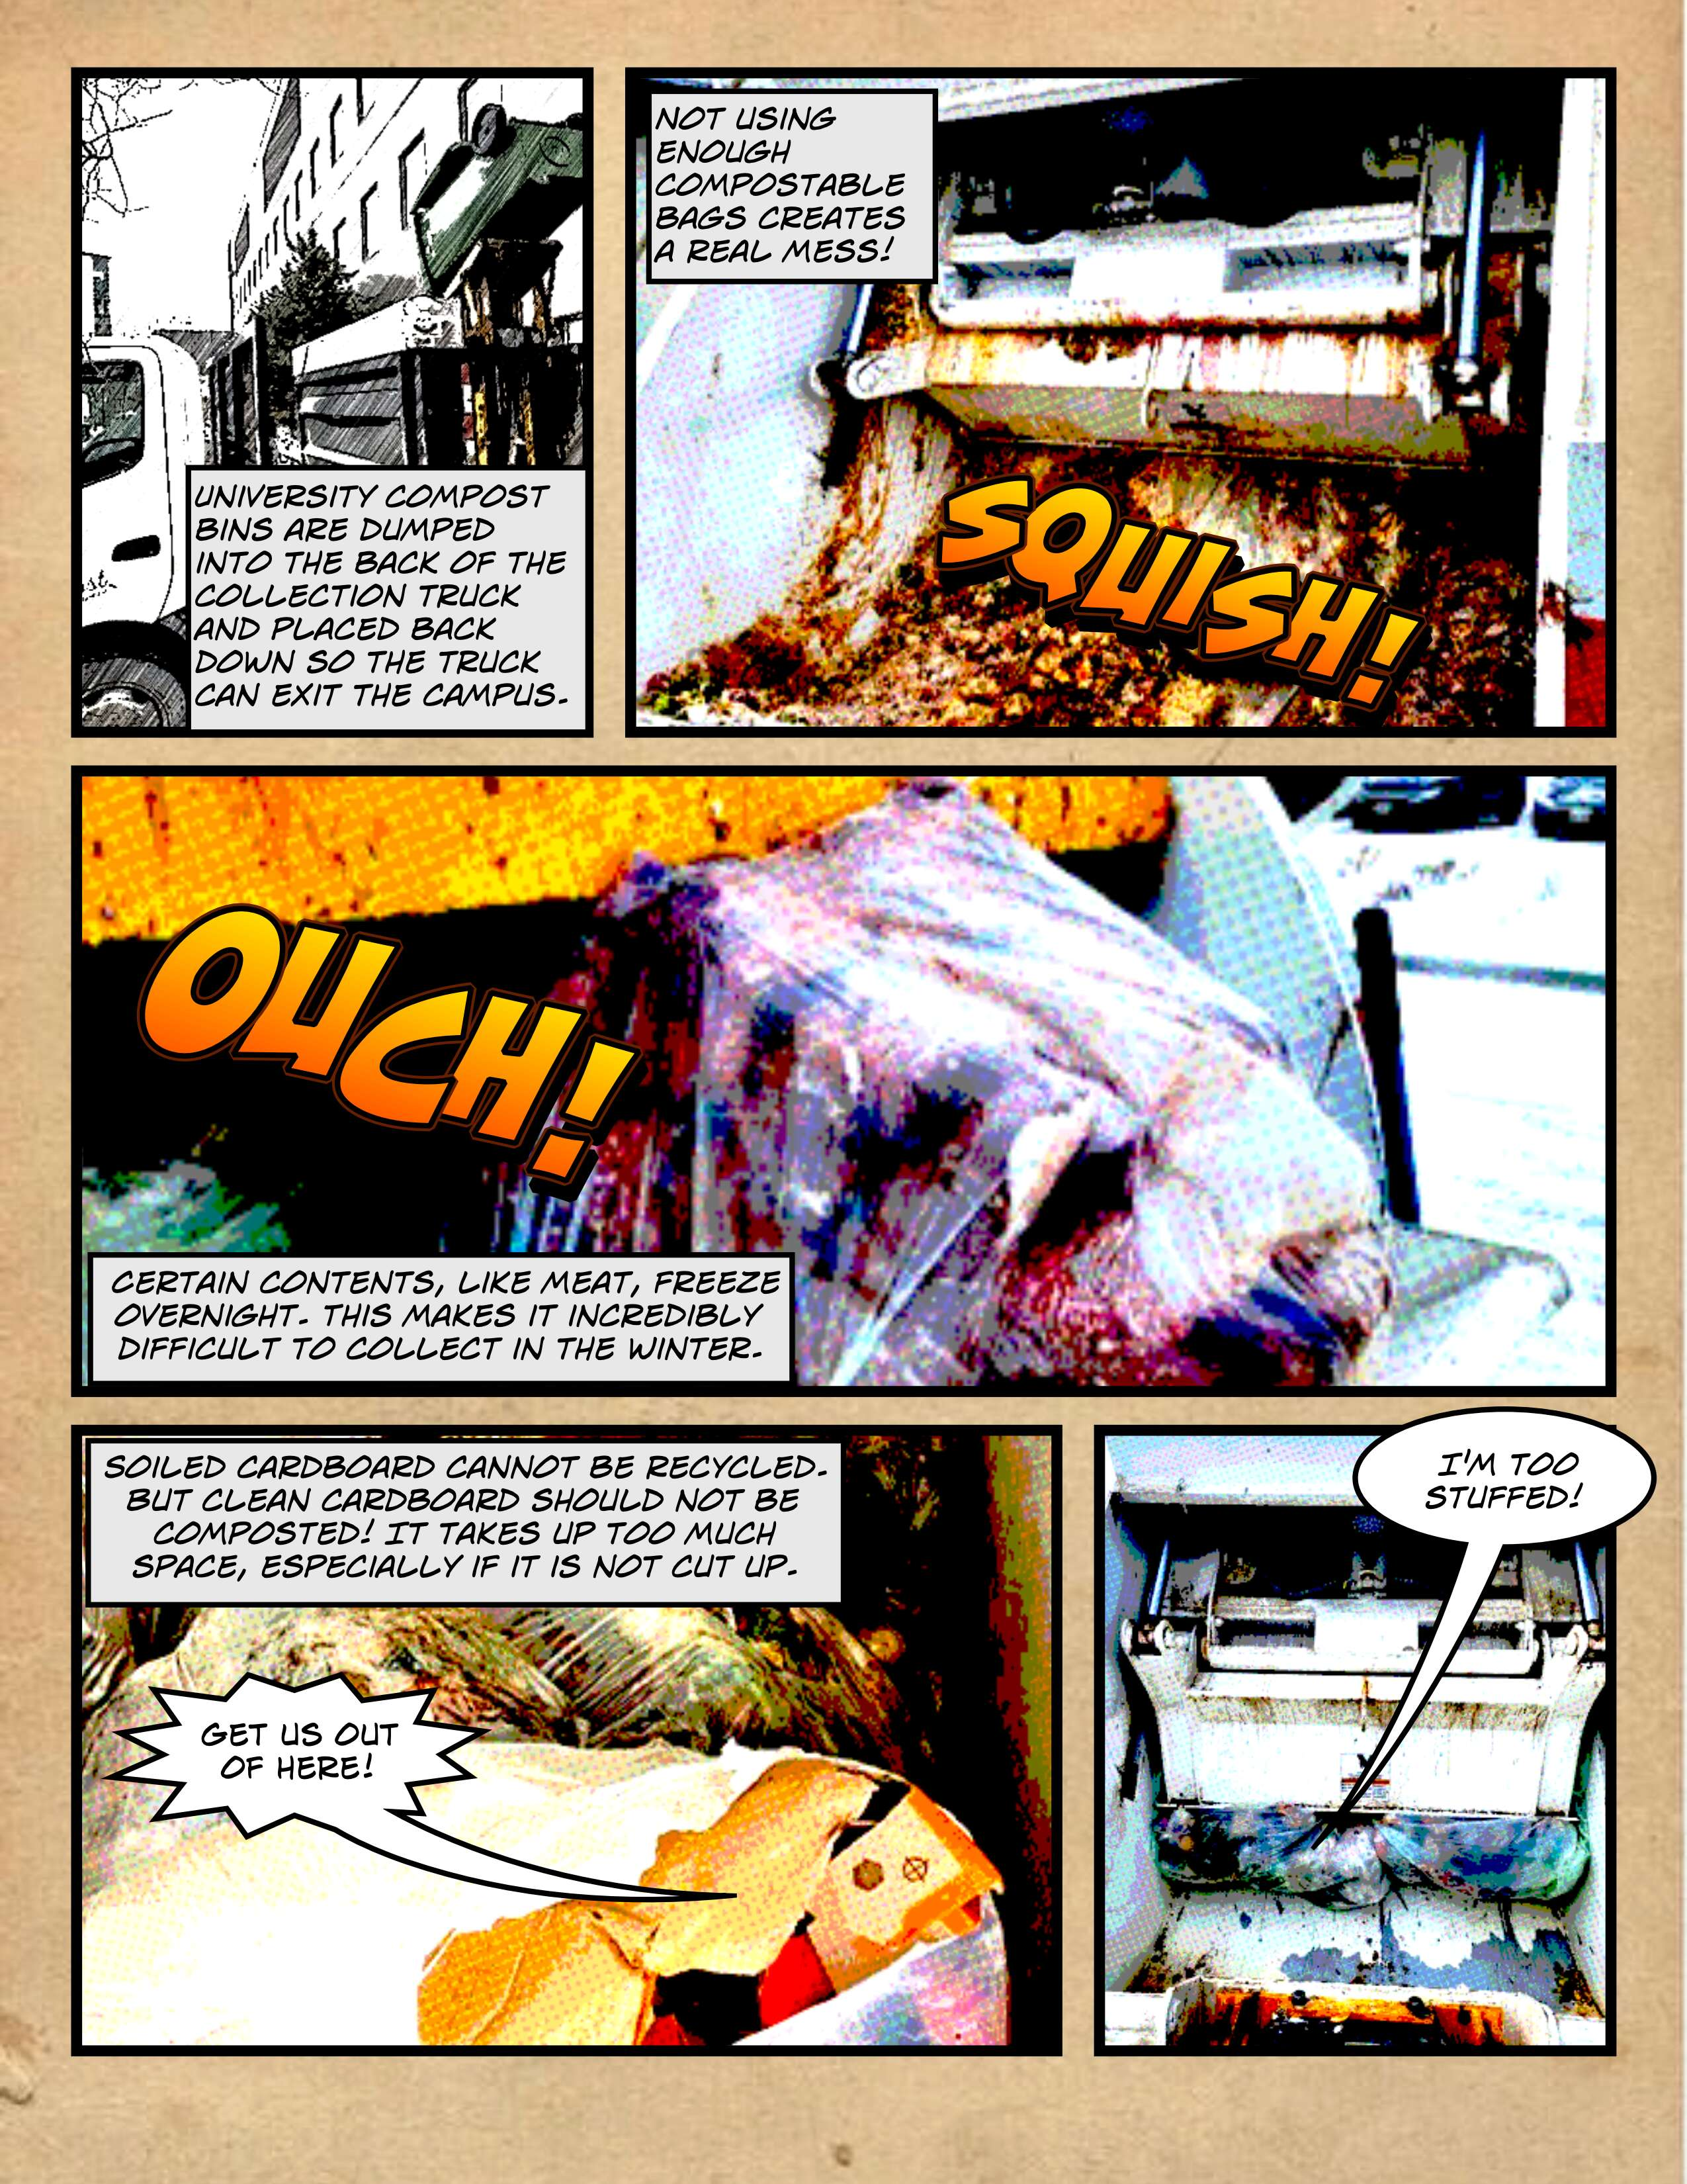
Findings

Slide 3
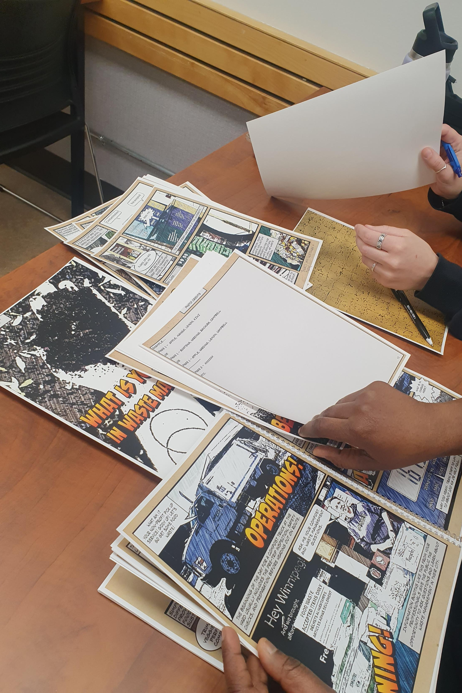
Research Question
“How do community members experience, understand, and document sustainability through their involvement in local waste management initiatives in Winnipeg?”

Slide 4
Research Sub-questions
How do participants express and reflect their ecoliteracy and environmental perceptions in the context of sustainable waste management?
What discourses about the political, social, and ecological dimensions of waste management emerge, and how do these narratives illustrate processes of collective awareness and critical reflection?
How do participants’ experiences with waste management processes become documented and reinterpreted, and what do these experiences reveal about their understandings of collective responsibility and orientations toward environmental action?

Slide 5
Project Outcomes (Purpose)
document collective responsibility related to sustainable waste management;
democratize knowledge production through visual storytelling; and
generate educational insights for campus sustainability.

Slide 6
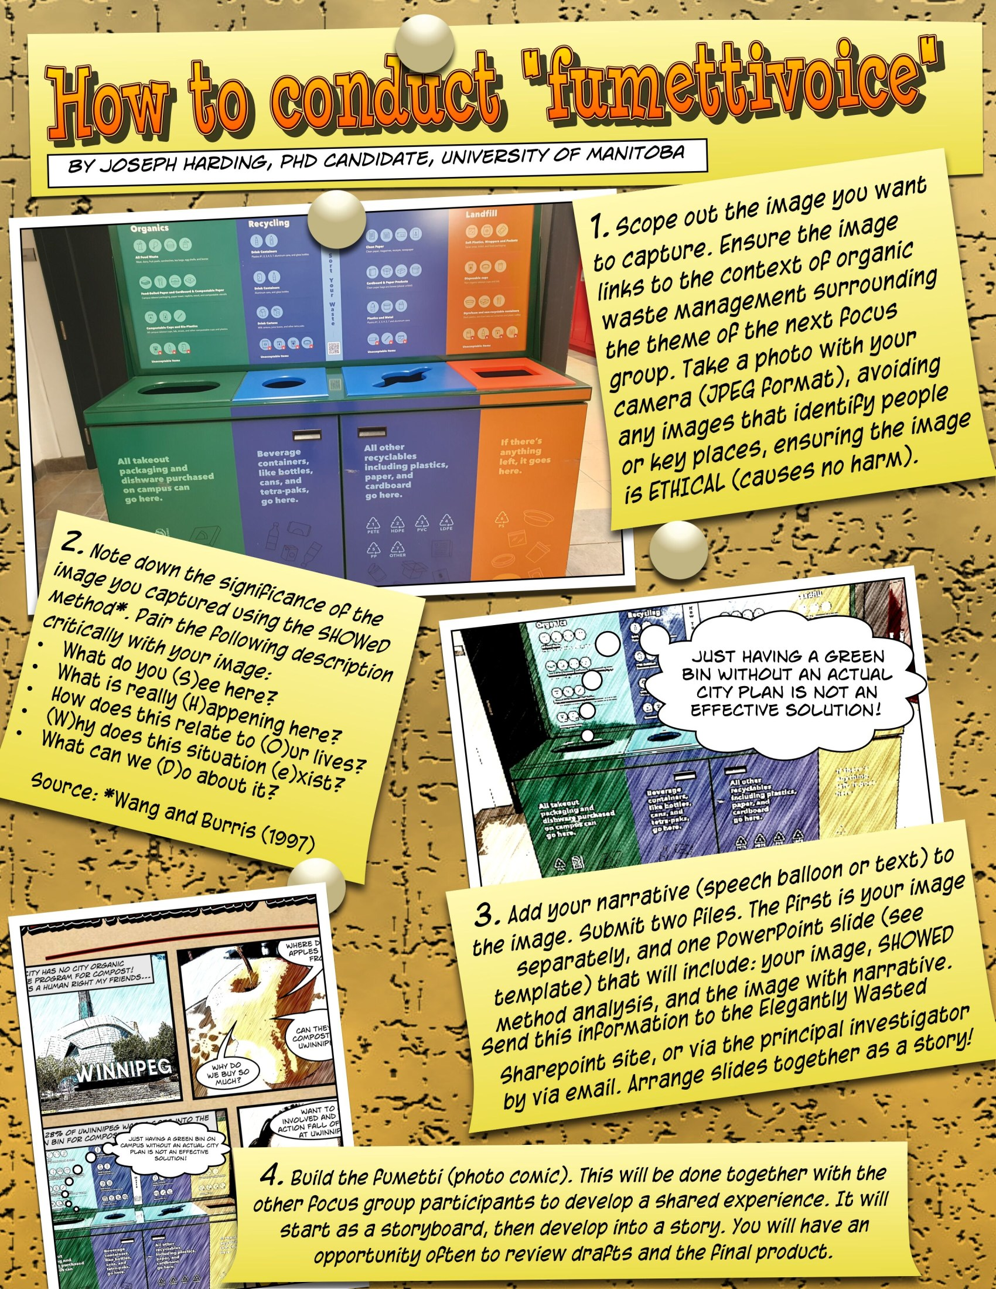
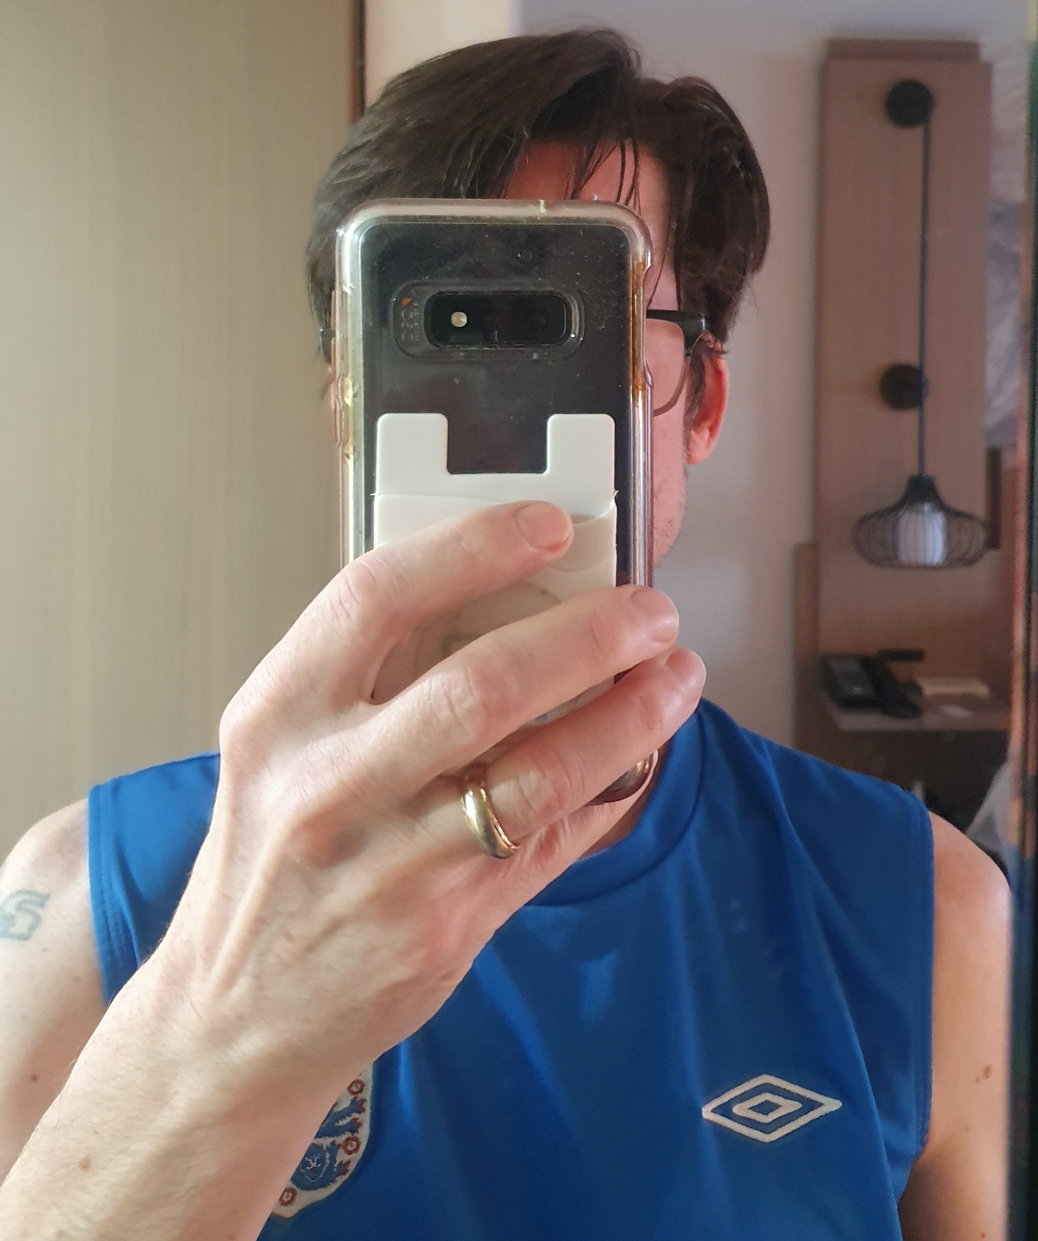
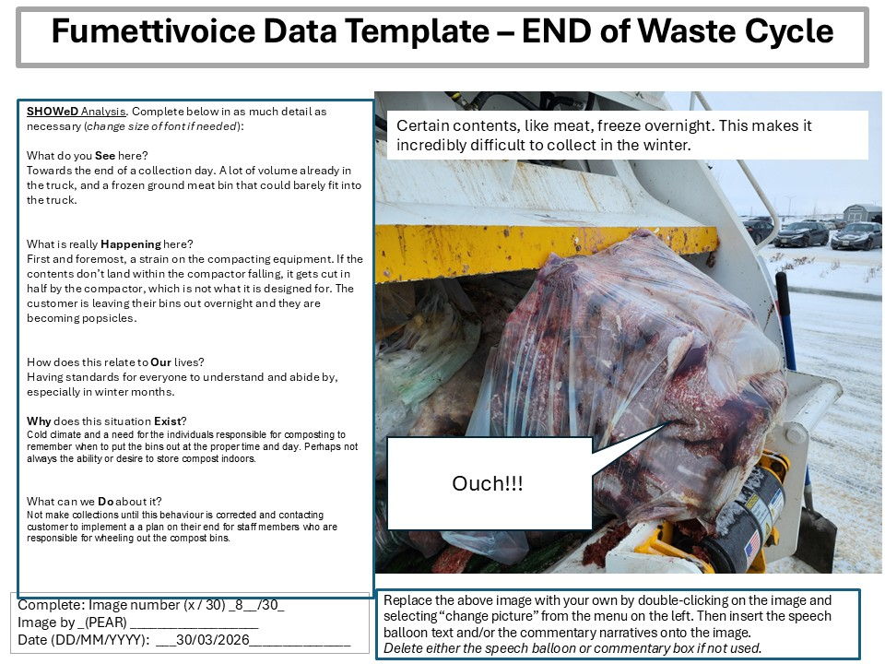
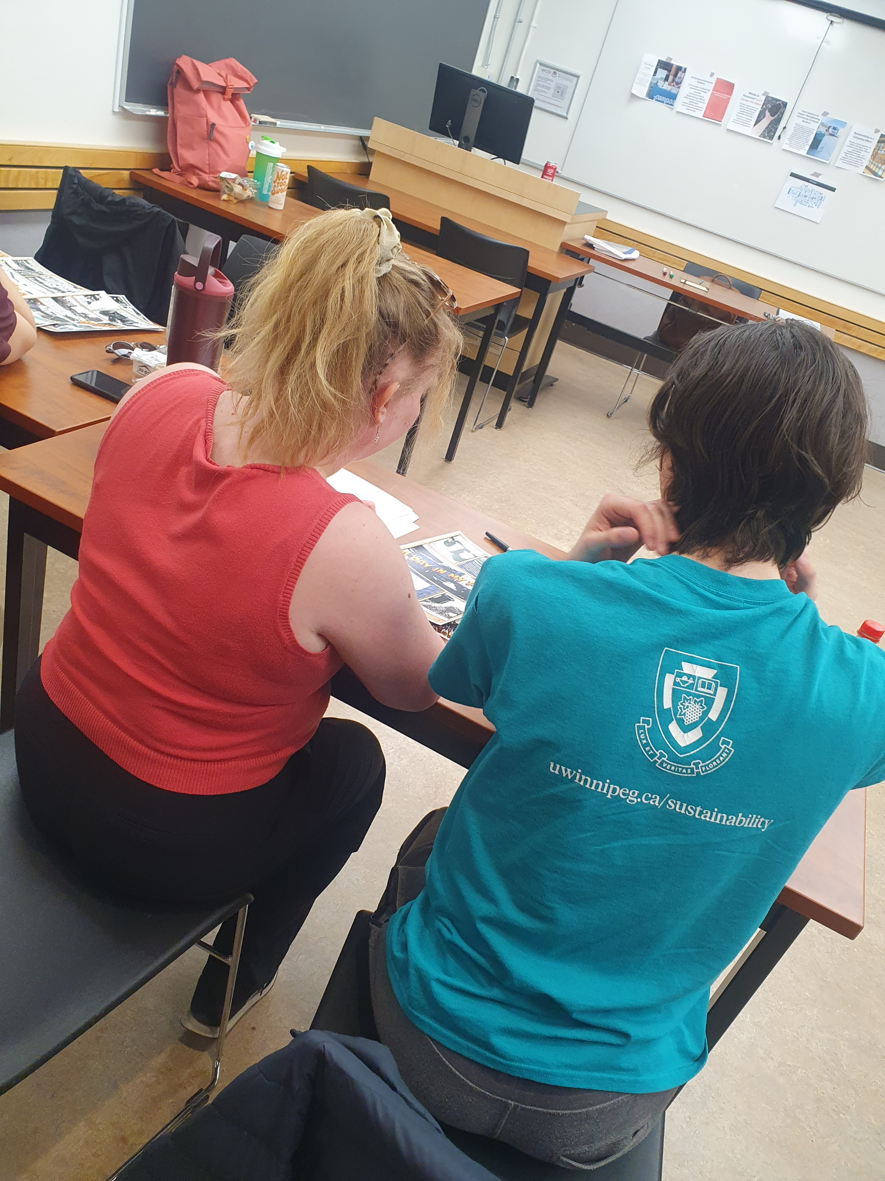
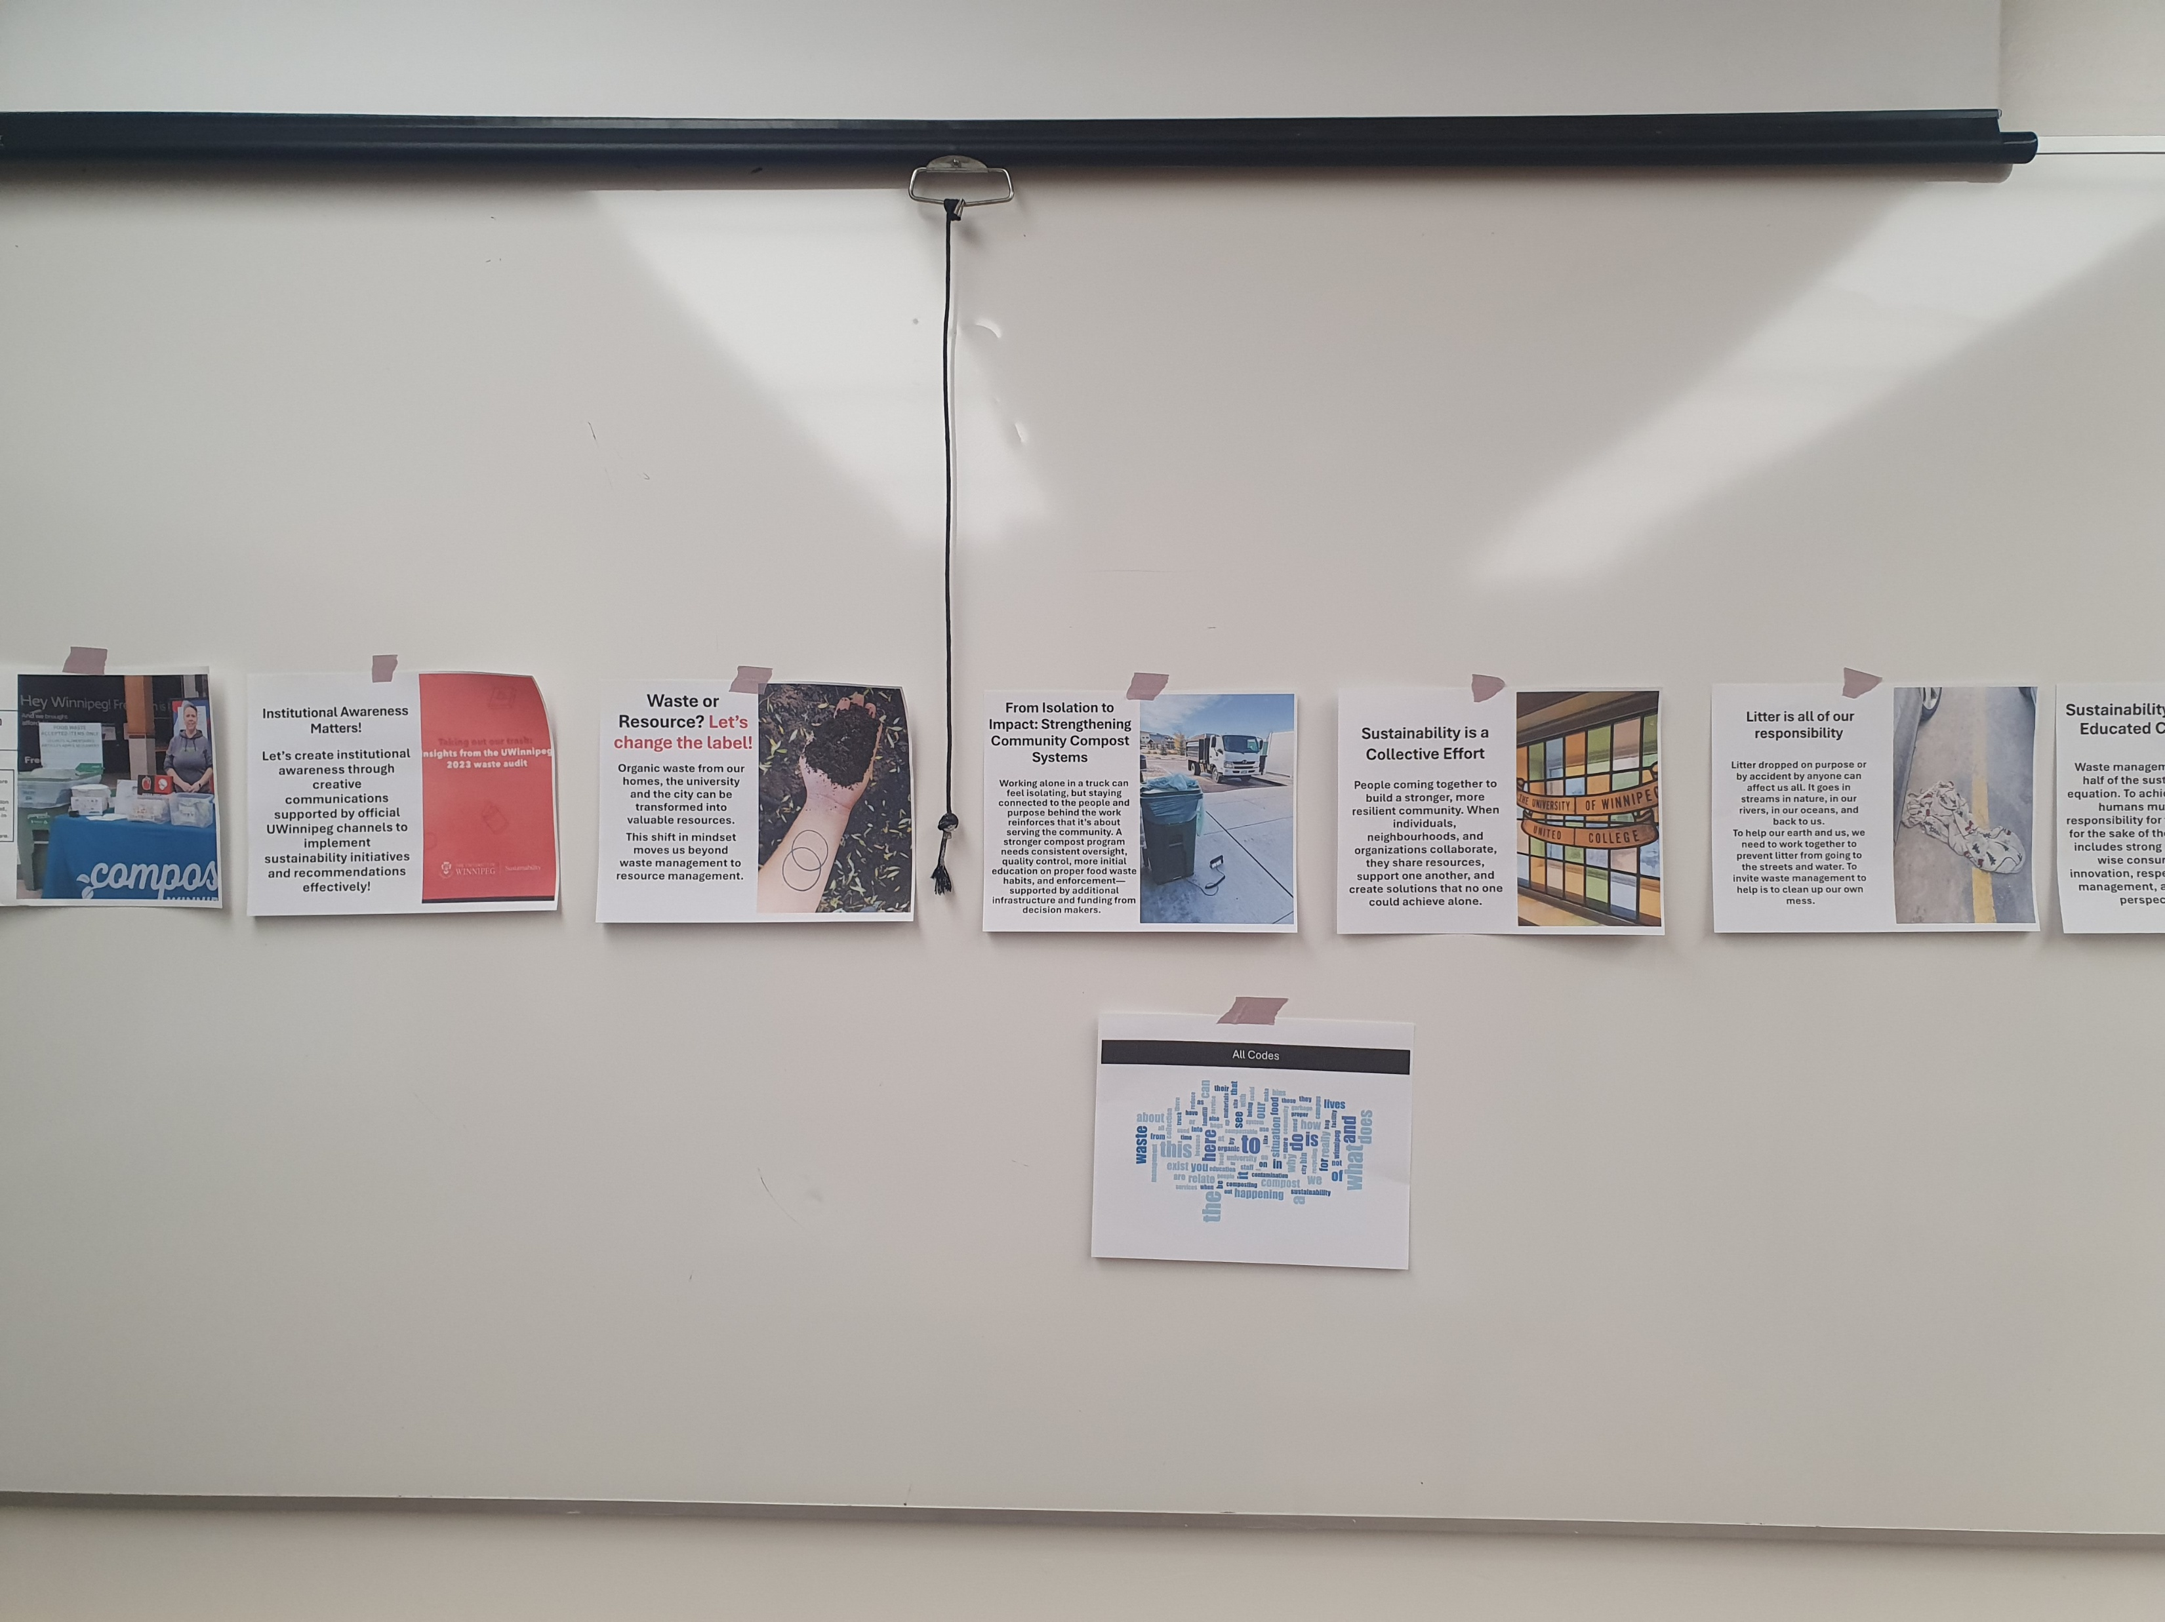
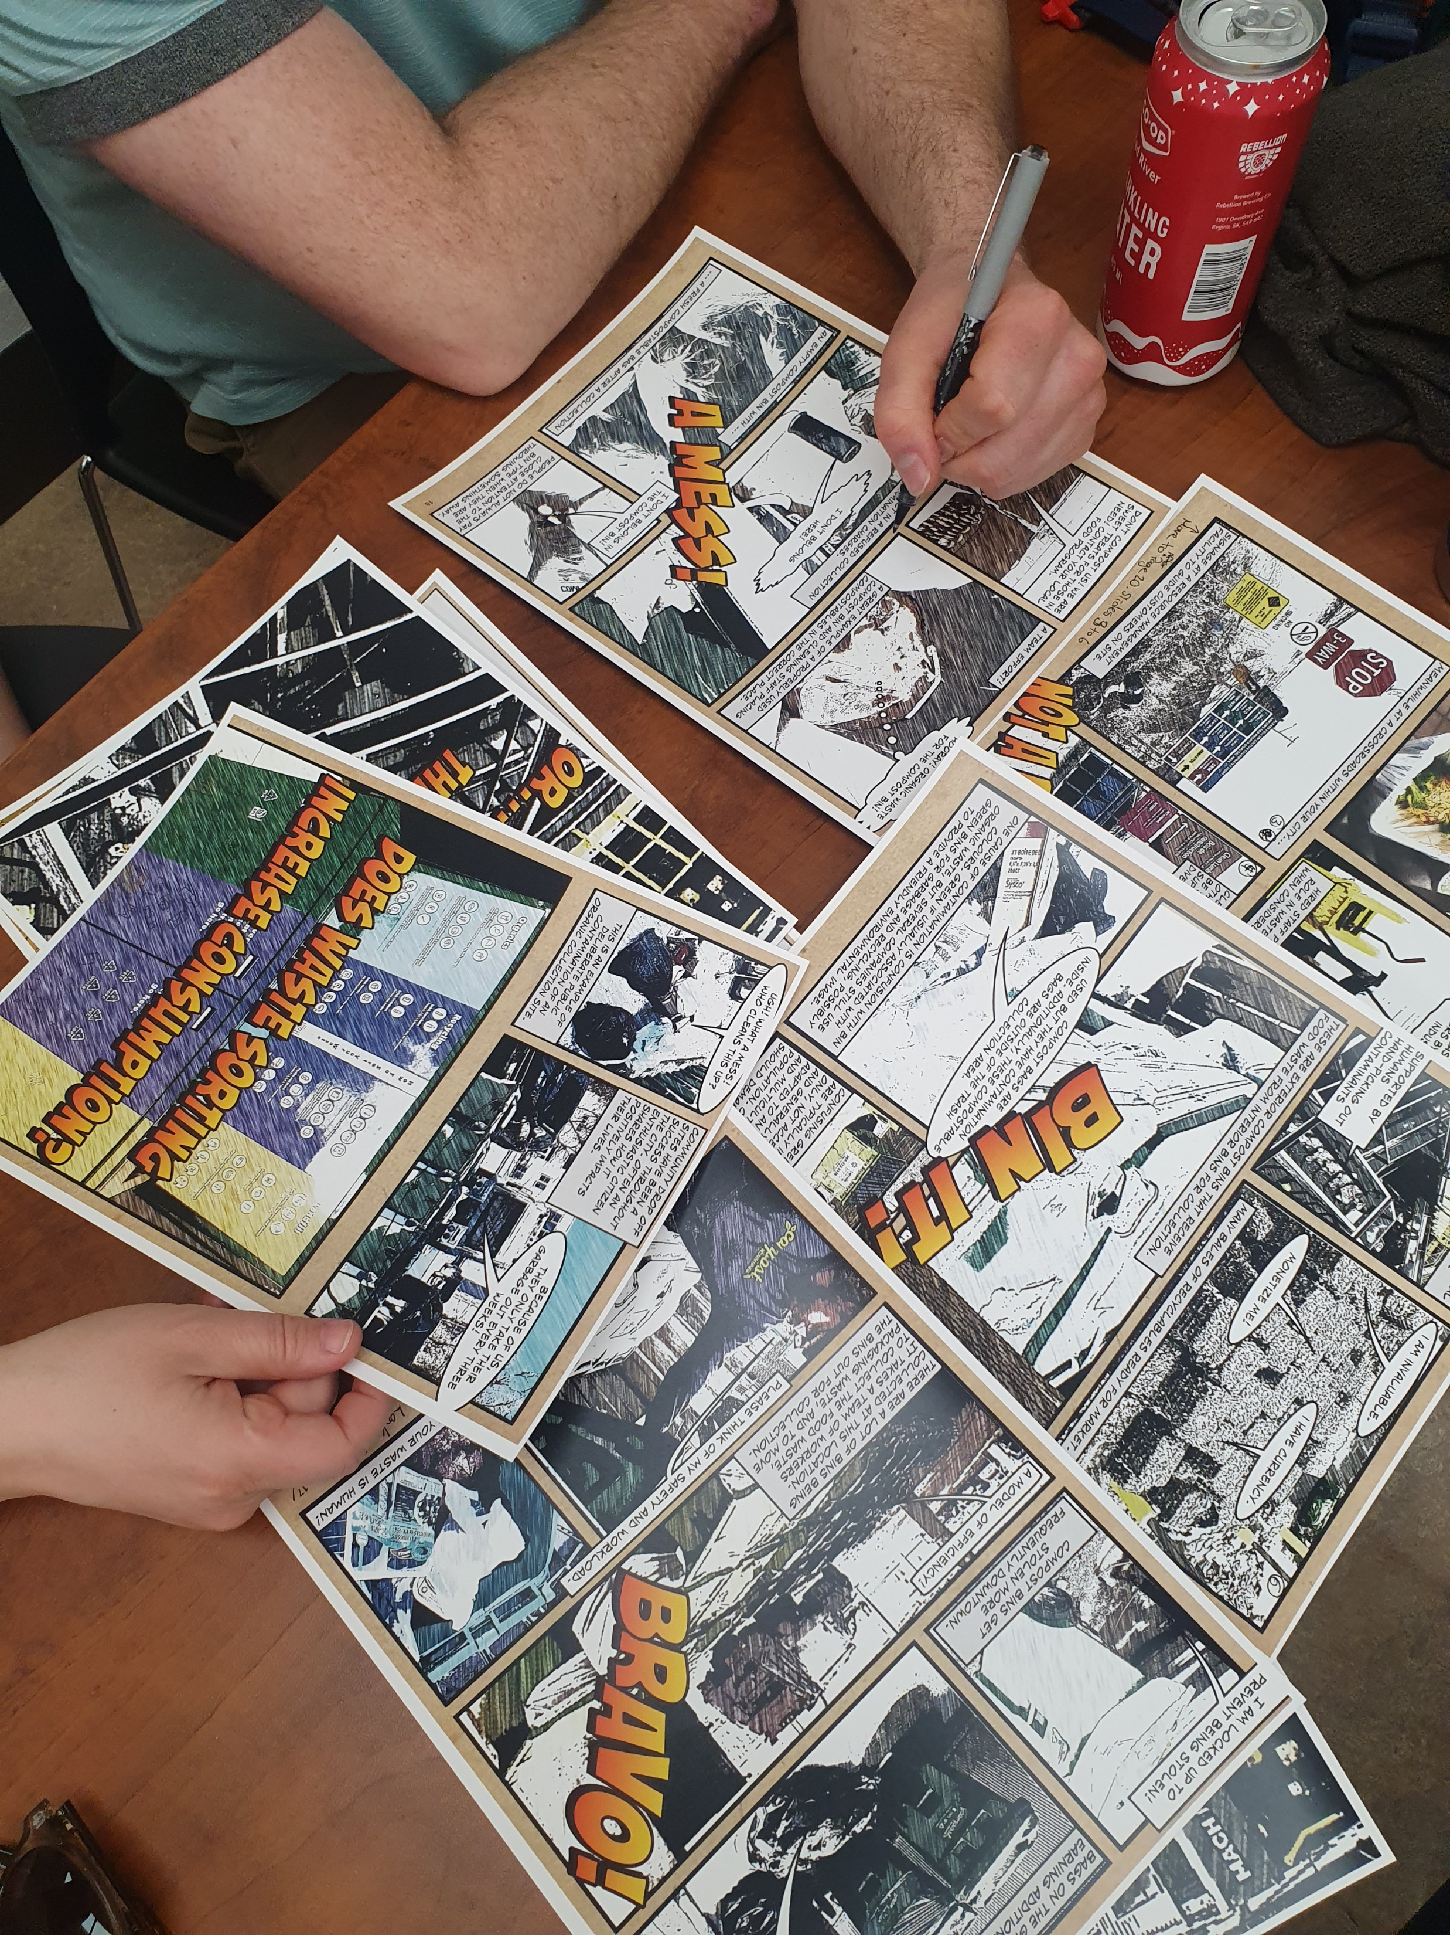
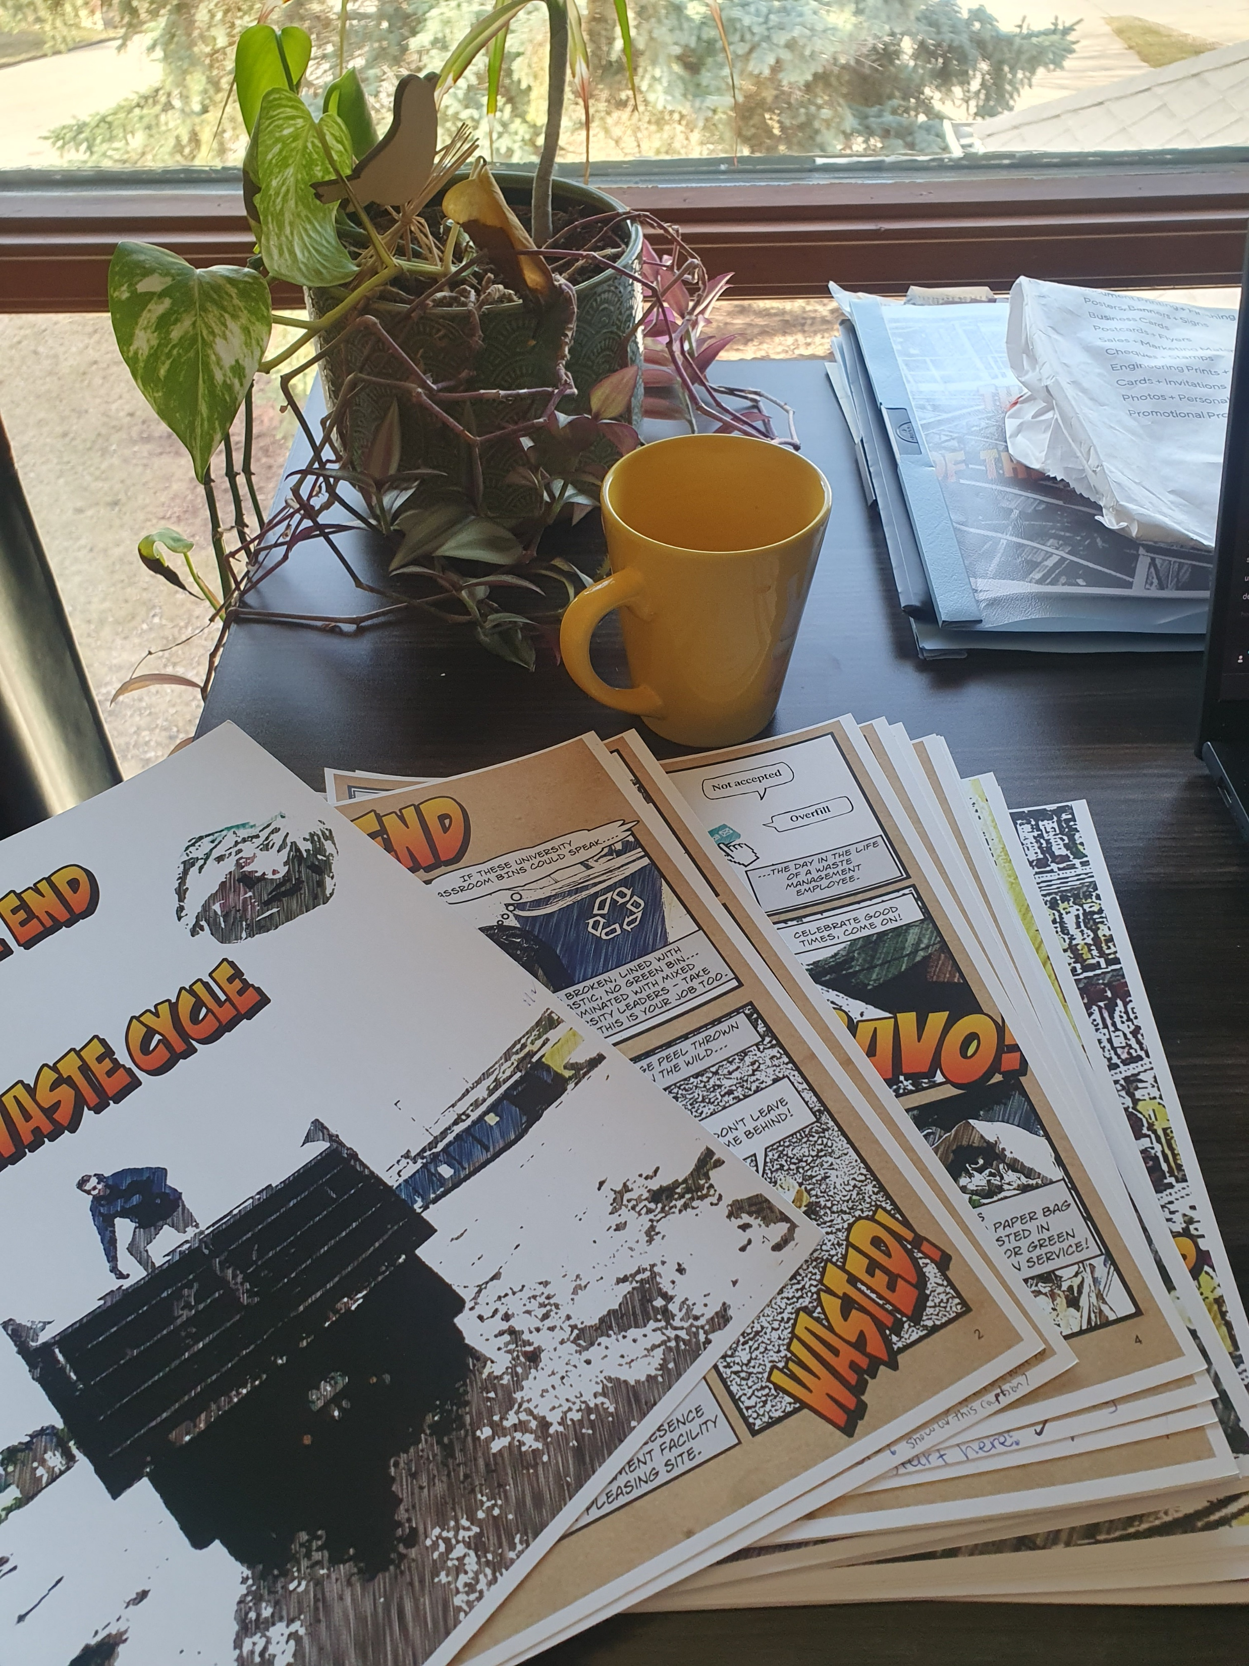
Research Methods in Action (8 steps)
1
2
3
4
Follow Guide
Take Photos
Collect Participant Fumettivoice Data
Run Focus Groups
Reimagine Fumetti
Publish Fumetti
Complete Artwork
Guide Participant Fumetti Storyboarding
8
7
6
5

Slide 7
Findings
Raw Data
Analysis Outcomes
Initial Interpretations

Slide 8

Raw Data

Slide 9
*Raw Data
Participant Captions per image
Participant Narratives per image
Reflection of SHOWeD Analysis
Participant Reflection
Focus Group Discussion
Fumetti Story per selected images & text
Fumetti Storyboard
Fumetti Review
Participant Images
PI Analytic Memos
Participant SHOWeD Analysis
Reflection of SHOWeD Analysis
5 Questions per image
3 x themed sessions of max 10 photos each
679
6
229
262
54
83
45
*679 visual and textual data items

Slide 10
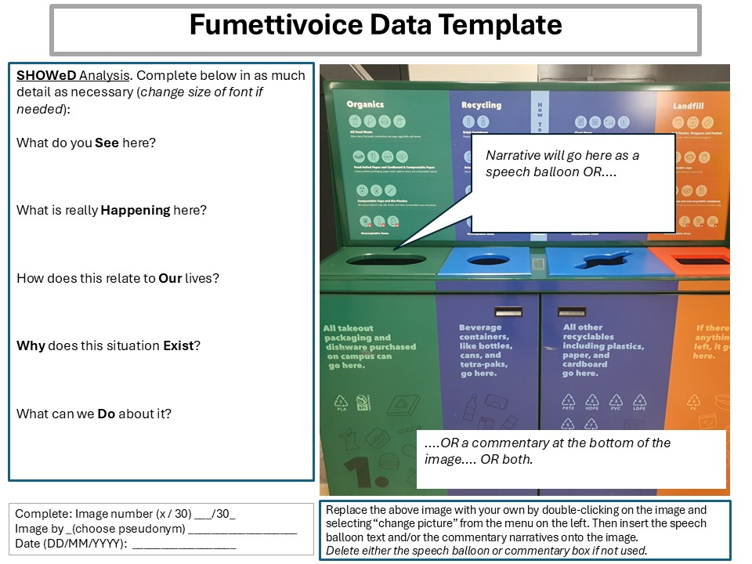
Raw Data – Fumettivoice
Data types
229 images
262 participant analysis statements
54 fumetti captions
83 fumetti narratives
45-page fumetti
229 templated slides (99 selected)

Slide 11
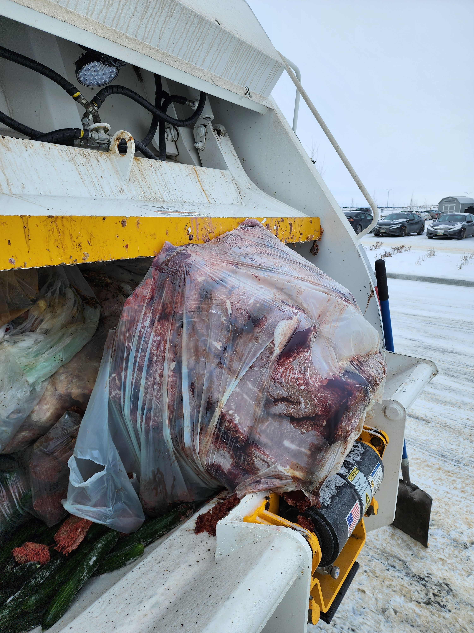
Replace the above image with your own by double-clicking on the image and selecting “change picture” from the menu on the left. Then insert the speech balloon text and/or the commentary narratives onto the image.
Delete either the speech balloon or commentary box if not used.
Fumettivoice Data Session 1 – “END of Waste Cycle”
Fumettivoice core data - Participant (PEAR) data submission
SHOWeD Analysis. Complete below in as much detail as necessary (change size of font if needed):
What do you See here?
Towards the end of a collection day. A lot of volume already in the truck, and a frozen ground meat bin that could barely fit into the truck.
What is really Happening here?
First and foremost, a strain on the compacting equipment. If the contents don’t land within the compactor falling, it gets cut in half by the compactor, which is not what it is designed for. The customer is leaving their bins out overnight and they are becoming popsicles.
How does this relate to Our lives?
Having standards for everyone to understand and abide by, especially in winter months.
Why does this situation Exist?
Cold climate and a need for the individuals responsible for composting to remember when to put the bins out at the proper time and day. Perhaps not always the ability or desire to store compost indoors.
What can we Do about it?
Not make collections until this behaviour is corrected and contacting customer to implement a a plan on their end for staff members who are responsible for wheeling out the compost bins.
Certain contents, like meat, freeze overnight. This makes it incredibly difficult to collect in the winter.
Fe
Ouch!!!
Complete: Image number (x / 30) _8__/30_
Image by _(PEAR) ___________________
Date (DD/MM/YYYY): ___30/03/2026_______________
Notes:
SHOWED Analysis(complete in as much detailas necessary):
What do you See here?
What is really Happeninghere?
How does this relate toOur lives?
Why does this situation Exist?
What can we Do about it?

Slide 12
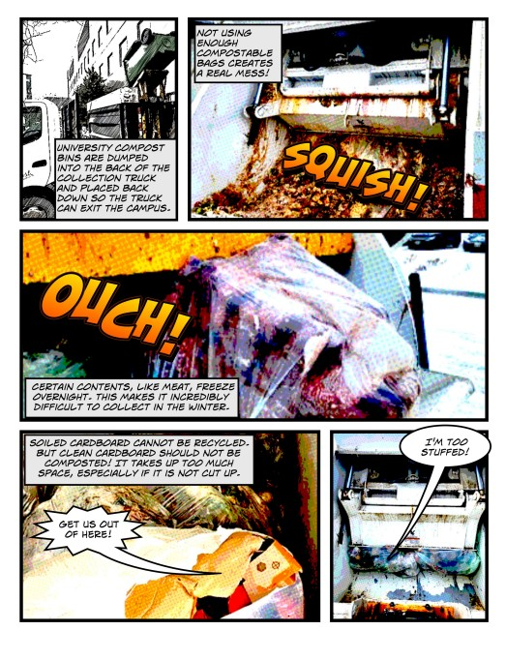
Raw Data – Participant Fumetti
Fumettivoice data is kept or discarded during focus groups by the participants.
229 considered
Once selected, it is transformed (and possibly edited) by the group to be integrated into the storyboarded fumetti.
99 chosen

Slide 13
Analysis Outcomes

Slide 14
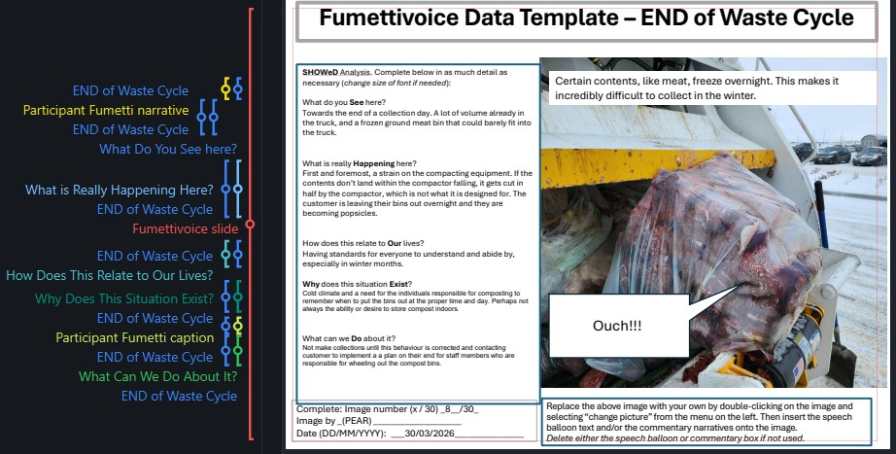
Analysis
Outcomes
Software MAXQDA
(679 items, 37 codes, 1407 coded)

Slide 15
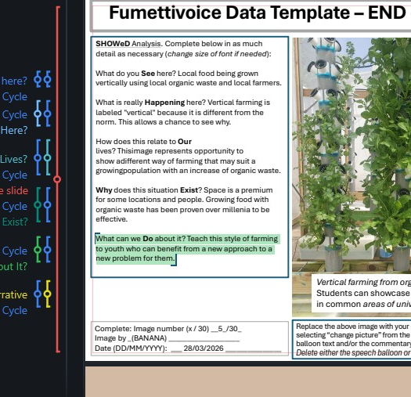
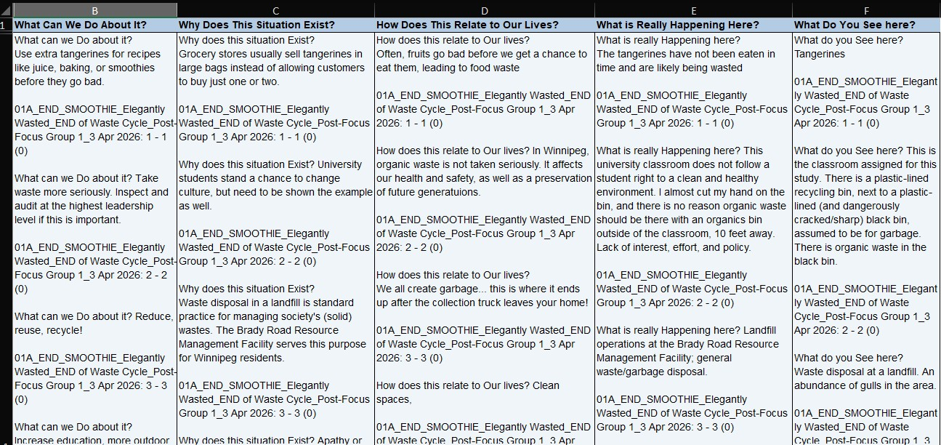
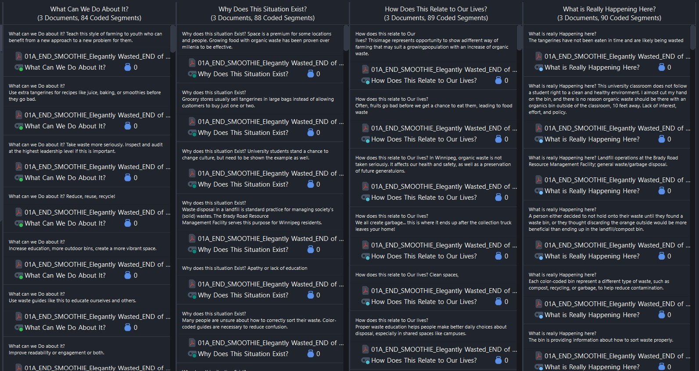
Code List – Example:
END of the Waste Cycle:
“What can we Do about it?”
(84 coded segments)
What can we Do about it?
“Teach this style of farming ​​to youth who can benefit from a new approach to a ​​new problem for them.” (Participant MANGO)

Slide 16
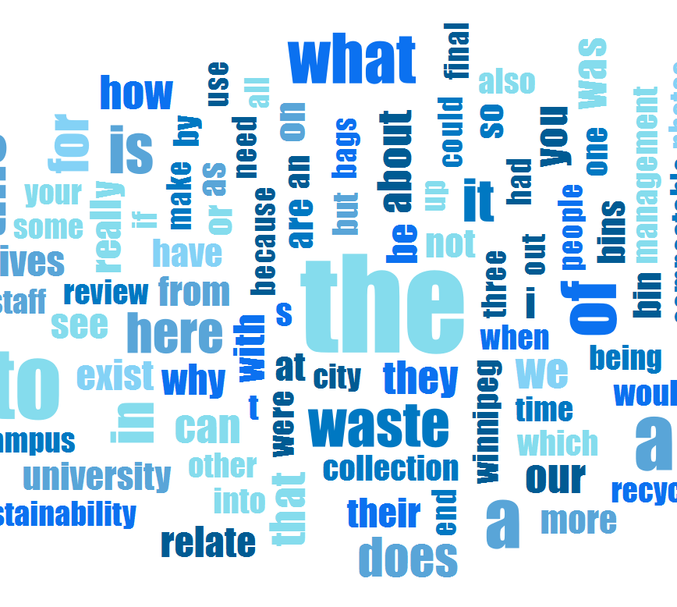
Initial Interpretations

Slide 17
Data Analysis Strategy
RQ1: “How do community members experience, understand, and document sustainability through their involvement in local waste management initiatives in Winnipeg?”
RQ1A
How do participants express and reflect their ecoliteracy and environmental perceptions in the context of sustainable waste management?
RQ1B
What discourses about the political, social, and ecological dimensions of waste management emerge, and how do these narratives illustrate processes of collective awareness and critical reflection?
RQ1C
How do participants’ experiences with waste management processes become documented and reinterpreted, and what do these experiences reveal about their understandings of collective responsibility and orientations toward environmental action?
Photos + Text
Focus Group
Fumetti
Map coded segments to sub-RQs, rolled up to the RQ. Highlight statements of interest. Add “final reflections” as a CPAR theme, & include the PI analysis of participant fumetti & analytical notes.

Slide 18
Data Analysis: Multimodal Critical Discourse Analysis (MCDA)
MCDA is an “emerging method, grounded in linguistic and visual communication scholarship, of identifying how different modes of communication - text, speech, image, sound - are used to achieve political purposes” (Machin, 2013, as cited in Joy et al., 2024, p. 1)
Memos
As an expansion of Fairclough’s CDA, MCDA’s approach to data analysis broadens the angle on what constitutes discourse (Liu et al., 2024).
Notes:
The project’s data will be analyzed using Multimodal Critical Discourse Analysis (MCDA), an expansion of Fairclough’s (2013) CDA. MCDA is an “emerging method, grounded in linguistic and visual communication scholarship, of identifying how different modes of communication—text, speech, image, sound - are used to achieve political purposes” (Machin, 2013, as cited in Joy et al., 2024, p. 1). MCDA’s approach to data analysis broadens the angle on what constitutes discourse (Liu et al., 2024). The core of the analysis remains CDA, albeit with a more inclusive outlook on data sources, such as fumettivoice, and the final fumetti story.

Slide 19
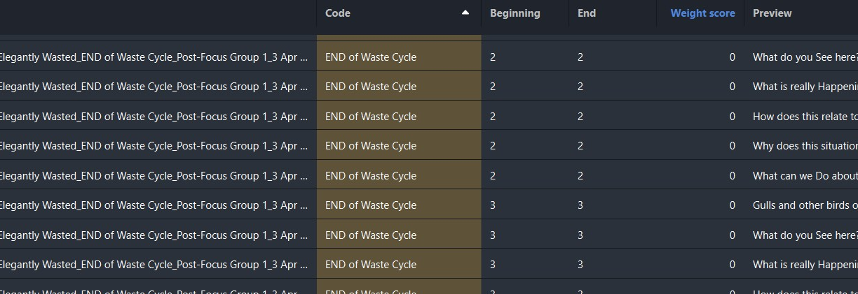
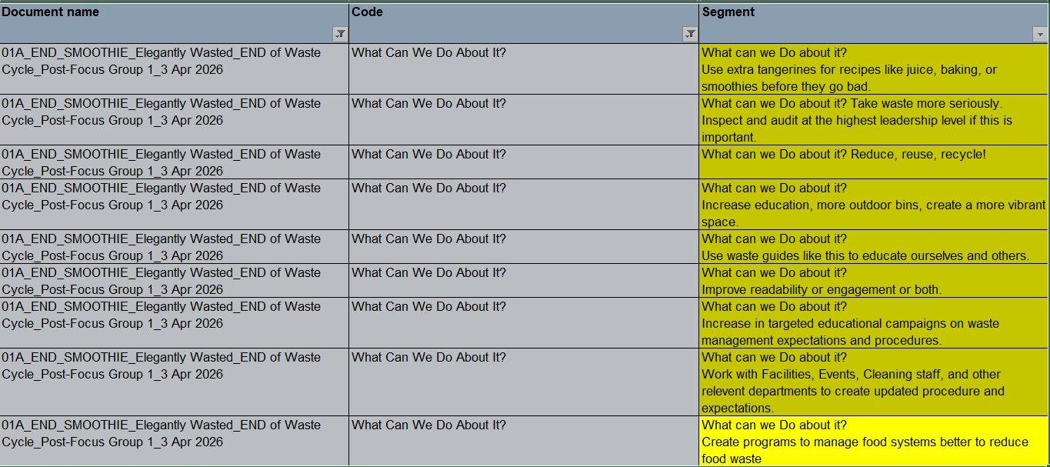
All Codes: 1407
Code 1: END of Waste Cycle: 498 codes
Code 2: What can we Do about it? 84 codes
Initial Interpretation Example (RQ1B)
Code 1 + Code 2 = 34 segments to code

Slide 20
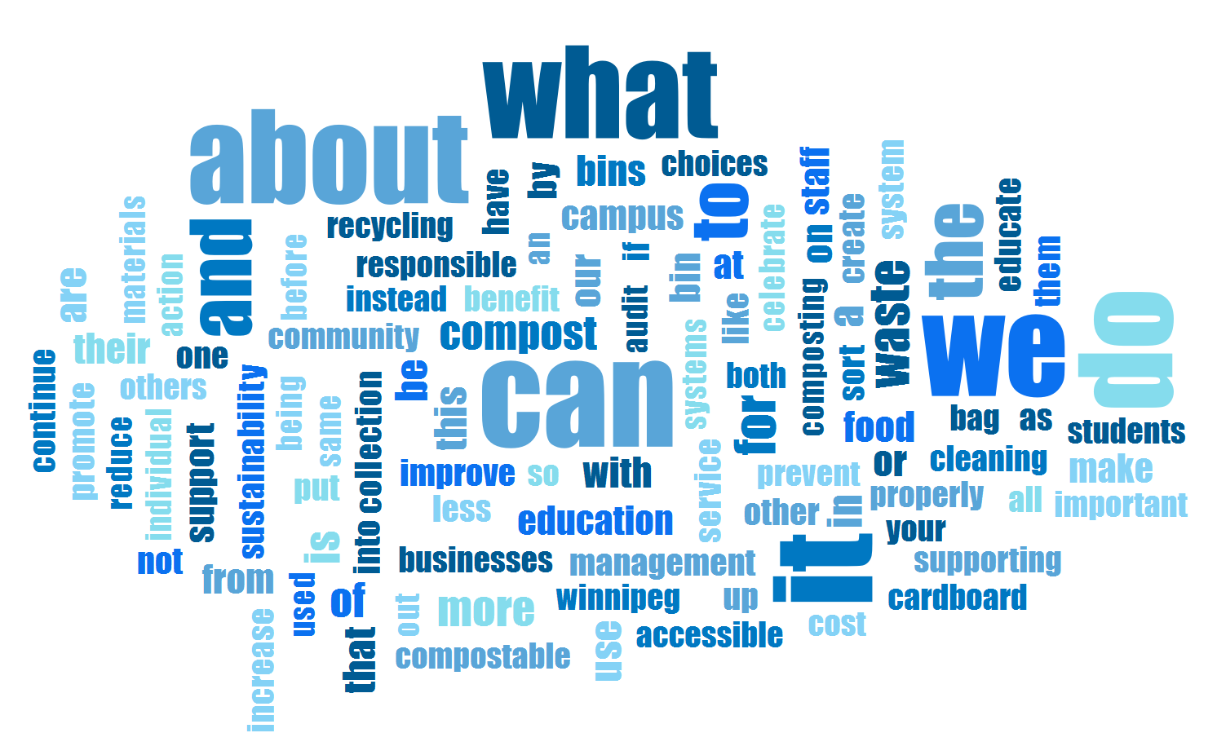
Research Question (RQ1B) versus END of the Waste Cycle:
What can we Do about it? (Word Cloud)
RQ: “How do community members experience, understand, and document sustainability through their involvement in local waste management initiatives in Winnipeg?”
1407 segments
Code 1: END of the Waste Cycle (498)
Code 2: What can we Do about it? (84)
34 segments – Word Cloud
SHOWED Words Included

Slide 21
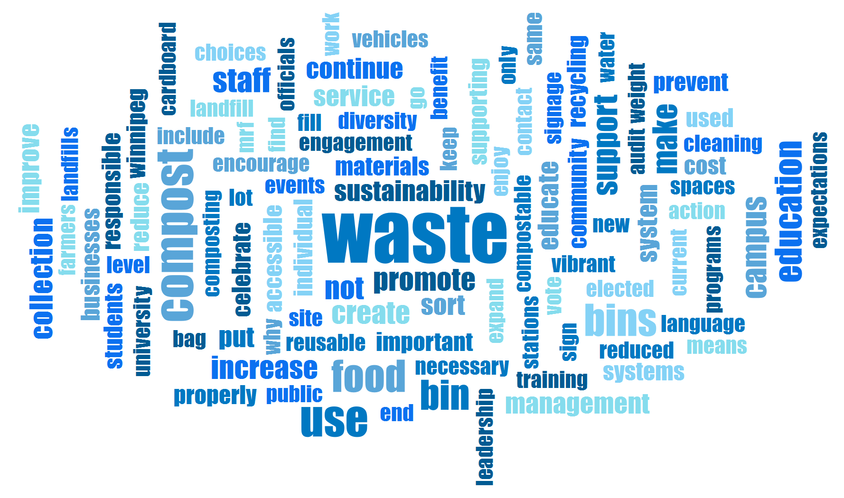
Research Question (RQ1B) versus END of the Waste Cycle:
What can we Do about it? (Word Cloud)
RQ: “How do community members experience, understand, and document sustainability through their involvement in local waste management initiatives in Winnipeg?”
1407 segments
Code 1: END of the Waste Cycle (498)
Code 2: What can we Do about it? (84)
34 segments – Word Cloud
SHOWED Words
NOT Included

Slide 22
Research Question (RQ1B) versus END of the Waste Cycle:
What can we Do about it? (PI Analysis)
RQ: “How do community members experience, understand, and document sustainability through their involvement in local waste management initiatives in Winnipeg?”
1407 segments
Code 1: END of the Waste Cycle (498)
Code 2: What can we Do about it? (84)
34 segments – Discourse Text Analysis (1)
What can we Do about it? | Key Discourse / Language | Relevant to Research Question(s)? | So WHAT?
Create programs to manage food systems ​​better to reduce food waste. | Create programs to better manage food systems ​​and reduce food waste. | RQ1B - What discourses about the political, social, and ecological dimensions of waste management emerge, and how do these narratives illustrate processes of collective awareness and critical reflection? | University waste management literacy is insufficient. Create programs to better manage food systems ​​and reduce food waste.

Slide 23
Research Question (RQ) versus END of the Waste Cycle:
What can we Do about it? (PI Analysis)
The END of the organic waste cycle means different things to the three stakeholders depending on their perspectives of what the “END” signifies. Of the 34 coded segments, the common threads (with recommendations) from the images’ supporting narratives/texts are the following:
There is no city-wide program for organic waste collection, the largest city without a program in the country.
  This is a key root of the wicked problem that cannot be resolved without intervention and analysis of human rights and the implications of not following national and United Nations policy. The message from the government(s) is that organic waste management and sustainability are not important. Is sustainable development even possible?
University waste management literacy is insufficient.
  Promote customized waste management education for all university stakeholders, including students, faculty, staff, contractors, and campus partners, to support effective and sustainable waste practices. The basic tenets of waste management remain necessary. There are a few who are experts, potentially not employed to their full potential for the organization.
Motivation versus opportunity to manage waste effectively appears mismatched.
  University waste management is not static. It requires a layered, intentional, ongoing, dynamic and active program and audit. According to university policy and the law, it is not illegal, unethical, or immoral to not operate in accordance with the principles of sustainable development or to manage waste effectively.
Effective organic waste management responsibilities extend beyond the university.
  Motivated habits at home and outside the university leverage affiliated stakeholder partners such as Compost Winnipeg and the City of Winnipeg. This is flagged as a leadership issue. Are university and stakeholder leaders aware and accountable?
Best practices for waste management separation include professionally paid waste sorting stations.
  Examples in the city by professional companies show that a standardized and trained team can almost eliminate dangerous and ineffective sorting and cross-contamination. This option has potential for the university. Waste sorting could be student positions or an expansion to current waste management roles.

Slide 24
Conclusion
Elegantly Wasted captures the paradox of being aware of environmental destruction yet failing to act, a theme central to this research on waste management.
This study advances participatory and visual qualitative methods, generating educational and policy-relevant insights for campus sustainability intervention, while empowering community voices in environmental action.
Image licensed by Shutterstock to Joseph Harding, 2022
Notes:
Winnipeg can consider the metaphor of being elegantly wasted. ‘Elegantly wasted' captures the paradox of being aware of environmental destruction yet failing to act, a theme central to this research on waste management. The city has sufficient knowledge and talent to enhance sustainability while challenging dominant, unsustainable environmental agenda patterns, such as blindly following the Sustainable Development Goals. This study aims to answer the following research question: “How do community members experience, understand, and document sustainability through their involvement in local waste management initiatives in Winnipeg?” *The answer rests somewhere in the messy portion as participants explore and document this wicked problem.
This study can advance participatory and visual qualitative methods, generating educational and policy-relevant insights for campus sustainability, while empowering community voices in environmental action.

Slide 25
Extra Slides

Slide 26
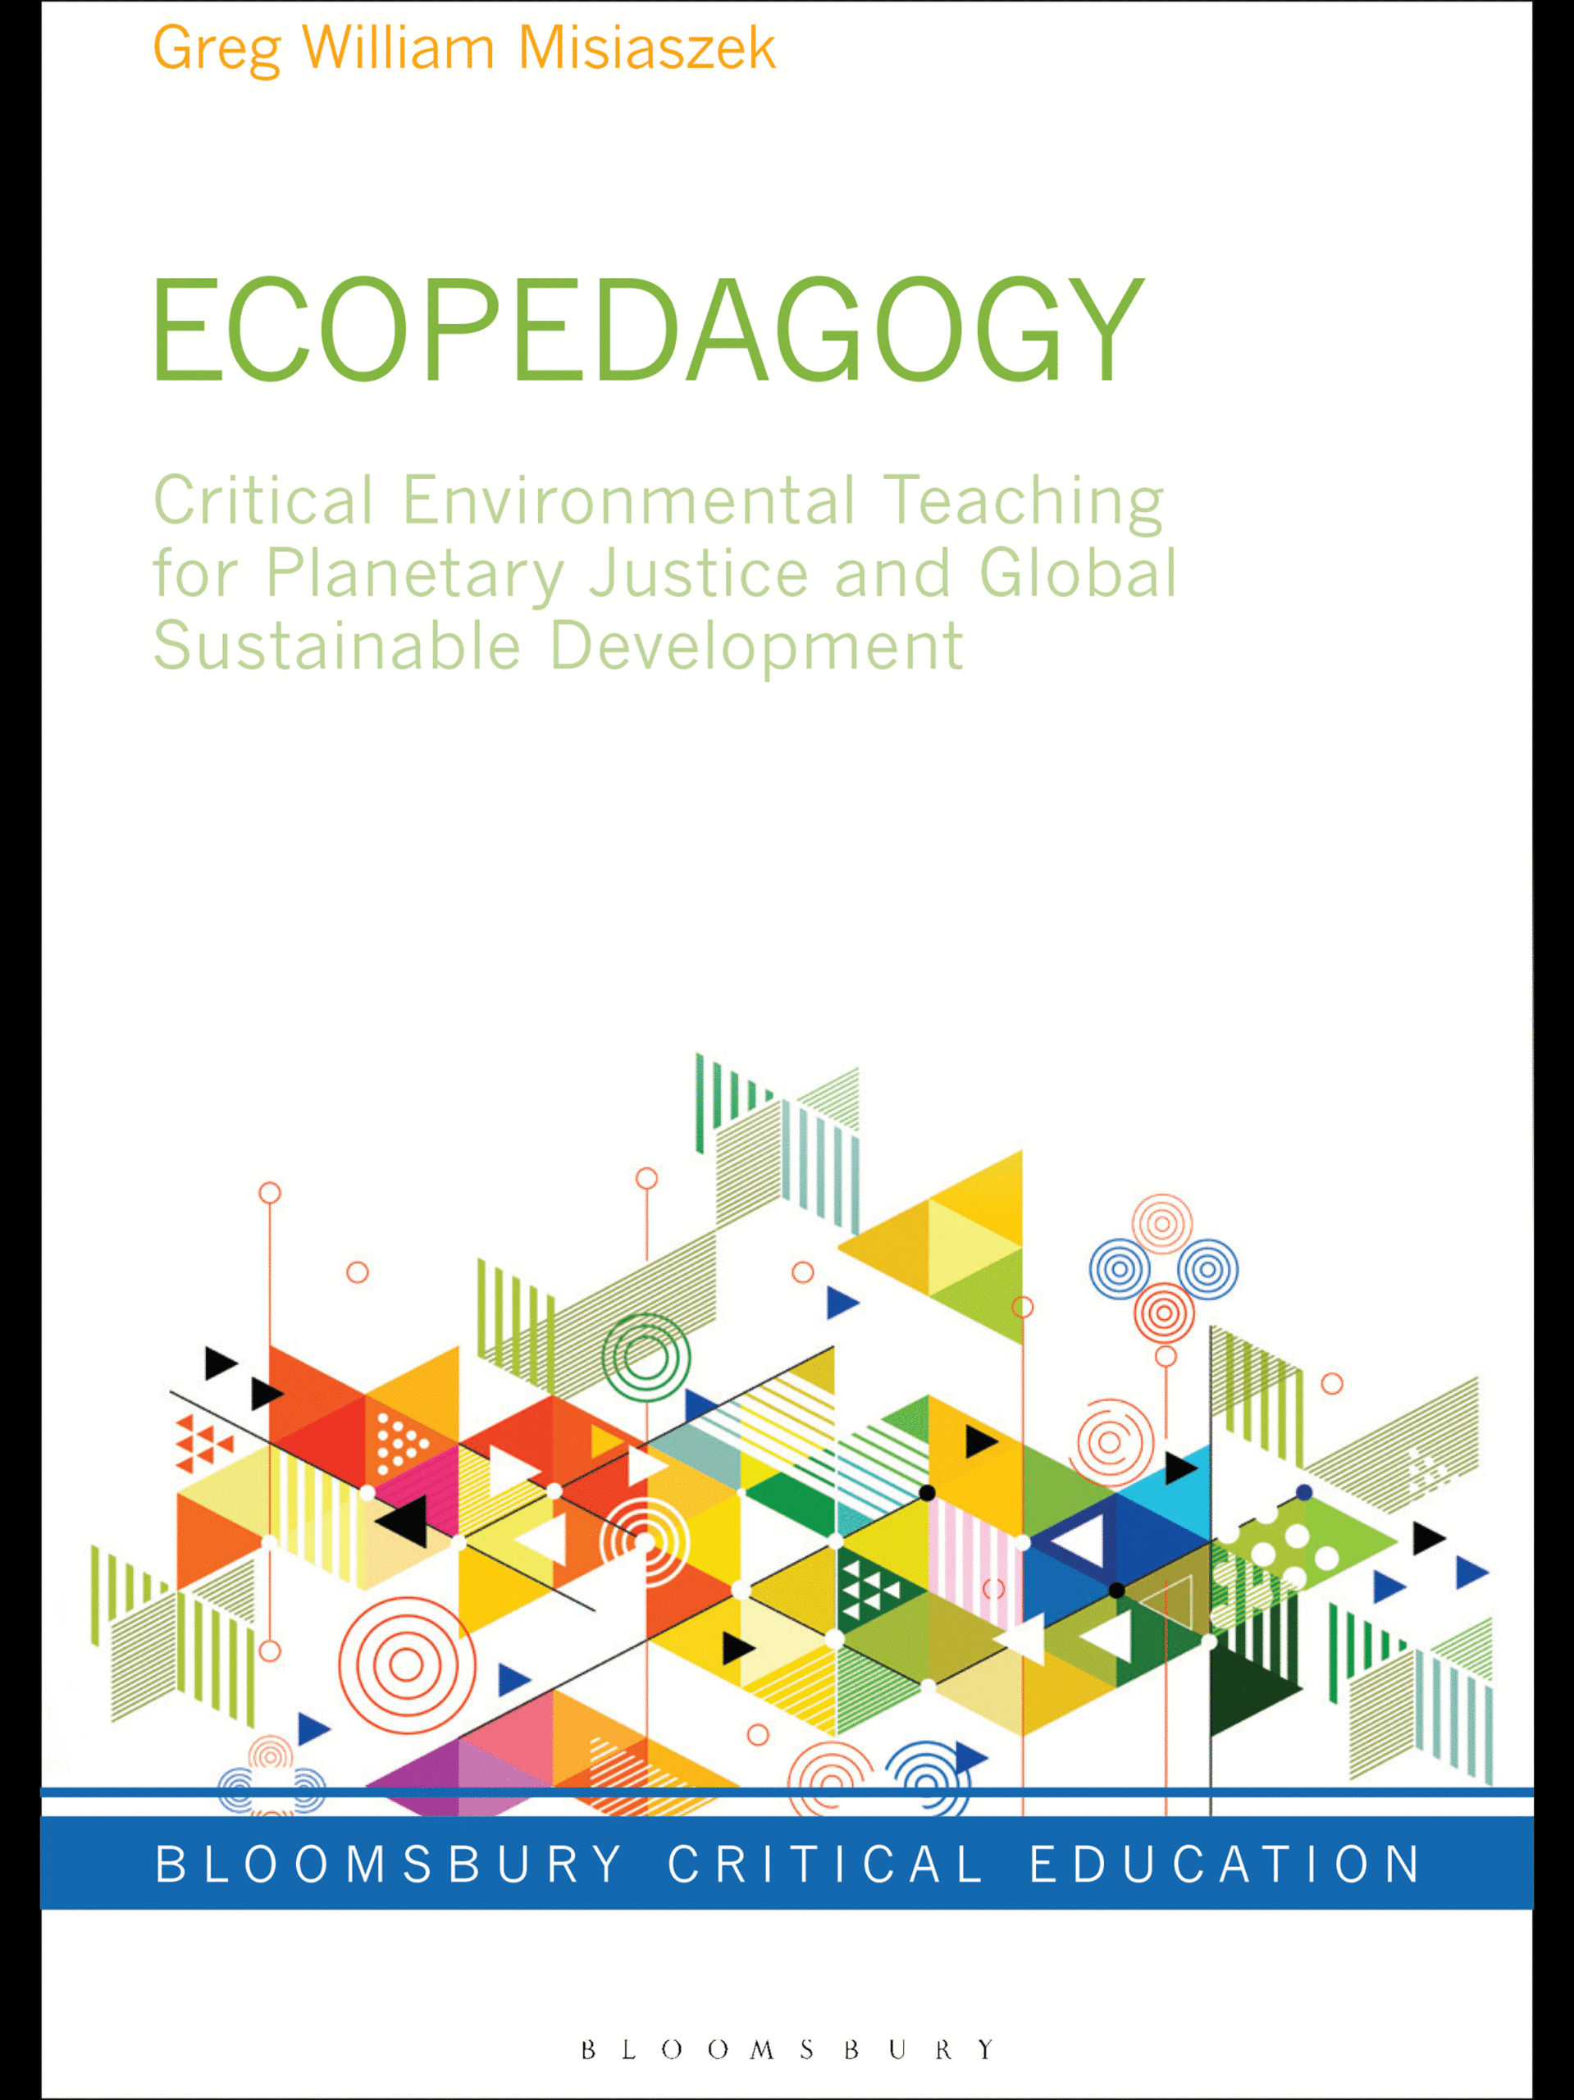
Theoretical Framework: Ecopedagogy
My research is guided by the theoretical framework of ecopedagogy, which acknowledges that a critical approach to enhancing ecoliteracy skills is necessary to address the irreversible effects of human interference with today’s ecosystems, commonly referred to by de Pencier et al. (2023) as the Anthropocene Era.
As one of the early collaborators of the concepts of ecopedagogy in the late 1990s in Brazil, alongside Paulo Freire and Francisco Gutierrez, Moacir Gadotti (2011) suggests
“(a) viewing human beings and nature holistically and
(b) maintaining a balance between them so that sustainability can be attained.
These are considered the fundamental beliefs of ecopedagogy” (p. 21).
Notes:
My research is guided by the theoretical framework of ecopedagogy, which acknowledges that a critical approach to enhancing ecoliteracy skills is necessary to address the irreversible effects of human interference with today’s ecosystems, commonly referred to by de Pencier et al. (2023) as the Anthropocene Era.
I adopt a critical qualitative research paradigm deeply influenced by ecopedagogy as the philosophical and theoretical foundation. Ecopedagogy extends critical pedagogy into environmental education by promoting ecological literacy, social justice for all ecosystems, and critically examining power structures such as neoliberalism that perpetuate environmental injustice.
Ecopedagogy is an appropriate theoretical framework for this study according to the literature; however, it is not all-encompassing and continues to evolve. Initially considered a pedagogy for sustainable development, or an Earth pedagogy, ecopedagogy emphasizes the need to address imbalances between humans and nature critically (Antunes & Gadotti, 2005).
As one of the early collaborators of the concepts of ecopedagogy in the late 1990s in Brazil, alongside Paulo Freire and Francisco Gutierrez, Moacir Gadotti (2011) suggests “(a) viewing human beings and nature holistically and
(b) maintaining a balance between them so that sustainability can be attained. These are considered the fundamental beliefs of ecopedagogy” (p. 21).
According to Misiaszek (2020) and Kahn (2010), ecopedagogy can serve as a philosophical and practical lens to frame the ecological and environmental
injustices inherent in contemporary issues, such as the complex problem of sustainable waste management addressed in this study.
Critics of ecopedagogy argue that it is rigid, utopian, and not realistic (Jandrić & Ford, 2022; The Schumacher Institute, 2024).
In the foreword to Postdigital ecopedagogies: Genealogies, contradictions,
and possible futures, McLaren (in Jandrić & Ford, 2022) provides a caution: “Today’s ecological consciousness demands that we move away from ecopedagogical models that posit a compromise with neoliberal capitalism, or that do not recognize that socialism can sometimes be more productivist than
even the most despotic tendrils of capitalism” (p. xi).
Ecopedagogy builds on the fundamentals of critical pedagogy to foster ecoliteracy and encourage the appropriate action to address ecological justice (Hossain, 2024). Critical pedagogy is a robust framework for emancipatory learning, action-oriented to help liberate individuals from social oppression.
Misiaszek (2022) considers ecopedagogy “literacy education for reading and rereading human acts of environmental violence” (p. 2298) as a development of critical pedagogy. Ecopedagogy calls for human reflection and action on their influences on the ecosystem toward justice for the ecological environment (nature), social (human), and non-human elements. This uniqueness transforms a “systemic change in which relationships and structures are fundamentally altered, often contrasted with smaller-scale changes such as varying or refining existing relations” (Cornish et al., 2023, p. 12).

Slide 27
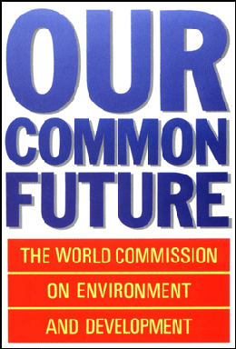
Literature Review:
Key Components
Theoretical Framework: Ecopedagogy
Sustainable Development and Neoliberalism
Wicked Problem Dimensions

Slide 28
Gaps in the Literature
Gap 1: Limited Integration of Ecopedagogy with Sustainable Development
Gap 2: Need for Critical Challenge to Neoliberal Educational Methods in Sustainability
Gap 3: Insufficient Research Linking Local Waste Management Practices to Global Frameworks
Notes:
Gap 1: Limited Integration of Ecopedagogy with Sustainable Development. Ecopedagogy has been reported as a credible and critical challenge to sustainable development, albeit with some limitations as previously noted. Both frameworks have extensive literature on their individual merits; however, a gap exists in integrating alternative models into the UN environmental agenda. There appears to be a reluctance to pursue alternative models to sustainable development, given its popularity and dominance in Western environmental agendas (Hickel, 2021; Kopnina, 2020).
Gap 2: Need for Critical Challenge to Neoliberal Educational Methods in Sustainability. Historical consumerism and exponential growth, under the guise of development, perpetuate free market paradigms that continue to challenge nations and the UN in their management. Waste is one indicator that the dominant environmental agenda of sustainable development, as outlined in the SDGs, is failing, as companies are not held reasonably accountable (Arora-Jonsson, 2023).
Gap 3: Insufficient Research Linking Local Waste Management Practices to Global Frameworks. Local communities require a deeper understanding of ecoliteracy to navigate the influences of hegemony and neoliberalism, particularly in waste management, where these forces have a direct impact as communities grow rapidly (Chen et al., 2024; Kopnina et al., 2024; Kowasch, 2024). The literature promotes alternative models to sustainable development, yet there appears to be a reluctance to adopt higher levels of ecoliteracy through alternative means.

Slide 29

Research Methods
Method 1: Fumettivoice
Method 2: Focus Groups

Slide 30
Research Participants (n = 8)
Co-researchers:
UWinnipeg Campus Sustainability Office (4)
(a) Leadership (2)
(b) Ambassador Students (2)
Co-researchers:
Compost Winnipeg (2)
(a) Staff (1)
(b) Driver (1)
Co-researchers:
City of Winnipeg:
Compost Project Manager (1)
Principal Investigator (1)
Insider within the waste management community
18 years +. All are welcome from the three stakeholder groups.
Maximum 30 hours over 10 weeks. No $$ compensation.
Notes:
All participants will continue to be paid via approval from their stakeholder oprganizations, with a $50 research compensation for expenses, paid at the beginning of the study.

Slide 31

SHOWeD Method of Image Analysis
What do you See here?
What is really Happening here?
How does this relate to Our lives?
Why does this situation exist?
What can we Do about it?
The SHOWeD method is a structured approach that facilitates discussion and critical analysis of photographs, supporting participants in reflecting on and interpreting images within participatory research settings.
Authored by Wang and Burris (1997) as part of their photovoice research method
Notes:
The SHOWeD method of image analysis was authored by Caroline Wang and Mary Ann Burris. They introduced this technique as part of their development of the photovoice methodology in the 1990s. The SHOWeD method is a structured approach that facilitates discussion and critical analysis of photographs, supporting participants in reflecting on and interpreting images within participatory research settings.

